Slide 1
UNGASS against Corruption
Debrief for Civil Society
6 July 2021
Mathias Huter Yonatan Yakir
Managing Director Programme manager
mathias.huter@uncaccoalition.org yonatan.yakir@uncaccoalition.org

Slide 2
About the UNCAC Coalition
A global network of over 120 CSOs and individual members and an additional 250+ groups in its wider network in more than 100 countries
Committed to advancing the ratification, implementation and monitoring of the UN Convention against Corruption (UNCAC) to combat corruption
Founded in 2006 as an informal network
Coalition opened its permanent office in Vienna in 2019, now 5 team members
uncaccoalition.org
info@uncaccoalition.org

Slide 3
About the UNCAC Coalition
Ensure that the voice of civil society is heard in UNCAC fora
Advocacy for policy priorities and civic space
Facilitation of joint advocacy, networking and coordination among civil society groups
Support to civil society groups engaging in the UNCAC review process
Support and funding for parallel reports
Transparency Pledge signed by 27 governments
Regular engagement with delegations in Vienna
Briefing sessions, sharing of good practices and civil society asks
uncaccoalition.org
info@uncaccoalition.org

Slide 4
UN General Assembly Special Session against Corruption
UNGASS: took place June 2-4 in New York
UNCAC Coalition submission https://ungass2021.unodc.org/uploads/ungass2021/documents/session1/contributions/UNCAC_Coalition_2nd_UNGASS_submission_March_2021.pdf
The UNGASS adopted a Political Declaration: https://undocs.org/en/A/S-32/L.1
– Full of caveats
– No proper follow-up mechanism
uncaccoalition.org
info@uncaccoalition.org

Slide 5
UNGASS – our key takeaways
Yes to Stronger UNCAC implementation
No to new normative frameworks, new mechanisms or new institutions
No asset recovery protocol
No deliberations on an IACC
No Working Group to discuss gaps in anti-corruption global architecture
uncaccoalition.org
info@uncaccoalition.org

Slide 6
UNGASS – our key takeaways
There was support for some fine-tuning of commitments on criminalization, prevention, asset recovery, international cooperation
There is a reluctance to agree to major new commitments
No momentum for effective follow-up to ensure effective implementation of current commitments
uncaccoalition.org
info@uncaccoalition.org

Slide 7
Political Declaration: Public procurement transparency
“10. We commit to increasing transparency and accountability in the management of public finances and in government procurement, funding and contracting services to ensure transparency in government actions in the use of public funds and during the whole public procurement cycle. We commit to strengthening data-collection systems and open databases that are accessible and user-friendly, in accordance with domestic laws, and to better understanding and better enabling oversight and accountability, including by supreme audit institutions and oversight bodies. (...)”
uncaccoalition.org
info@uncaccoalition.org

Slide 8
Beneficial Ownership Transparency
“16. We commit to making efforts in international cooperation and taking appropriate measures to enhance beneficial ownership transparency by ensuring that adequate, accurate, reliable and timely beneficial ownership information is available and accessible to competent authorities and by promoting beneficial ownership disclosures and transparency, such as through appropriate registries, where consistent with the fundamental principles of domestic legal systems and using as a guideline the relevant initiatives of regional, interregional and multilateral organizations against money-laundering.”
uncaccoalition.org
info@uncaccoalition.org

Slide 9
Access to Information
“22. We will respect, promote and protect the freedom to seek, receive, disseminate and publish information concerning corruption, and ensure that the public has effective access to information, in accordance with the domestic laws of States. We commit to increasing the transparency of decision-making processes, in accordance with the fundamental principles of domestic law, as a means to prevent and combat corruption and facilitate efficient processes, including by adopting appropriate and necessary procedures or regulations and designating and enhancing bodies responsible for facilitating access to information, as well as through the use of digital tools, open data and Internet-based portals to help make information more accessible, with due regard for data protection and privacy rights. ”
uncaccoalition.org
info@uncaccoalition.org

Slide 10
Whistleblowing
“30. We will provide a safe and enabling environment to those who expose, report and fight corruption and, as appropriate, for their relatives and other persons close to them, and will support and protect against any unjustified treatment any person who identifies, detects or reports, in good faith and on reasonable grounds, corruption and related offences.
To this end, we will, inter alia, enable confidential complaint systems, protected reporting systems and programmes for the protection of reporting persons, and increase awareness of such measures, in accordance with domestic legal systems and within our means. (...)”
uncaccoalition.org
info@uncaccoalition.org

Slide 11
Role of Civil Society
“We note with appreciation the important role of civil society, academia, the private sector and the media in identifying, detecting and reporting on cases of corruption, and we will take appropriate measures, within our means and in accordance with the fundamental principles of domestic law, to promote the active participation of individuals and groups outside the public sector, such as civil society, non-governmental organizations, community-based organizations and the private sector, in the prevention of and the fight against corruption and to raise public awareness regarding the existence, causes and gravity of and the threat posed by corruption. ”
uncaccoalition.org
info@uncaccoalition.org

Slide 12
Political financing; free & fair elections
Member States are responsible for ensuring transparent, free and fair elections (...)
Ambition to ensure responsive, inclusive, participatory and representative decision-making at the national level.
We will maintain, strengthen, develop and implement measures that protect the integrity of the electoral process and promote its accountability to voters, transparency and impartiality in domestic electoral institutions and oversight mechanisms, and transparency in the funding of candidatures for elected public office, political parties and electoral campaigns (...)
uncaccoalition.org
info@uncaccoalition.org

Slide 13
Asset Recovery
Strive to ensure transparent and accountable return of assets (OP 48)
...allocating such proceeds to the national revenue fund or the State treasury, reinvesting funds for special purposes and compensating victims of the crime, including through the social reuse of assets for the benefit of communities (OP 49)
Strengthen efforts to confiscate and return assets when employing non-trial resolutions, including settlements (OP 50)
uncaccoalition.org
info@uncaccoalition.org

Slide 14
Interesting commitments
Expand the global knowledge and data collection on AR
UNODC to hold corruption prevention campaigns, including education and research, incl. addressing young people
Promote the use of technological innovations against corruption and facilitate digital government
Creation of Global Operational Network of Anti-Corruption Law Enforcement Authorities under the auspices of the UNODC

Slide 15
Interesting commitments
Improve understanding the linkages between gender and corruption; continue to promote gender equality and women's empowerment, including by mainstreaming in relevant legislation, policy development, research and projects
COVID-19: commit to redoubling efforts to prevent and combat corruption and to ensuring that corruption safeguards and responses are integral elements of our recovery efforts as we respond to COVID
Criminalize bribery in all its forms by 2030.
UNODC to support States in measurement of corruption

Slide 16
The UNGASS- What’s next?
P84: “We encourage the CoSP to conduct the necessary surveys on particular gaps, challenges, lessons learned and best practices on prevention, criminalization, law enforcement, international cooperation and asset recovery and return, to be undertaken by the United Nations Office on Drugs and Crime”

Slide 17
The UNGASS - What’s next?
“We invite the CoSP to identify gaps and challenges in UNCAC implementation…by taking into account…any gaps and corruption challenges within the international anti-corruption framework, and to consider recommendations by States parties to address the gaps and challenges identified…as a first step, we invite the Conference, in the future, after the conclusion of the second review cycle, to organize a special session of the CoSP on all aspects of the asset recovery and return process, with a view to considering all options available under the Convention, including exploring possible areas for improvements to our international asset recovery framework.”
“will consider holding a General Assembly follow-up special session on corruption”

Slide 18
High level national statements
(the General Debate)
117 countries delivered statements
Analysis of the statements- who mentioned what?
Order of speakers
Recording of statements on our YouTube channel
uncaccoalition.org
info@uncaccoalition.org

Slide 19
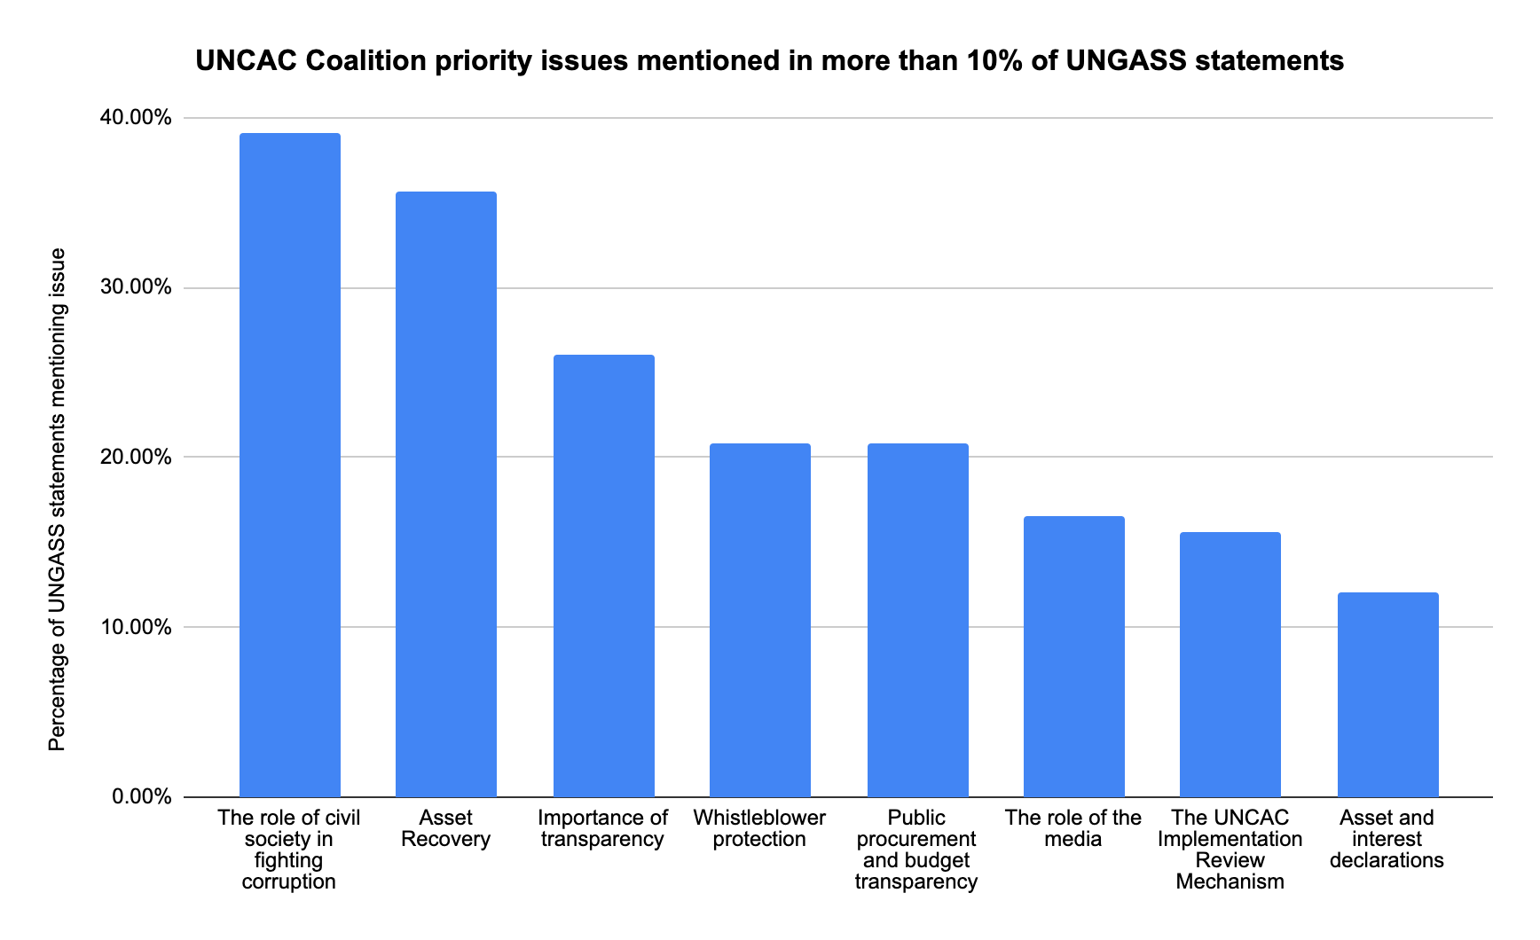
High level national statements
(the General Debate)
uncaccoalition.org
info@uncaccoalition.org

Slide 20
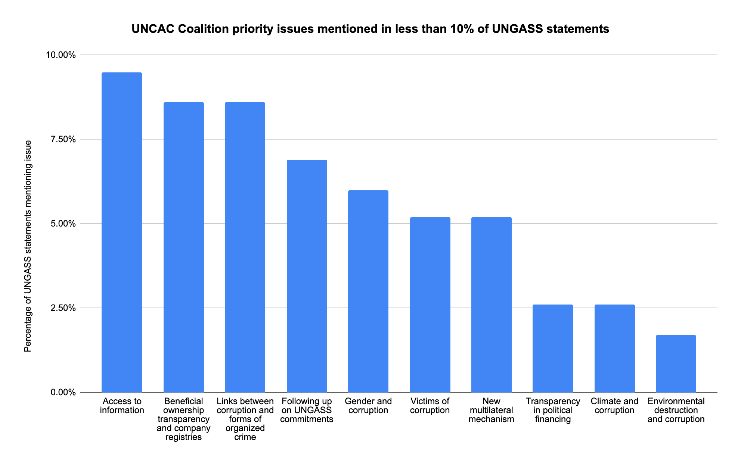
High level national statements
(the General Debate)
uncaccoalition.org
info@uncaccoalition.org

Slide 21
High level national statements: findings
Few new commitments to tackle corruption
Strong G7 statement – transparency, role of civil society, UNCAC review
Few expressed need for new multilateral frameworks
Few mentions of commitment to follow-up on the UNGASS
The role of civil society: true commitment? lip service?
uncaccoalition.org
info@uncaccoalition.org

Slide 22
UNGASS- follow up
‘Fact check’ statements!
TI Sri Lanka, TI NZ
UNGASS side events (including new initiatives)
Basis for advocacy: UNGASS commitments + national statements
“Commit to fully and effectively follow-up on the conclusions and observations from the UNCAC implementation review process”
uncaccoalition.org
info@uncaccoalition.org

Slide 23
UNGASS Follow up
Run up to the UNCAC CoSP
The UNGASS is the latest international consensus
Preparation of resolutions for the UNCAC Conference of States Parties, 12-17 December, Sharm El Sheik
! Application period will be in late July-August !
The NGO briefing on margins of UNCAC IRG: 7 September
UNODC mandates & actions?
States Parties actions?
uncaccoalition.org
info@uncaccoalition.org

Slide 24
Questions? Thoughts? Ideas?
Mathias Huter Yonatan Yakir
Managing Director Programme manager
mathias.huter@uncaccoalition.org yonatan.yakir@uncaccoalition.org
Sign up to our newsletter: https://uncaccoalition.org/newsletter/
uncaccoalition.org
info@uncaccoalition.org

