Slide 1
UNODC SMALL GRANTS SCHEME
5th round –Summer 2018

Slide 2
UNODC Small Grants Scheme
Small Grants aim at assisting Civil Society Organizations in their engagement with the private sector in anti-corruption
Raise awareness among businesses about the UNCAC and its application at the local level

Slide 3
Criterias for CSO selection
CSOs based in Africa
Experience in monitoring activities, conducting legal analysis, drafting reports, and working with the private sector
Advocacy experience in sectorial industries (e.g. extractive industries, construction industry, financial sector, etc.)
Organization’s potential to make useful contributions to the review process and country/regional follow-up activities

Slide 4
Why partner with the private sector ?
Private sector accounts for about 60% of the GDP globally
About 10% of private sector companies are MNCs and their sales are worth US $31 trillion – 90% are SMEs
Private sector is increasingly providing services that were previously provided by the State
Actors of private sector are not only victims of corruption but part of the solution

Slide 5
Why CSOs should encourage SMEs to work on UNCAC?
Existence of a number of global initiatives and compliance programmes that partner with MNCs (e.g. UN Global Compact, EITI, GSCP)
A need to engage with SMEs at local level as they represent 90% of gobal economy and are more difficult to reach
CSOs are part of the local community and potential clients of SMEs
CSOs can play an important role in engaging SMEs on the implementation and monitoring of UNCAC

Slide 6
Grant Scheme Achievements
Empower CSOs to engage SMEs in the implementation of UNCAC
Involved marginalized groups such as women, disabled and indigenous people
Created local mechanisms such as action plans and business networks to combat corruption

Slide 7
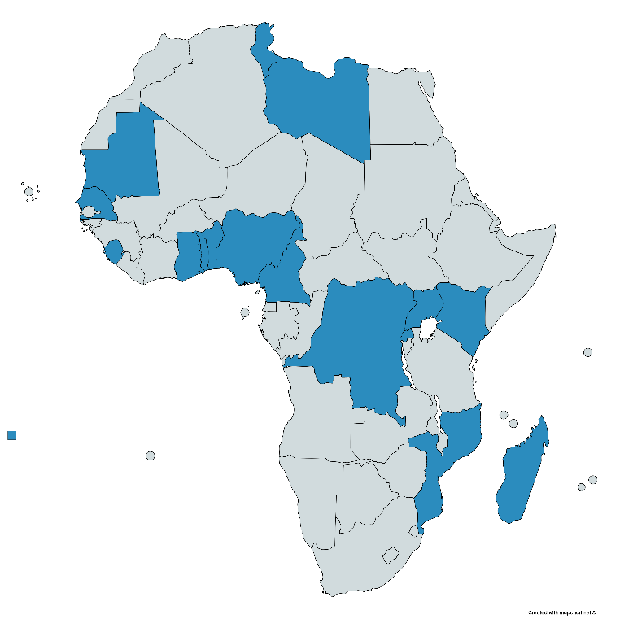
Small Grant Recipients
26 CSOs from 16 countries supported in the first 4 rounds since 2012
In the last round (15 July – 15 November 2015) 9 CSOs from 8 countries have been selected: Benin - Cameroon – Kenya – Madagascar Rwanda – Senegal – Togo – Uganda

Slide 8
Success Story:
Christian Partners Development Agency (CPDA) – Kenya
Objective: Enhance social accountability and empower small and medium sized enterprises to combat corruption through intensive workshops and self-help groups at grassroots level.
Outcome: Practical instrument in the form of the proposed Vihiga County Anti-Corruption Policy, to be led by CPDA, as an instrument to check and combat corruption in Vihiga and therefore offer a best practice to other countries in the region.

Slide 9
Success Story: Transparency International-Madagascar (TI-IM)
Objective: engage the private sector in the implementation of the UNCAC.
organize sensitization workshop for 500 SMEs
create a platform for dialogue between SMEs and public decision-makers
produce an internet website with a monthly newsletter,
organize public events and specific training for SMEs willing to learn about the tools to fight corruption, including a code of conduct.
Outcome: Created a platform for informal dialogue between SMEs and TI-Madagascar

Slide 10
Next Round of Small Grants
In the summer 2018 Six Grants of USD 5000 will be distributed
Send you applications to: unodc-ngounit@un.org

Slide 11
How to contact us:
Civil Society Team
unodc-ngounit@un.org
+43 1 26060-5582
_______________________________________ Thank you for your attention!

