Slide 1
UNCAC PREVENTION CHAPTER: TRANSPARENCY PROVISIONS
GILLIAN DELL – TRANSPARENCY INTERNATIONAL
Addis Ababa, Ethiopia, 9 April 2019
Email: gdell@transparency.org

Slide 2
TRANSPARENCY PROVISIONS
ARTICLE 5
Preventive anti-corruption policies and practices
Each State Party shall…develop and implement…effective, coordinated anti-corruption policies that promote the participation of society and reflect…transparency and accountability

Slide 3
TRANSPARENCY PROVISIONS
ARTICLE 7
Public sector
Each State Party shall endeavor to adopt …systems for the recruitment, hiring, retention promotion and retirement of civil servants….that are (a) based on principles of efficiency, transparency and objective criteria…. (para 1)
..shall consider taking legislative and administrative measures…to enhance transparency in the funding of candidatures for elected public office…(para 3)
…shall endeavor to adopt, maintain and strengthen transparency and prevent conflicts of interest. (para 4)

Slide 4
TRANSPARENCY PROVISIONS
ARTICLE 9
Public procurement (Art 9, para 1)
Each State Party take the necessary steps to establish appropriate systems of procurement, based on transparency, competition and objective criteria ….(a) public distribution of information relating to procurement procedures and contracts…
Management of public finances (Art 9, para 2)
Each State Party shall take appropriate measures to promote transparency and and accountability in the management of public finances…….

Slide 5
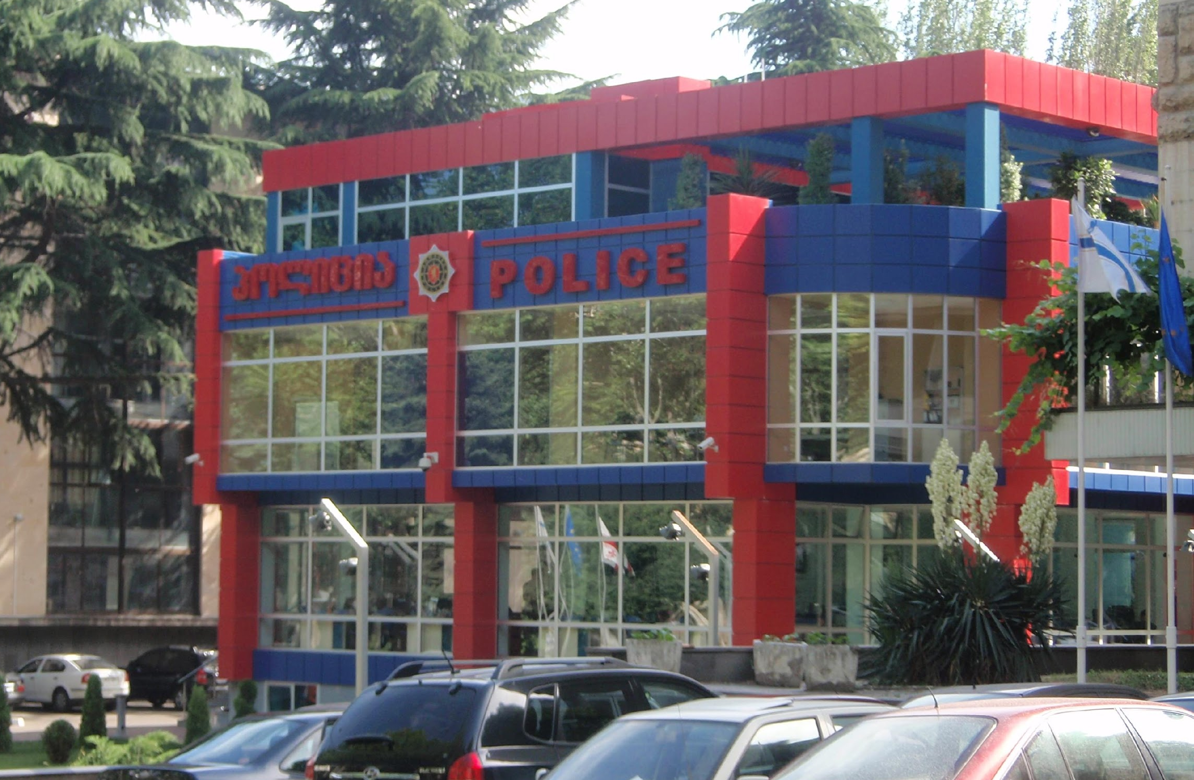
TRANSPARENCY PROVISIONS
ARTICLE 10
Public reporting
Each State Party shall…take such measures as may be necessary to enhance transparency in its public administration….
Such measures may include, inter alia…(a) procedures allowing members of the public to obtain information on org’n, functioning & processes and…decisions & legal acts; and (b) publishing information, such as periodic reports on risks of corruption in its public administration

Slide 6
TRANSPARENCY PROVISIONS
ARTICLE 12
Private sector
Each State Party shall take measures to prevent corruption involving the private sector…
.
Measures to achieve these ends may include, inter alia,…(c) Promoting transparency among private entities, including…measures regarding the identify of legal and natural persons involved in the establishment and management of corporate entities….

Slide 7
TRANSPARENCY PROVISIONS
ARTICLE 13
Each States Party shall…promote the active participation of individuals and groups outside the public sector, such as civil society …in the prevention of and the fight against corruption and to raise public awareness regarding…corruption.
Including such measures as:
Enhancing the transparency of and promoting the contribution of the public to decision-making processes
Ensuring that the public has effective access to information…
Undertaking public information activities…
Respecting, promoting and protecting the freedom to seek, receive, publish and disseminate information concerning corruption…

Slide 8
UNCAC COALITION PROPOSALS
ACCESS TO INFORMATION
Seeking a resolution reminding States Parties that access to information is essential for corruption prevention and calling on them to adopt and implement comprehensive access to information legislation. (Statement para 2)
The Working Group on Prevention should include this topic in its Work Plan
The questionnaire for the second cycle should ask if they have comprehensive & functioning access to information laws

Slide 9
UNCAC COALITON PROPOSALS
TRANSPARENT COMPANY OWNERSHIP
Seeking a resolution calling for collection of beneficial ownership information through national-level public registers of companies and trusts maintained with updated current information….

Slide 10
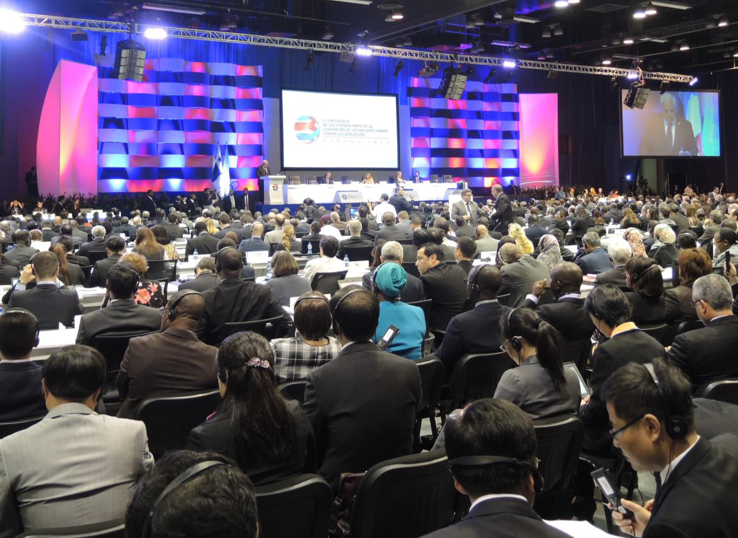
5TH UNCAC COSP RESOLUTIONS
ACCESS TO INFORMATION
Resolution 5/4 Follow up to the Marrakech Declaration on the Prevention of Corruption
calls for “effective measures facilitating access by the public to information and requests the Secretariat to provide technical assistance to States parties seeking to introduce or enhance measures in this area…” (para 23)

Slide 11
5TH UNCAC COSP RESOLUTIONS
TRANSPARENT COMPANY OWNERSHIP
Resolution 5/3 Facilitating international cooperation in asset recovery
encourages States parties “to cooperate in order to implement the necessary measures to enable them to obtain reliable information on beneficial ownership of companies, legal structures or other complex legal mechanisms, including trusts and holdings, used to commit crimes of corruption or to hide and transfer proceeds.” (para 23)
Resolution 5/4 Follow up to the Marrakech Declaration on the Prevention of Corruption
encouraging States parties “to exchange best practices in the identification of beneficial owners of legal structures used to commit crimes of corruption or to transfer their proceeds”. (para 24)

Slide 12
PUBLICATION OF DOCUMENTS – 1ST CYCLE
https://www.unodc.org/unodc/en/treaties/CAC/country-profile/index.html
Self-assessments published by
Botswana, Nigeria, Rwanda,
Tanzania
Full 1st cycle reports published by
Botswana, Burundi, Cameroon, CAR, Côte d’Ivoire, Ethiopia, Kenya, Lesotho, Madagascar, Malawi, Namibia, Niger, Nigeria, Rwanda, South Africa
Not published yet by Angola, Benin, Côte d’Ivoire, Djibouti, Gabon, Ghana, Liberia, Mali, Mauritania, Mauritius, Mozambique, Senegal, Seychelles, Togo
Not ready with executive summary
Chad, Comoros, Congo Brazzaville, Democratic Republic of Congo, Equ. Guinea, South Sudan, Sudan
Not published by
Benin, Comoros, Congo Brazzaville, Côte d’Ivoire, Democratic Republic of Congo. Gabon, Ghana, Liberia, Malawi, Mali, Niger, Senegal, South Sudan, Togo

Slide 13
PUBLICATION OF DOCUMENTS – 2ND CYCLE
https://www.unodc.org/unodc/en/treaties/CAC/country-profile/index.html
Self-assessments published by
Nigeria
Full 2nd cycle reports published by
Mozambique
Not published yet by Mauritius, Senegal (executive summaries published)
Not ready with executive summary
All other African countries
Not published by
All other

Slide 14
www.transparency.org
facebook.com/transparencyinternational
twitter.com/anticorruption
blog.transparency.org
© 2014 Transparency International. All rights reserved.

