Slide 1


The United Nations Convention Against Corruption
A Global Response to the threat posed by Corruption to Peace and Economic Development
Requirements for Procurement

Slide 2
Public Procurement and Corruption: implications on development
Procurement indispensable for achieving Government’s development objectives.
Governments are expected to minimize costs and maximize the value of the contracts, ensuring accessible and high quality outputs.
Effective procurement system helps to address the real needs of the society, balancing public and private sector interests.

Slide 3
Corruption as an obstacle to effective procurement
Public procurement is repeatedly reported as the largest single area of corruption in Countries in the region.
It leads to funds being wasted and sub-standard goods and services being bought.
It also means that dishonest businesses benefit at the cost on honest businesses. While there have been many
Initiatives to strengthen public procurement the area remains problematic.

Slide 4
UNCAC Article 9, paragraph 1. Public procurement and management of public finances
Each State party shall, in accordance with the fundamental principles of its legal system, take the necessary steps to establish appropriate systems of procurement, based on transparency, competition and objective criteria in decision-making, that are effective, inter alia, in preventing corruption. Such systems, which may take into account appropriate threshold values in their application, shall address, inter alia:
(a) The public distribution of information relating to procurement procedures and contracts, including information on invitations to tender and relevant or pertinent information on the award of contracts, allowing potential tenderers sufficient time to prepare and submit their tenders;
(b) The establishment, in advance, of conditions for participation, including selection and award criteria and tendering rules, and their publication;
(c) The use of objective and predetermined criteria for public procurement decisions, in order to facilitate the subsequent verification of the correct application of the rules or procedures;
(d) An effective system of domestic review, including an effective system of appeal, to ensure legal recourse and remedies in the event that the rules or procedures established pursuant to this paragraph are not followed;
(e) Where appropriate, measures to regulate matters regarding personnel responsible for procurement, such as declaration of interest in particular public procurements, screening procedures and training requirements.
Notes:
Chapter II outlines a detailed set of measures that States should take to prevent corruption in both the public and private sector.
Perhaps one of the most striking aspects of this chapter is the breadth of measures that it covers, including requirements in relation to the recruitment and management systems of civil servants, rules relating to the funding of political candidates and political parties, measures taken to address conflicts of interest and measures aimed at enhancing integrity and reducing corruption in the private sector.
Articles 5 and 6 of the Convention place specific requirements on States to ensure that they take a coordinated and effective approach to the introduction of these measures and identify relevant bodies to lead this task of coordination.
A further over-arching provision of Chapter II is Article 13, which requires States parties to promote the participation of individuals and groups outside the public sector, such as civil society, non-governmental organisations and community organisations in the prevention of and the fight against corruption.

Slide 5
Three Fundamental Principles of UNCAC: Article 9
Transparency
Competition
Objectivity
Notes:
Transparency:
Given that procuring entities frequently have a high degree of discretion in the procurement process, transparency which allows this exercise of discretion to be monitored.
Procurement systems depend on transparency to allow stakeholders (policymakers, officials, competitors and members of the public)
to monitor the procurement process.
Importantly, transparency also facilitates the achievement of the other objectives of a procurement
system (in particular, non-discrimination), and thus it must be addressed at all stages of the public procurement process.
i.e. must be clear what the tender is for, who can bid, what documents are required, who was selected etc.
Competition:
Competition in public procurement usually means that two or more bidders act independently and engage in a contest for the opportunity to secure the procuring entity’s contract by offering the most favourable terms.
Potential suppliers to the government are likely to compete only when they are confident that they have been provided with all necessary information and that their offers will be evaluated on the basis of objective criteria in a non-discriminatory way and that decisions of the procurement entity
can be challenged before an independent body.
i.e. fair competition, all information/ same information known by all, not rigged (decision made in advance), no cartels, specifications written to favour one supplier, specifications make the bidding process closed etc
Use of Objective Decision-Making Criteria:
Objectivity in decision-making in the context of public procurement refers to striving (as far as possible) to reduce or eliminate biases, prejudices and subjective evaluations.
Objectivity can be safeguarded in many ways, for instance, through requirements to disclose all criteria for participation and qualification of suppliers, rules on technical specifications drafted with the express intention of ensuring that procuring entities do not discriminate against and
among foreign suppliers, and requirements guiding technical and price evaluations.
i.e. fairly evaluate all bids, no one particular bidder in mind,

Slide 6
Transparency
In procurement, transparency is understood as having three important elements:
a/ open and transparent publishing of all procurement notices as well as the rules, criteria and standards
b/ Procurement procedure open to public scrutiny
c/ Putting in place a system that facilitates effective internal and external control

Slide 7
Objectivity
The principle of “objective criteria in decision-making” requires that all procurement decisions are justified and taken in accordance with predetermined criteria to avoid subjective bias.
Early, transparent definition and publication of the criteria for participation and selection
Drafting of technical specifications and terms of reference in a non- discriminatory manner.
Use of open procedures.

Slide 8
Competition
Competition improves the efficiency of the market mechanisms and reduces the risks of bid-rigging and collusion.
Competition may reduce the cost of procurement and may improve the quality of the services and goods.
To ensure competition, technical specifications should be formulated broadly, in a generic, objective way
All participants in the tender procedure should have sufficient (and equal) time to prepare and submit their offers

Slide 9
Elements of the effective preventive framework: legislation, institutions and practices
Legislative framework
E-government and e-procurement
Strong ethics infrastructure, including systems for managing conflicts of interest
Specialized procurement oversight and anti-corruption bodies
Protecting reporting persons
Access to information and participation of society
External control and external audit
Risk management systems

Slide 10
Legislative framework
Specialized procurement laws
Enabling legal framework for the whole public service
Legal framework on the use of information and communications technologies
Drafting and adoption of legislation: preliminary regulation impact assessment and public consutlations

Slide 11
E-government and e-procurement
Procurement portals
  Providing information, notices and allowing to download documents
  Full fledged e-solutions which allow submission and bidding
  Extended IT solutions with functionalities to track and monitor spending and implementation to detect irregularities.
Public consultations on procurement plans

Slide 12
Strong ethics infrastructure, including systems for managing conflicts of interest
Code of conduct
Training to ensure that staff has the knowledge and skills to apply the code
Clear leadership (including leading by example);
Functioning enforcement mechanism
Conflict of interest management and disclosure mechanisms

Slide 13
Specialized procurement oversight and anti-corruption bodies
Procurement oversight bodies: centralizing procurement, corruption prevention, monitoring, review functions
Specialized anti-corruption bodies
  Preventive functions (art. 6 UNCAC)
  Enforcement functions (art. 36 UNCAC)

Slide 14

Protecting reporting persons
UNCAC article 33: consider measures to provide protection against unjustified treatment to those reporting offences of corruption when reporting is done in good faith and on reasonable grounds
UNODC Guide: Resource Guide on Good Practices in the Protection of Reporting Persons (2015)
Hotlines, mobile phone apps, internet sites increasingly being used.
Anonymous reporting an issue.
Notes:
More to come on the next presentation.

Slide 15
Effective Remedy Systems (Bid Protest System)
Right to turn to a review body
Independence of the review body
Power to grant different type of remedies and corrective measures
Existing systems: specialized procurement review bodies or tribunals; bodies which are in charge of protection of competition; general system of administrative or civil courts.
Notes:
Effective Remedy Systems (Bid Protest System)
Key to successful procurement system. If no one challenges decisions (errors/corruption), corruption will continue unabaited as there are few consequences for those involved.
Right to turn to a review body:
An effective remedy system, which is also known as a challenge or bid protest system, in public procurement is a key element of a robust procurement framework. For this reason, article 9 (1) of UNCAC explicitly calls for an effective system of domestic review in public procurement.
Independence of the review body:
An effective remedy system requires that an application for review be heard by an independent body. The notion of independence with respect to the review body usually means independence from the procuring entity rather than independence from the government.
It is good practice for a reviewing body to include, or be composed of, outside experts independent from the government, such as experts from statutory professional representations such as a chamber of commerce or a non-governmental organization.
Power to grant different type of remedies and corrective measures:
Remedies in an effective enforcement system usually include interim measures and corrective measures, as well as damages. The possibility of suspension of a procurement procedure as an interim measure while the challenge is pending is essential, because this prohibits the procuring
entity from entering into the contract before the review body has decided on an application for review. A suspension will allow the reviewing body to verify whether the challenged decision was made in accordance with the rules and the solicitation materials.
If it is found that a decision was issued in breach of the applicable rules, the review body may make use of a corrective measure, such as prohibiting the procuring entity from taking a decision, or overturning or revising a decision of the procuring entity.
Further Corruption Prevention Strategies in Public
Procurement
Integrity of public officials and bidder employees:
Both the public sector and the private sector must ensure that only professional, honest, reliable
and skilled staff who demonstrate integrity are involved in public procurement activities.
A robust compliance programme that
includes a code of conduct is considered important, to provide contractors and potentially public
agencies a framework for following the law.
Exclusion, suspension and debarment:
Depriving private companies of the opportunity to do business with the
government is likely to be one of the strongest deterrents for future wrongdoers, and it ensures
that the government does not contract with those contractors that lack effective internal
controls.
As debarment systems have matured in different countries, two broad models for debarment have
emerged.
The first is a highly discretionary approach, under which a senior contracting official, acting on behalf of one or more
government agencies, may exclude contractors because of almost any serious issue regarding contractor qualification (used by the United States federal procurement system).
The alternative model, is much more focused: under this approach, the reviewing officials act in an adjudicative manner,
and a formal determination must be made as to whether the contractor in question has committed
acts that qualify as grounds for debarment, under a specific list of prohibited acts (used by the World Bank).
Whistle-blowing:
Whistle-blowing allows insiders to provide information to other individuals or organizations, such
as the compliance officer within the corporate structure of a private company participating in a
public tender or a public anti-corruption authority, so they can take the necessary steps.
In order to encourage reporting of corruption, it is absolutely essential to have effective
whistle-blower protection systems in place.
E-procurement:
E-procurement tools include the electronic publication of contract opportunities, the electronic
distribution of tender documents and the electronic submission of bids. Importantly, all the tools
of e-procurement (e.g. e-communication, e-submission, e-tendering, etc.) have one essential effect:
they eliminate or minimize the direct human interactions between bidders and the procurement
personnel, interactions which are one of the main sources of corrupt behaviour in public
procurement.
The use of e-procurement is well suited to assisting countries to establish
systems of public procurement based on the fundamental principles of transparency, competition
and objective decision-making as required by article 9 of UNCAC.

Slide 16
Access to information and participation of society
Access to information: public reporting, limitations and procedures
Increasing use of ICT solutions to provide access to information and to stimulate participation of society, including public consultations.

Slide 17
External control and external audit
The overall purpose of an external or state audit “is to carry out an appraisal of management’s discharge of its stewardship responsibilities, particularly where they relate to the use of public money, and to ensure that these have been discharged responsibly” (UNCAC Technical Guide)

Slide 18
Risk management
Article 9, subparagraph 2(b) of the Convention calls for establishment of an “effective system of risk management and control”
Should be based on facts, past experiences and review of processes
Proper prioritization important
Plan to mitigate the identified risks
Notes:
That includes risk assessment

Slide 19
Risk Mapping and Prevention – Pre-Tender Stage
Needs assessment/market research
Structuring of the bidding process:
  Tender documents
  Procurement procedure
  Time limits
  Contractor qualifications
  Minimum and selection criteria
  Technical specifications
  Award criteria

Slide 20
Risk Mapping and Prevention – Tender Stage
Public notice
Requests for clarification
Public bid opening
Evaluation of tenderers and tenders
Publication of intended contract award and awarded contract

Slide 21
Risk Mapping and Prevention – Contract Administration Stage
Stage of procurement with high risk of corruption
  Contract specification or scope inconsistent
  Contractors do not perform as per agreement
  Product delivered is not per specifications
  Unjustified change in scope/orders
  Contract changes
Monitoring system are key

Slide 22
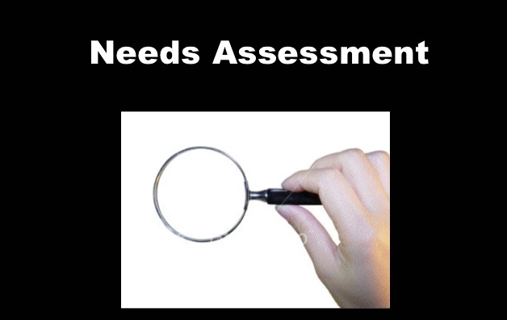
Main outcomes and challenges

Slide 23
Legislative framework
Most of legislative documents in the Region have been developed with the support of World Bank and taking into account UNCITRAL model Law
Many laws in the Region are still quite recent and not entirely implemented.

Slide 24
E-government and e-procurement
One of the main innovation in most laws, all the countries are considering or in the process to develop and use e-procurement
This is also one of the main challenge

Slide 25
Strong ethics infrastructure, including systems for managing conflicts of interest
Codes of conduct are mostly existing in the countries of the Region
Training, especially regular ones, remain a challenge
Conflict of interest is a very new concept and often challenging in practice

Slide 26
Specialized procurement oversight and anti-corruption bodies
Most of the countries have a functional oversight body
However, carrying in out all the functions are often challenging
Appeal process is often challenging and detection of corruption cases is difficult
Coordination with other institutions, such as the ACA needs sometimes to be strengthen

Slide 27
Risk mapping / risk management
This is the most challenging side in the countries assessed.
Some countries welcomed the work of CSOs on their mission of procurement assessment and monitoring when the institutions do not have always the capacity to conduct in depth risk assessment
Notes:
That includes risk assessment

Slide 28
Procurement stages
Open bid always the default process
Verification of process chosen when under the threshold of open bid often challenging
Separation of functions not always done as it requires staff capacity
Contract management phase is the most challenging phase globally

Slide 29
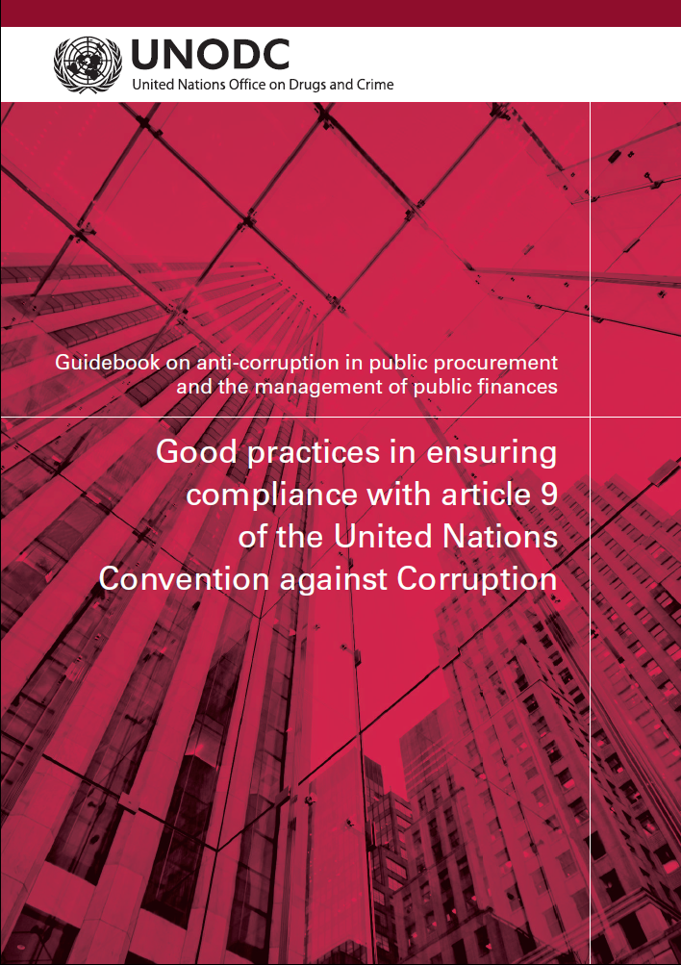
Guidebook on anti-corruption in public procurement and the management of public finances
http://www.unodc.org/unodc/en/corruption/publications.html
Notes:
UNODC recently developed a Guidebook for governments on good practices in implementing article 9. It contains examples from countries around the world, as well as a set of questions which can be used by States to evaluate their compliance with UNCAC.

