Slide 1

11th Session of the UNCAC CoSP
Key Takeaways & Follow-up
18 February 2026
info@uncaccoalition.org

Slide 2
Agenda of the Briefing
Main achievements & challenges for civil society
Analysis of resolutions & main commitments
Spotlight on resolutions: 11/2, 11/5, 11/9 & 11/3
Civil society feedback - main findings
Opportunities for engagement in 2026
Q&A

Slide 3
Backdrop to CoSP11
An extremely challenging, rapidly evolving geopolitical context; an expectation for 1st time vote on resolutions
Immense challenges for NGOs with severe funding cuts and shrinking civic space across the globe
Qatar as the host of the Conference

Slide 4
Main achievements from a civil society perspective
Number of civil society participants- 460 reps from 177 CSOs registered
Well attended and dynamic pre-CoSP Civil society Forum
Active & meaningful engagement: Side events, plenary statements, 54 written submissions
High Number of CSO representatives in country delegations - 19 reps in 13 States
The Doha Civil Society Declaration
Effective advocacy leading to significant impact on adopted resolutions

Slide 5
CoSP 11 Resolutions
11 resolutions and 1 decision adopted by consensus:
  The Doha declaration on AI in preventing and combating corruption (Qatar)
  Second phase of the UNCAC Implementation Review Mechanism (Qatar)
  Small island developing countries (Tuvalu, follow-up)
  Follow-up to the Marrakech Declaration on Prevention (Morocco, follow-up)
  Measurement of corruption (Saudi Arabia, follow-up)
  Strengthening education and activities on anti-corruption for young people (Austria, Slovenia, Chile)

Slide 6
CoSP 11 Resolutions
Political finance transparency (Norway, Albania, Mongolia, Ghana)
Corruption as it relates to crimes that affect the environment (Brazil, Namibia)
Cooperation between Anti-corruption Bodies and Financial Intelligence Units (Palestine)
Enhancing regional cooperation in Central Asia (Uzbekistan)
Corruption and smuggling of migrants (USA)
Decision: Venue of CoSP 12 in Uzbekistan

Slide 7
Priority Topics for CoSP 11
Civic space in AC
Access to information
IRM next phase
Human rights and corruption
Political financing transparency
Environmental crime and corruption/integrity in climate finance

Slide 8
Resolution implementation
Resolutions are not binding but set standards for UNCAC implementation
States Parties are expected to take actions to implement
Sponsoring countries signal a strong commitment
CoSP subsidiary bodies to discuss resolution implementation
Several CSOs have published blogs on specific resolutions
Civil society should play a role in monitoring & implementation of commitments!

Slide 9
Key Takeaways on priority topics:
Our Analysis of CoSP11 resolutions include:
  Highlights: aspects of the resolution that advance commitments, including those that go beyond previous ones.
  What is missing
  Notable follow-up by the States Parties, UNODC & mandates given to the CoSP subsidiary bodies
  Promoting implementation of resolutions

Slide 10
Civic space, Article 13
More references to “civil society” in CoSP11 resolutions than CoSP10 resolutions;
First time that indigenous peoples and local communities are included in CoSP resolutions (ECC and SIDS resolutions)
Meaningful follow-up measures in Marrakech:
Secretariat to identify practical recommendations to implement Article 13, publish reports on input received, Prevention WG to discuss and consider (consulting civil society did not make it into the final resolution, no specific date on when WG on Prevention would discuss this)
Prevention WG to discuss facilitating access to information at 17th Session (2026)

Slide 11
Civic space, Article 13
In other resolutions civil society participation language was watered down
- environmental defenders did not make it in the ECC resolution; media, academia also taken out in other instances.
Stronger language from UNGASS, Atlanta Declaration on civil society protection are in 3 resolutions; SIDS resolution has language on creating enabling environments for civil society, academia and the media
Language proposals on risks to civil society and developing early warning and protection mechanisms for civil society did not make it into the resolutions.

Slide 12
Outcomes on other priority topics
Political finance transparency: first ever dedicated resolution with the most detailed recommendations on political finance transparency and integrity that exist globally, record number of co-sponsors (59)!
Environmental crime and corruption/climate:
Resolution on Corruption relating to crimes that affect the environment: commitments on enforcement and international cooperation, disclosure and use of beneficial ownership, effective access to public information to help enhance public oversight, and tackling the role of enablers (new language).
SIDS resolution: new commitments on climate finance governance (but only applies to SIDS States Parties)
Human rights: Commitments on the interlinkages between human rights and corruption made it into the Marrakech follow-up resolution; also human rights references in the Doha Declaration

Slide 13
What is missing
Victims of corruption - no language in any of the resolutions addressing the victims of corruption
Gender and corruption - Only one mention of gender across resolutions (gender-disaggregated data in SIDS resolution, women and girls were mentioned in some other resolutions
Linkages with other fora - far fewer references to the SDG Agenda in resolutions; recalling, reaffirming or promoting linkages with other specific UN fora or other mechanisms didn’t make into the final resolutions.

Slide 14
2nd phase of IRM - Highlights
Improvements for civil society participation in reviews: encourages considering information from civil society stakeholders in preparing review reports, reflecting civil society engagement and views in the full country report & annex
Greater transparency of the review process: publishing upcoming review visit dates, estimated dates for review completion, press-release, compiling information into a document for the IRG
Scope includes: progress made to follow-up from previous reviews, review of technical assistance, implementation in practice, and other information on measures taken relating to UNCAC implementation as provided by State Party under review
Structured, public but voluntary progress reporting process on measures countries have taken after reviews are completed, published before each CoSP

Slide 15

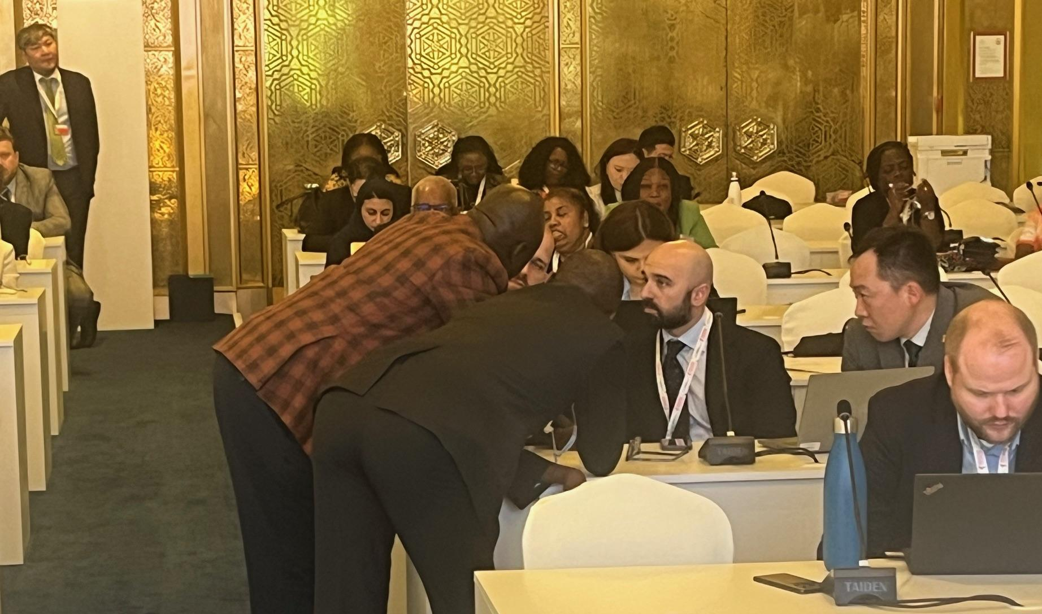
PREVENTING AND COMBATING CORRUPTION THROUGH
TRANSPARENCY IN POLITICAL FUNDING
UNCAC CoSP Resolution 11/7
December 2025

Slide 17
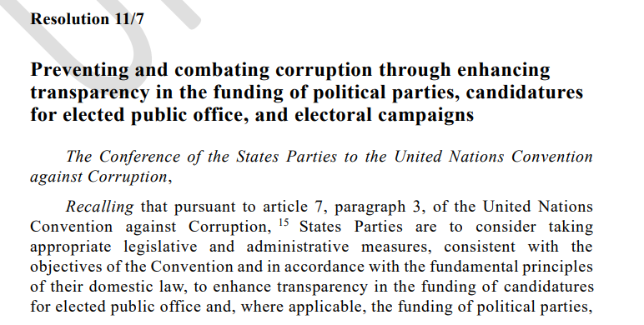
Why is Res11/7 important?
First resolution on Art. 7.3 – on transparency, and beyond
Most comprehensive global standards
Follow up actions

Slide 18
What does Resolution 11/7 call for?
Transparency
Clean money (or prevent bribery, undue influence)
Strong oversight body
Civic oversight
State neutrality
Follow up to implementation
Notes:
The resolution unpacks transparency. Rather than simply recognising the principle of transparency, the resolution unpacks what it should look like in practice: standardised bookkeeping, comprehensive reporting with identification of donors, timely publication online including before elections, as well as the members of the public’s freedom to seek and receive this information. (OP 1, 2-4, 10, 13)

Slide 19
TRANSPARENCY UNPACKED
Standardised bookkeeping (OP 3)
Identification of donors above thresholds, incl. sponsors of ads (OP 3 and 10)
Comprehensive reporting to oversight authority (OP 3)
Timely publication online with donor identification, incl. before elections (OP 4)
Freedom to seek and receive political finance information (OP 13)

Slide 20
CLEAN MONEY (to PREVENT BRIBERY AND UNDUE INFLUENCE)
Restrict corporate donations with anonymous source (OP 6)
Caps on donations from public contractors (OP 6)
Third party activity to disclose sponsors (OP 9)
Limits on amount of donations to prevent bribery and trading in influence (OP 8)
Restrict or ban funding by foreign entities (OP 6) and to get an undue advantage from foreign officials and parties (OP 7)

Slide 21
EFFECTIVE OVERSIGHT BODY
Oversight body with necessary independence, staff and resources (OP 2)
Inter-agency cooperation, incl. election authorities, cross-border (OP15)
Authority to monitor compliance, refer to law enforcement, and impose sanctions (OP 12)

Slide 22
CIVIC OVERSIGHT
Participation of groups outside society, including election monitoring mechanisms, to support political finance transparency (OP 13)
Confidential, safe and secure reporting of corruption offences related to political finance (OP14)

Slide 23
STATE NEUTRALITY
Prohibit misuse of state resources (OP 11)
Empower authorities to monitor and detect misuse of state resources (OP 11)
Public funding must be allocated and disbursed with fair and objective criteria (OP 5)

Slide 24
FOLLOW UP. We intend to influence:
UNODC to collect information on good practices, challenges and lessons learned (OP 16) – early 2027?
UNODC to develop materials to promote effective implementation of Resolution (OP 17) – any time
Working Group on Prevention to discuss good practices and challenges at 18th meeting (OP 18) – May or June 2027?
UNODC to report on implementation of Res. to CoSP 12 (OP 19) – Dec 2027
UNODC to provide technical assistance in cooperation with other multilateral bodies (OP 20) – any time

Slide 25
REACH OUT! jvalladares@transparency.org | jvrushi@transparency.org

Slide 26
Res. 11/9 Corruption and the environment
Builds upon Resolution 8/12, lays out many new commitments to help address important gaps and challenges in tackling corruption as it relates to CAE, combating organized crime, money laundering and illicit financial flows.
Strengthens enforcement and (cross-border) cooperation, among authorities and other stakeholders, Articles 49 & 50, (joint investigations and special investigative techniques), asset seizure and recovery, the use of technology, mutual legal assistance.
Applying other anti-corruption tools measures: use and sharing of beneficial ownership information, tackling the role of service providers (enablers), access to information to enhance public oversight, transparency and integrity of public-private sector relationships, procurement
Civil society participation: Recognizes the vital role of “indigenous peoples” and “local communities”, the first time these terms have been explicitly referenced in a CoSP resolution (along with Resolution 11/3).

Slide 27
Res. 11/3: SIDS
Climate change: Preamble acknowledges that climate change poses an existential threat to SIDS and that integrity, transparency and accountability are essential for the effective use of climate finance and environmental resources; recognizes the linkages between corruption, , CAE and the mismanagement of sustainability finance.
Climate governance: Enhance transparency, integrity and accountability mechanisms, including in the planning, disbursement and oversight of funds, in climate finance and natural resources management.
Gender and social inclusion: Collection of gender disaggregated data on the impact of corruption on people in vulnerable situations; take into account social inclusion considerations when developing and implementing anti-corruption strategies and policies, with the special nature of small island developing States (SIDS), with Indigenous Peoples, local communities and community-based groups.

Slide 28
CoSP11
CSO Feedback

Slide 29
Relevance and usefulness of CoSP11 for civil society participants
 | Great space for networking and stakeholder engagement. Useful for understanding current priorities and learning best practices. Opportunity to showcase work and conduct advocacy with governments. Insightful discussions around relevant themes at side events.
 | Ability to have an impact felt limited for those with less access to delegations.

Slide 30
Impact of the collective civil society community on shaping the CoSP11 agenda, discussions and resolutions
 | Key resolutions were positively impacted by civil society outputs and sustained advocacy.
 | Lack of political will in some areas. Sometimes difficult to gauge the impact of civil society’s contributions to the discussions. Difficult to navigate the many events and figure out who were the right people to meet with.
 | Increase the capacity of CSOs who are less familiar with the CoSP. Improve on how inclusive parts of the CoSP are for CSOs.

Slide 31
  Useful CoSP11 follow-up information and activities to support anti-corruption work
  Resolutions
Information on resolution follow-up and the role of CSOs in monitoring and supporting resolution implementation at the national level.
  Detailed analysis of resolutions.
  Progress of resolution implementation and the impact of resolutions at the national level.
  UNODC & other relevant agencies’ plans for follow-up actions.
  Collaboration with governments on resolution implementation.
  Working group efforts to support resolution implementation on specific topics.
  How the new Implementation Review Mechanism will be implemented.

Slide 32
  Useful CoSP11 follow-up information and activities to support anti-corruption work
  Side events
Summary of relevant side events.
Follow-up on side event initiatives discussed.
  CoSP12
Reflect on where we gained or lost ground at CoSP11.
Outline CoSP12 priorities in advance.
  Other
Identify opportunities for regional collaboration and joint action to be taken.
Database of CoSP11 participants (for those who would like to be included) for follow-up.

Slide 33

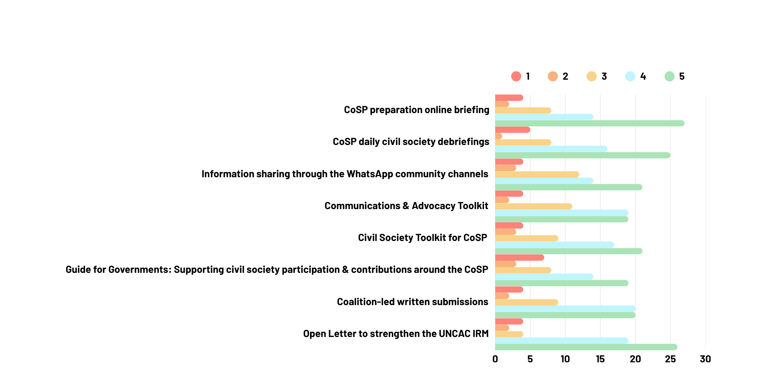
Resources and Activities
Not useful (1)
Very useful (5)

Slide 34
In-person civil society preparatory meeting
 | Networking opportunities to coordinate on advocacy and build connections. Useful information on the dynamics, procedures and agenda of the CoSP, strengthening coordination around priorities, and an overview of key issues in upcoming negotiations. Breakout sessions around resolutions and priority topics were one of the most useful elements.
 | More time for networking, interactive discussions and regional breakout sessions. Encourage participant preparation prior to the meeting to better identify key priorities and existing relationships that can be mobilised, have better knowledge on resolutions and how to contribute to moving them forwards. More practical and regional focused discussions and guidance, and information on engaging with government delegations. Encourage more government participation.

Slide 35
  Ways the Coalition can better support CSOs in preparation for and participation at CoSP12
  Information sharing
  CSO Support
Information about the latest developments.
Updates on UNODC’s activities around the CoSP.
Continue with the online preparatory briefings.
Information on important contact points.
Mentoring for CSOs at the CoSP.
Capacity-building support.
Information on resources for funding support.
  Other
Maintain valuable relationships with diplomatic missions in Vienna.
Stronger regional coordination & facilitate regional connections ahead of the CoSP.

Slide 36
  How the Coalition can strengthen joint advocacy before and during the CoSP
Reduce the amount of priority areas to focus on.
Information sharing and stronger networking.
One-pagers to be shared with delegates on topics around key resolutions and why they are important to support.
Encourage civil society to think beyond resolutions and about a larger theory of change in anti-corruption efforts around the UNCAC.
Launch a call for CSOs to express side event topics of interest prior to the official call for side events, to better coordinate on this.
Start coordination and planning earlier.

Slide 37
Other suggestions
Analysis of government plenary statements on priority topics and trends compared with prior CoSPs.
Guidance on using plenary statements, written submissions and commitments made in advocacy.
Information on where to find conference materials (plenary videos, final resolution texts).
Coordinate on sharing photos and videos taken during the CoSP.

Slide 38
Key Takeaways
Pre-CoSP
At the CoSP
Post-CoSP
Pre-CoSP online briefings and resources were useful.
More topic-specific guidance in pre-CoSP resources and capacity-building activities.
More information and support on engagement for first time attendees.
Great for networking and engaging with governments and civil society.
Felt the strong impact of collective civil society advocacy.
Reduce the number of priority areas of focus.
Streamline information sharing.
Increase regional coordination.
Focus on resolution follow-up and implementation.
Information on priorities and the agenda for CoSP12.

Slide 39
CoSP 11 follow-up & advocacy
Plan of subsidiary bodies in 2026:
  18-22 May: IRG & WG on Prevention + NGO briefing (Open to CoSP 11 observers)
  31 August- 4 September: Resumed IRG
  2-6 November: 2nd resumed IRG, WG no International Cooperation, WG on Asset Recovery,
    CoSP Special session to adopt the IRM documents

Slide 40
CoSP follow-up & advocacy in 2026
Discussions on resolution implementation in the COSP Subsidiary Bodies:
    Res.11/2- IRM next phase key documents (May, September IRG)
    Res.11/4- Access to information & Res.11/6- Anti corruption education (May, Prevention WG)
    Res. 10/5- Corruption and organized crime (November, International Cooperation WG)
    Res. 11/8- Collaboration between ACAs & FIUs

Slide 41
CoSP follow-up & advocacy in 2027
In 2027, discussions on:
Political finance transparency (11/7)
Corruption & environment (11/9)
Practical measures for ensuring non-gov participation (11/4)
Organisation of the future CoSP special session on asset recovery

Slide 42
CoSP 11 follow-up- possible action
Civil Society possible action on resolution implementation:
    Advocate to include civil society in country delegations to follow discussions in relevant subsidiary bodies
    Encourage the Government to submit info on implementation action ahead of WG meetings & deliver Statements on issues of priority
    Support and inform the Government’s reporting
    Make a submission in parallel to the Gov. submission (IRG in May 26’ )
    Monitor States Parties published info on CoSP subsidiary bodies websites
    Organize events on the margins of the WG sessions/CoSP Special session (in collaboration with States parties)
    Engage with the government to implement important resolutions

Slide 43
CoSP Special session- Nov. 2026
One day between 2-6 November
Objective: to adopt the IRM next phase documents: Self-Assessment Questionnaire, Templates for full country reports & Executive Summaries
Adoption by consensus or vote
CoSP RoP apply- CSOs participation, statements, written submissions, events
Timeline
By mid-March: States can provide comments on the draft SAQ proposed by UNODC
May, September IRGs: States deliberate on the SAQ, full report and executive summary templates
November: last deliberations and adoption- ahead of the launch in 2027

Slide 44
Further follow-up
“Unique” entry points in 2026
Civil society’s input on the IRM next phase- will begin a consultation very soon on the SAQ!
UNODC Practical Guide on corruption measurement- open for public consultation through this form until 31 March
Civil society input on the Asset Recovery Special Session
Action to be discussed further in:
CoSP 11 follow-up 2nd online briefing
Coalition Working Groups, Regional Groups
Coalition CoSP 11 webpage, [CoSP11] emails
Other thematic groups outside the Coalition
Feel free to reach out to the Coalition to discuss bi-laterally!

Slide 45
Resources in the pipeline
CoSP 11 Resolution analysis -
CoSP 11 webpage for further updates
A summary of CoSP 11 national plenary statement according to issues of priority
Summary of UNODC report on State of UNCAC implementation chapters II and V

Slide 46
Thank you very much for your attention!
Yonatan Yakir
Programme Manager & UN Affairs Lead
yonatan.yakir@uncaccoalition.org

