Slide 1


Social Accountability in Bhutan
Kinley Drukpa, Program Officer, BTI
Notes:
Felt accountability is how strongly you feel accountable for doing good work
Clarity of accountability is how clear you are about those things for which you are accountable

Slide 2

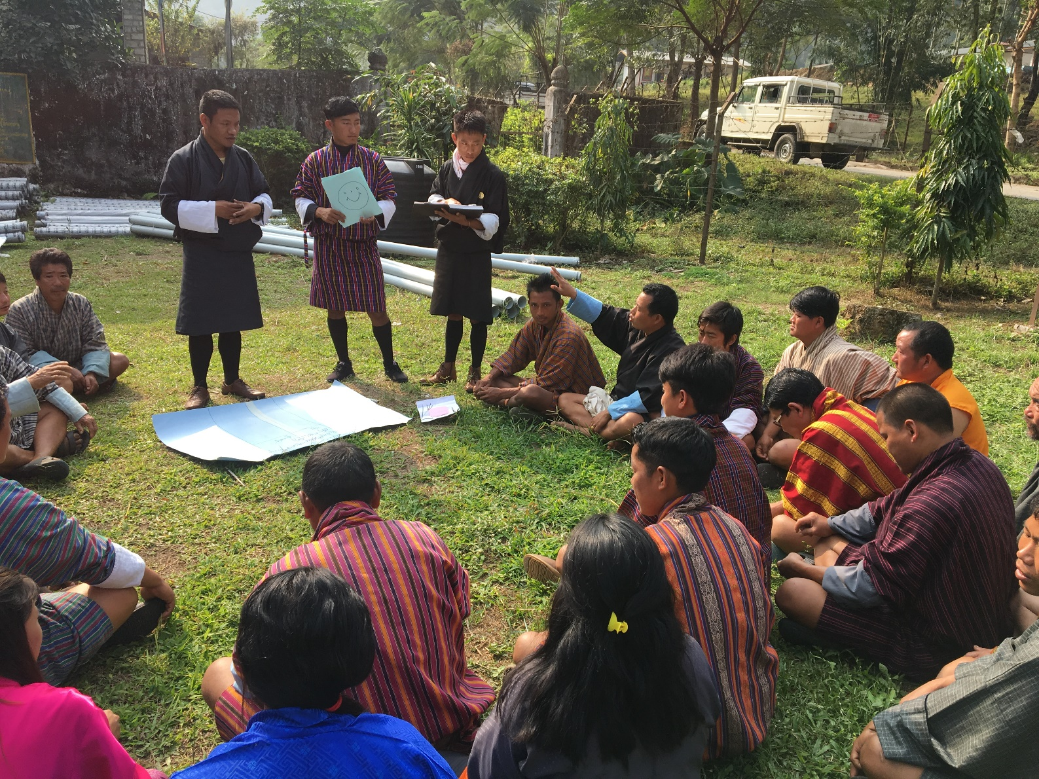
Scope of Presentation
The Context
The challenge
The Approach
The journey
The Future Plan
Notes:
Felt accountability is how strongly you feel accountable for doing good work
Clarity of accountability is how clear you are about those things for which you are accountable

Slide 3
The Context
The Demand
The Supply
Notes:
Felt accountability is how strongly you feel accountable for doing good work
Clarity of accountability is how clear you are about those things for which you are accountable

Slide 4
The Context…
The Supply | The Demand
Democratic Decentralization processes | Lack of awareness on and capacity in civic engagement
The Legal frameworks: The constitutions of the Kingdom of Bhutan 2008 Local Government Act of Bhutan 2009 The Anti-Corruption Act of Bhutan 2011 The Audit Act of Bhutan 2018
The policy for developmental plan (Five year Plans)
Notes:
Felt accountability is how strongly you feel accountable for doing good work
Clarity of accountability is how clear you are about those things for which you are accountable

Slide 5
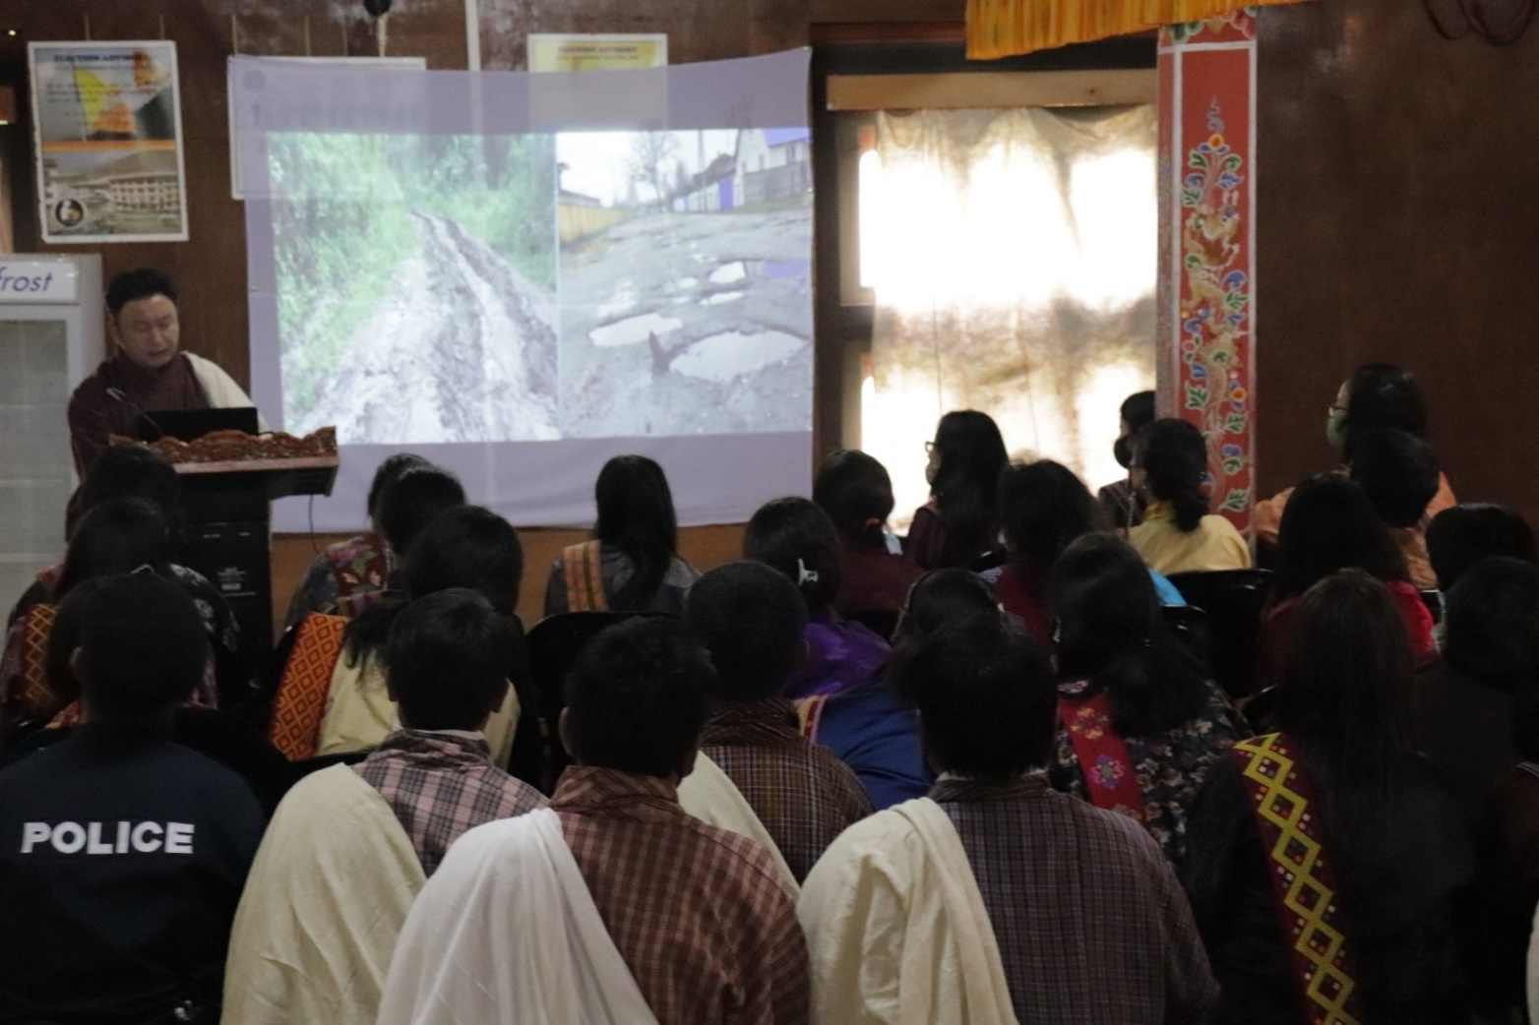
The challenge
Lack of awareness on civic engagement
Closely knit society
Lack of coordinated efforts
Access to information
Resources
Notes:
Felt accountability is how strongly you feel accountable for doing good work
Clarity of accountability is how clear you are about those things for which you are accountable

Slide 6
The Approach
Collaboration and Coordination
Relevant Institutions (ACC, DLG, RAA, ECB, CSOs and others)
2.Negotiation
Local Government leaders
3. Advocacy
Rigorous Advocacy
4. Capacity Building
Community Representatives and Service Providers
5. Institutionalization
Institution of SA practitioner Groups
Institution of engagement platform
6. Implementation
Periodic assessment of services or developmental plans using CSC
7. Lobbying for policy Change
Embedding SA in the performance M&E
Notes:
Felt accountability is how strongly you feel accountable for doing good work
Clarity of accountability is how clear you are about those things for which you are accountable

Slide 7
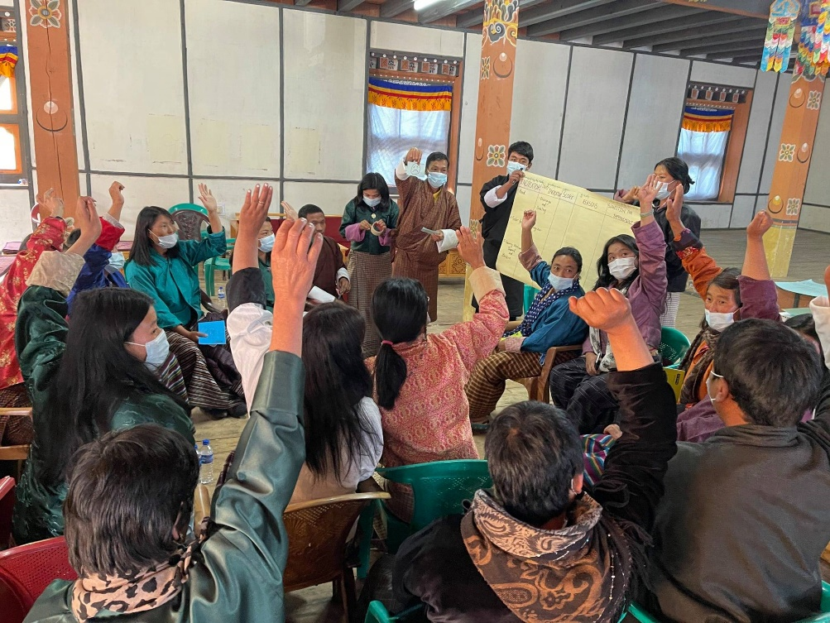
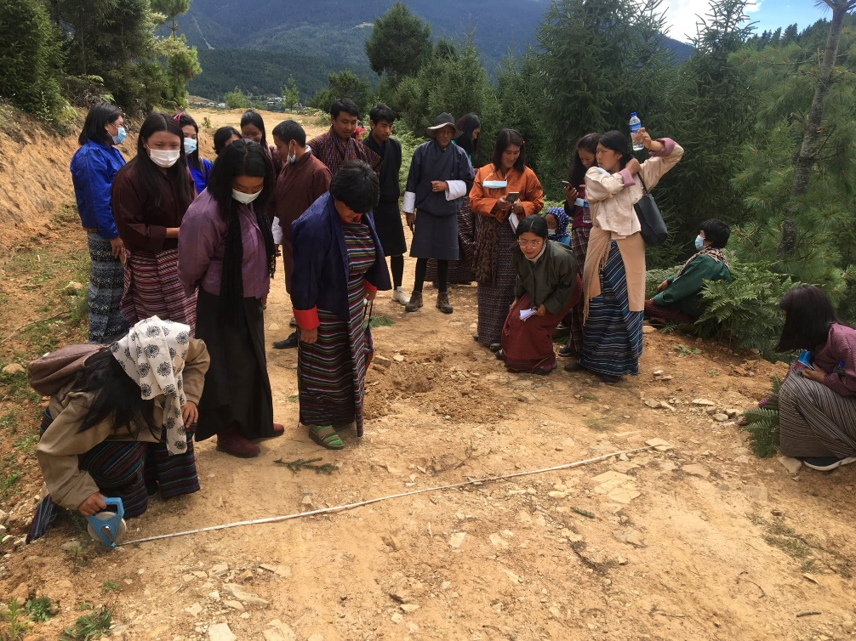
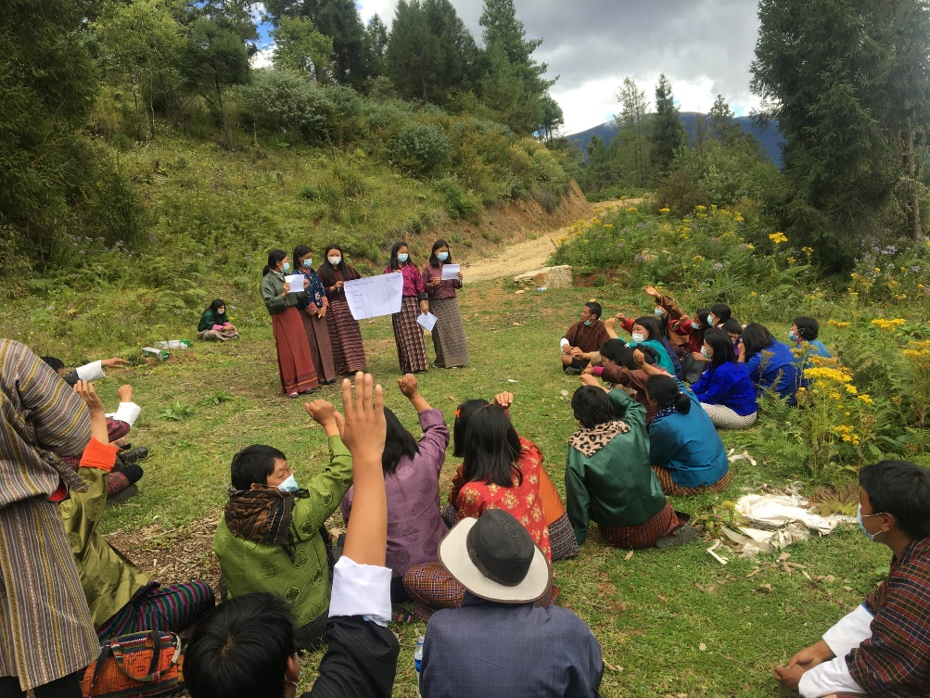
The journey
Initiated a pilot project in 2015
Piloted in one district (Paro)
Used Community Score Card (CSC)
Notes:
Felt accountability is how strongly you feel accountable for doing good work
Clarity of accountability is how clear you are about those things for which you are accountable

Slide 8
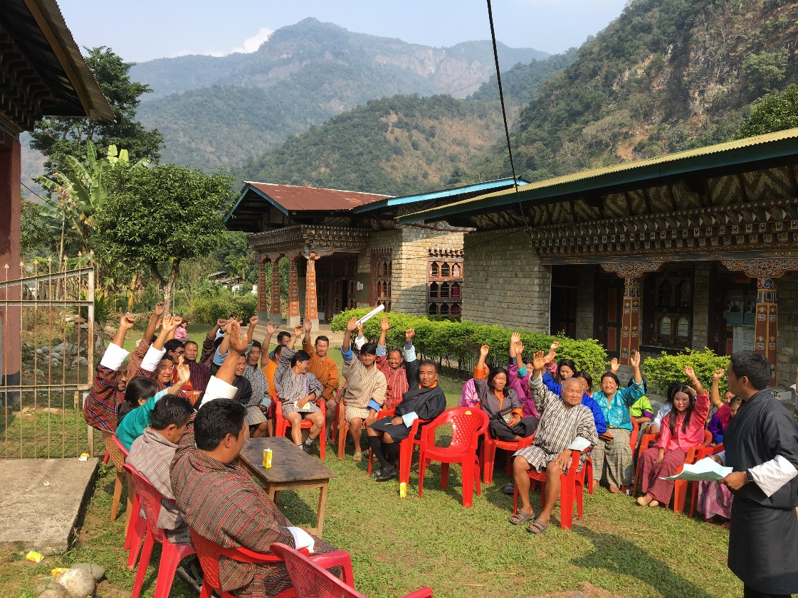
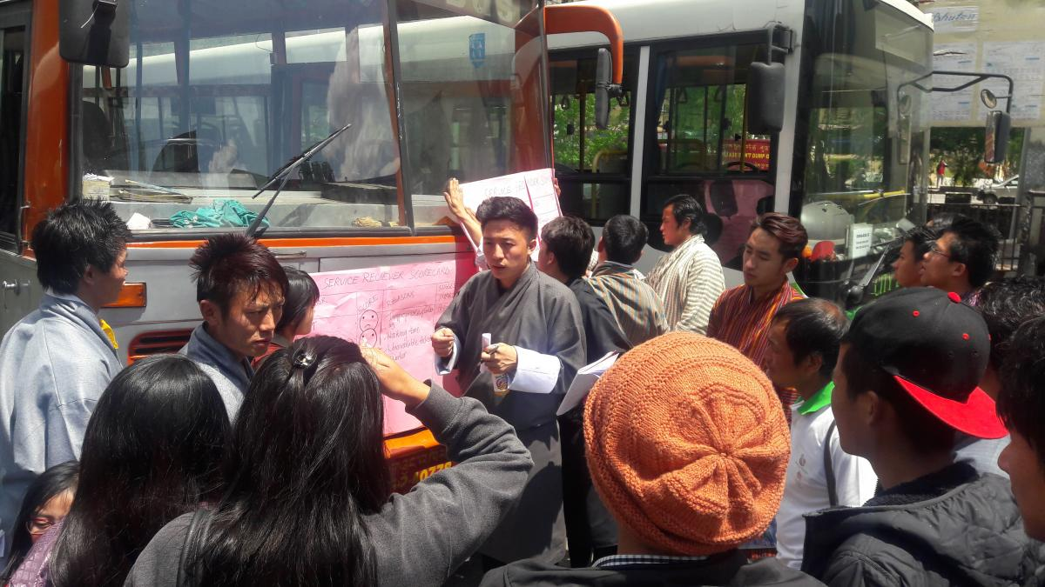
The journey…
2. Scaled up to other districts from 2016
SA Practitioner Groups instituted in four districts and 2 municipalities.
Conducted Citizens’ Report Card on the implementation of 11th Five year Plan at the Midterm in 2016.
3. Instituted SA in the Colleges in 2019
Youth Practitioner for Accountability Clubs in two colleges.
Instituted SA in the M&E for the 12th FYP (2018-2023)
Notes:
Felt accountability is how strongly you feel accountable for doing good work
Clarity of accountability is how clear you are about those things for which you are accountable

Slide 9
The Future Plan
Roll out Social Accountability in all the local governments (205 Blocks and four Municipalities) by 2027
Continue to lobby for Right to Information Act (RTI)
Embed SA in the Service Providers’ regular performance M&E in the LGs
Institute platform for continuous learning
Notes:
Felt accountability is how strongly you feel accountable for doing good work
Clarity of accountability is how clear you are about those things for which you are accountable

Slide 10
Thank You
Notes:
Felt accountability is how strongly you feel accountable for doing good work
Clarity of accountability is how clear you are about those things for which you are accountable

