Slide 1

Civic Participation and Social Accountability:
Lessons from TI-Bangladesh
Iftekhar Zaman
Presented to the 4th Regional Meeting organized by the UNCAC Coalition
19 November 2021

Slide 2
Four key strategic thrust areas of TIB’s work
Objective: Create demand and catalyse change – institutions, laws, policies and practices for better governance and corruption control
Research & Policy (R&P) – knowledge and evidence-based campaign and advocacy for legal, policy and institutional change
Civic Engagement (CE) - creating platforms of common people including the women and youth with special emphasis on the disadvantaged sections of the society
Outreach & Communication (O&C) – for multi-stakeholder engagement and outreach, partnerships and communication
Strengthen anti-corruption mobilizational and institutional capacity of TIB, key actors in CE and other stakeholders

Slide 3
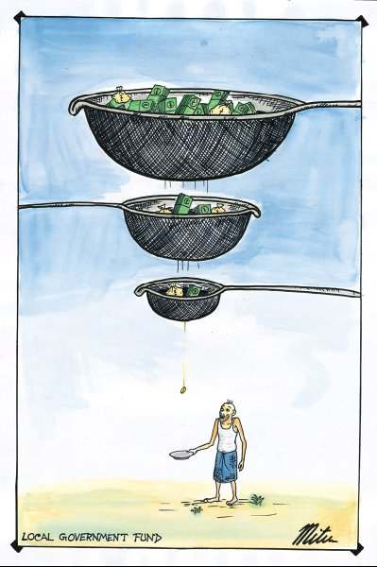
Why Engage People
Corruption affects the people daily, with a bias against the poor and disadvantaged
Laws and institutions are necessary, but not sufficient
Power belongs to the people; victims as catalysts for social accountability
Research, campaign and advocacy are stronger when supported by the people
Bring the service providers and recipients close to each other as co-stakeholders

Slide 4
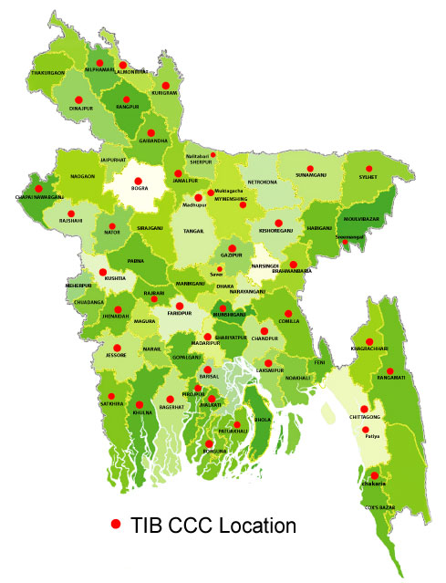
TIB’s People’s Participation Infrastructure at a glance
45 Committees of Concerned Citizens (CCCs) are working in 38 Districts and 7 sub-districts
45 Swajon (Citizens for Transparency) Groups
44 Active Mothers Forums
61 Youth Engagement and Support (YES) Groups (45 at CCCs, 16 in Dhaka)
49 YES Friends Groups
Total: About 6,000 core actors voluntarily engaged.

Slide 7
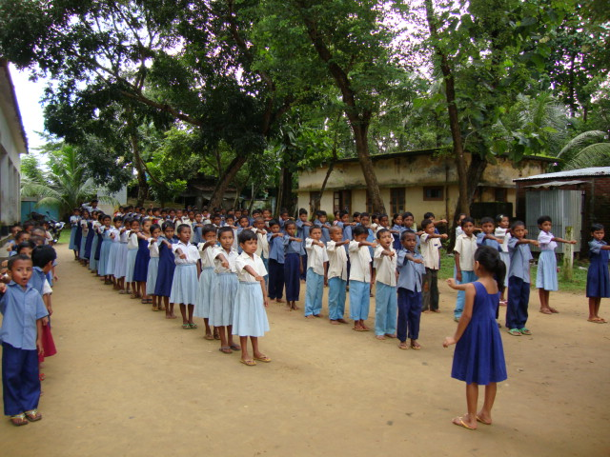
Some result indicators - Education
Unauthorized payments stopped
Scholarship & free book delivery fair & transparent
SMCs reformed and activated, teachers, officials, parents engaged
Teachers’ performance improved - exploitative private tuition controlled
Student drop-out reduced, improved results in exams - Grading improved from “C” to “A”
Replication by the Government

Slide 8
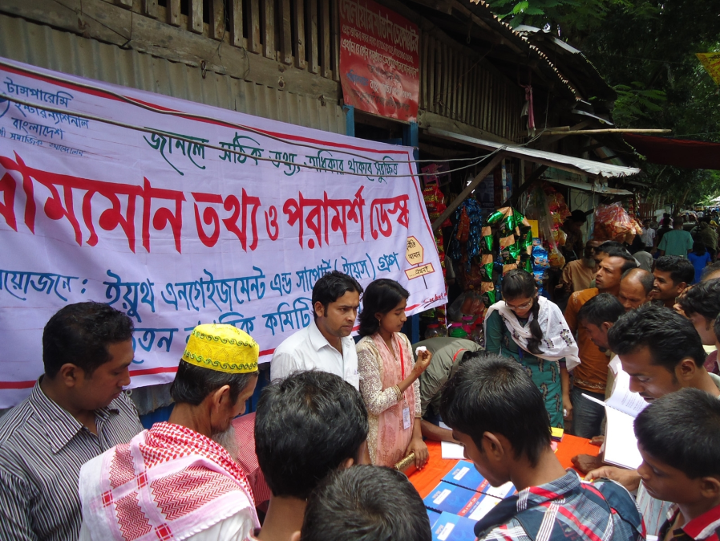
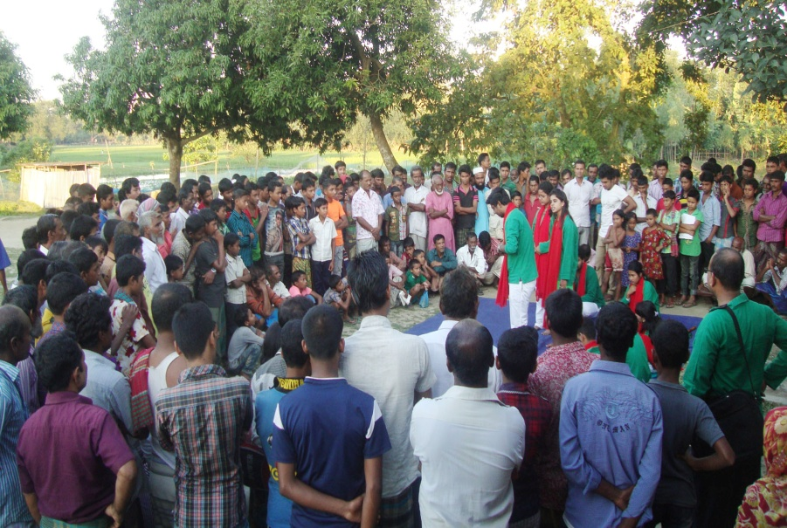
Some result indicators - health
Unauthorized charges controlled
Proactive disclosure – services, costs, duty rosters
Forcing patients to private clinics stopped
Doctors & other staff available in hospital on time
Illegal payment for ambulance & other services stopped
Food quality for indoor patients & cleanliness improved
Intrusion of representatives of pharmaceuticals in doctors’ chambers stopped
Better understanding between service providers and recipients
Engaging the people

Slide 9
What we have learnt
Civic participation for social accountability is a continuing process – it needs appropriate platforms and strategies of engagement based on understanding of shared stakes
People’s voluntary involvement, especially youth engagement is the key. Erosion of volunteerism will jeopardize success
Visible and measurable success including amplification and replication is possible, but limited to the given resources and capacities
Higher levels of success will depend on newer and enhanced capacities through institutional and policy support
Sustainability depends on continued commitment of all stakeholders
Favourable political will and administrative support are crucial

Slide 10
Thank you

