Slide 1

PUBLIC OFFICIAL’S WEALTH REPORT
INDONESIA’S EXPERIENCE
to Facilitate public access to information
Adhi Setyo Tamtomo
adhi.tamtomo@kpk.go.id
+62 815 998 2287
Abu Dhabi, Dec 20, 2019

Slide 2


COMMISIONERS
ADVISOR
PREVENTION
ENFORCEMENT
INFORMATION &
INTERNAL AFFAIRS &
SECRETARY
DATA
PUBLIC COMPLAINTS
GENERAL
SECRETARIAT
SECRETARIAT
SECRETARIAT
SECRETARIAT
Planning and
Finance
Registration & Examination
of Public Official’s Wealth
Report
Pre-investigation
Information and Data
Processing
Internal Supervision
Gratification
General Affairs
TASK FORCES
Public Complaints
Monitor
NETWORK INTER
Public Education
and Services
Investigation
COMMISION AND
Human
Resources
Fostering Networks
Between Commissiom
& Institutions
Legal
Research and
Development
TASK FORCES
Prosecution
TASK FORCES

Slide 3
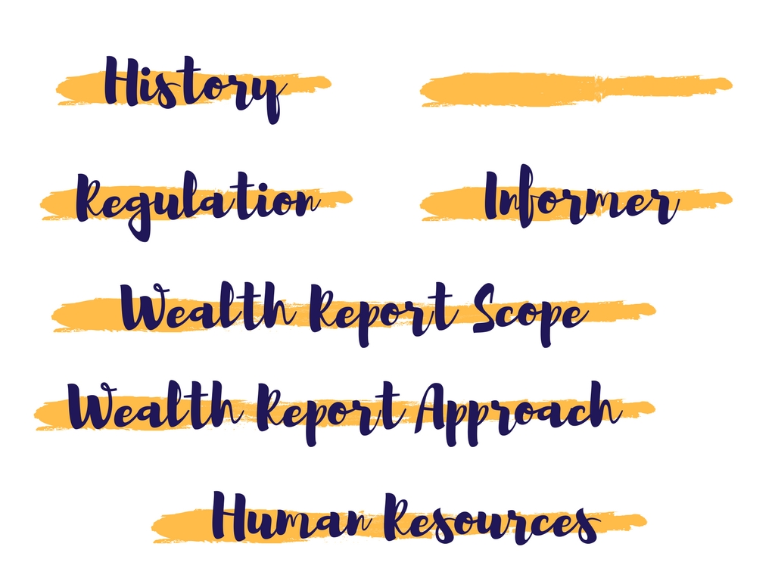

SANCTION
Law Number 28 of 1999 article 20
→ ADMINISTRATIVE SANCTION
Law Number 28 of 1999 “A Clean and Free from Corruption, Collusion and Nepotism State Administration”
Public Official has an obligation to :
Article 5, figure 2 : Be willing his wealth report be examined before, during and after his role as a Public Official Article 5, figure 3 : Report & declare his wealth before, during and after his role as a Public Official
Decree of CEC Number 07 of 2016 “Registration, Announcement, and Examination Wealth Report Procedure”

Slide 4
According to the Law
No. 28 of 1999 article 2
Who have the Obligation to Report
PUBLIC OFFICIALS
High Rank State Officials
MINISTERS
GOVERNORS
JUDGES
Other State Officials According to The specific Laws / Regulations
Other State Officials in Strategic Function
Including:
Deputy of Governors/Regents
Explanation article 2 (6) Laws No. 28 of 1999
Members of District Parliaments
Explanation article 11 (a) Laws No. 30 of 2002

Slide 5
Compliance
ITEMS / YEAR
Number of Public Officials
Submitted WR (Accumulative)
Percentage Of Compliance
2014
179.873
125.655
70 %
2015
218.662
149.072
68 %
2016
270.273
190.557
71 %
2017
315.561
245.815
78%
2018
304.183
193.993
63.78%
2019
347.910
314.811
90.77%
Institutions (Scope of Works)
Ministries
State Institutions
Provinces’ Executives & Legislatives
Districts’ Executives & Legislatives
State & Regional Owned Enterprises
Amount
= 35
= 50+
= 34 x 2
= 514 x 2
= 100+
Total
1281+

Slide 6
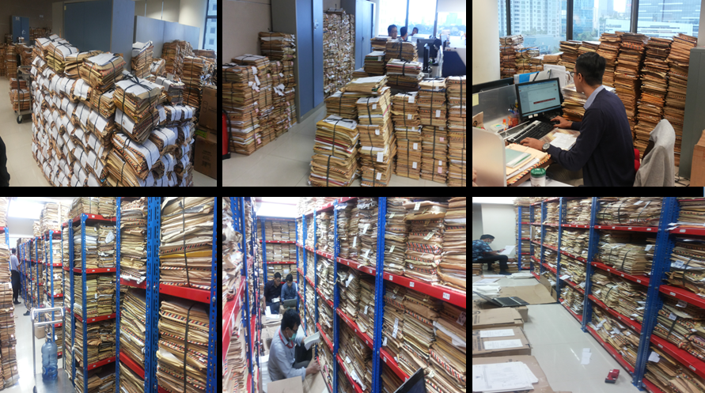
“Handling” Asset Declaration
CEC RI, 2009
On The Guidelines of Conflict Interest for Public Official

Slide 7
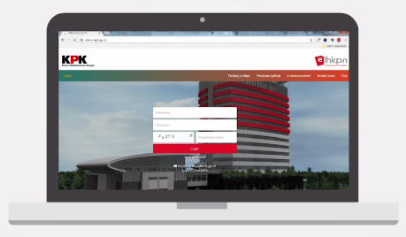

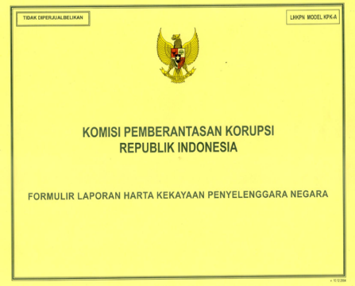
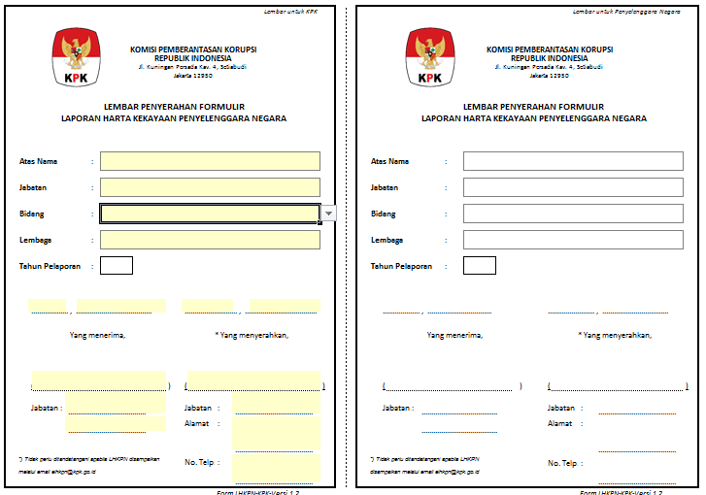
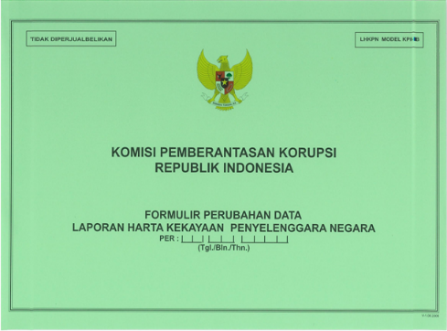
Changes in Reporting Method
Online system
Online system reporting
PAPER-BASED
Excel Format
Divided into 2 forms
Transition period before applying online system

Slide 8

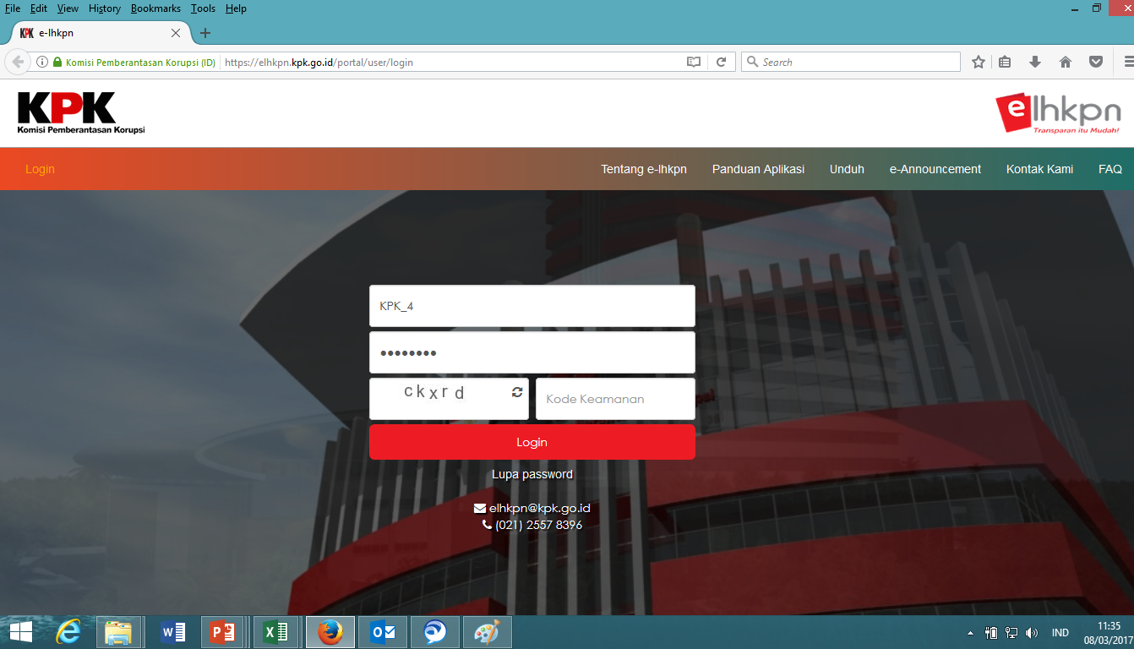
When to Submit ?
Asset*
Regular Declaration
Annual → Jan 1st –March 31st
Liability
Expenditure
Income
Special Declaration
Max. 3 month after Occupied/Leaved the post
Candidates for Election (Legislatives & Presidential)

Slide 9
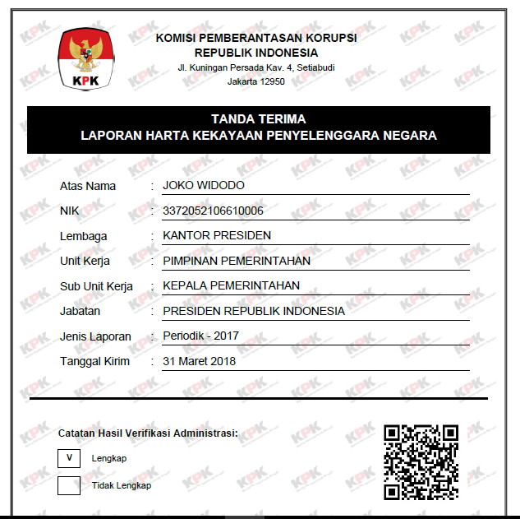
Business Process of Registration
01
02
03
04
Submit Online
Public officials submit the report by online
Including the attachments documents
Except Power of Attorney
Verification
To ensure the completeness of required documents
To reduce any typo that leads to information inaccuracy
Receipt Form
(completion status)
Incomplete reports will be returned to Public Officials
Announcement of Asset Declaration
Can be accessed online by public through e-announcement

Slide 10
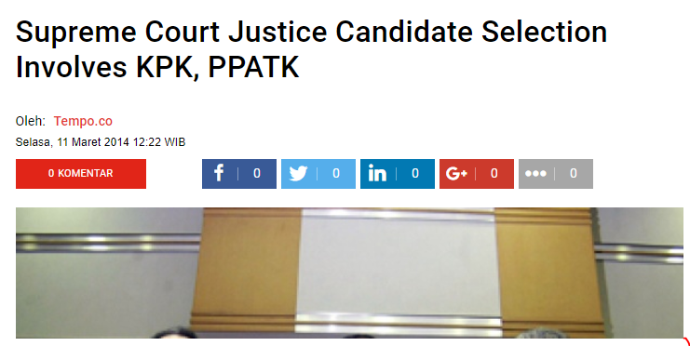
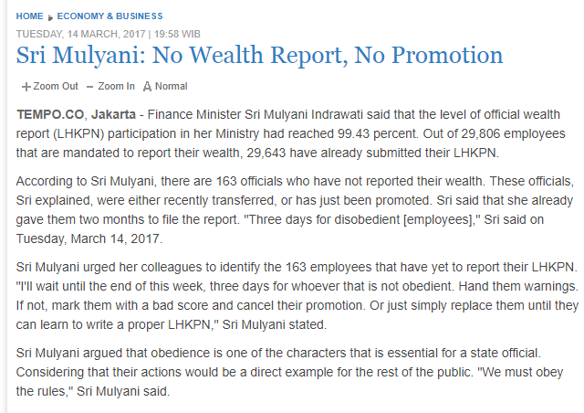
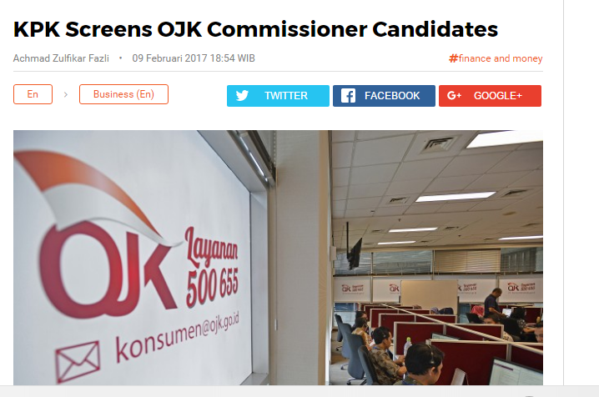


Slide 11
Impacts of Wealth Reporting throught the online website
01
To build the atmosphere of accountability and transparency
1
2
To identify potential conflict of interests
Accountability& Transparency
Detection
02
Impacts
To detect early illicit enrichment
Prevent COI
To build Public Officials with high integrity standard and gain public trust
Integrity
3
4
Notes:
to discourage attempts to conceal assets
COI
Illicit Enrichment
Integrity = Gain Public Trust

Slide 12
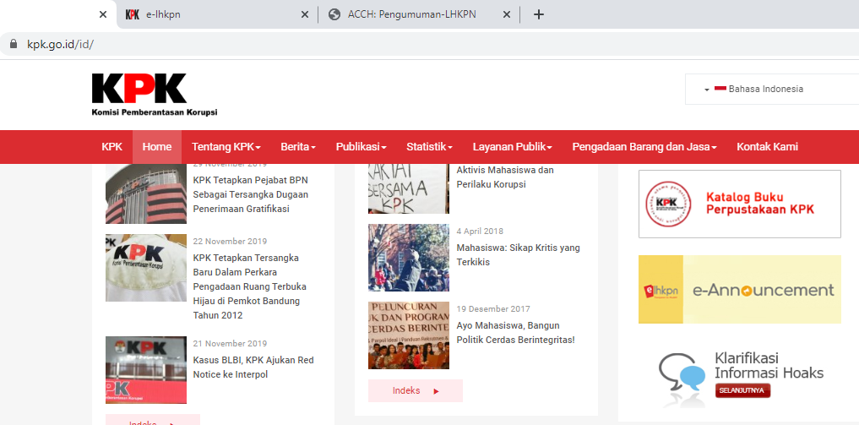
02
Notes:
to discourage attempts to conceal assets
COI
Illicit Enrichment
Integrity = Gain Public Trust

Slide 13
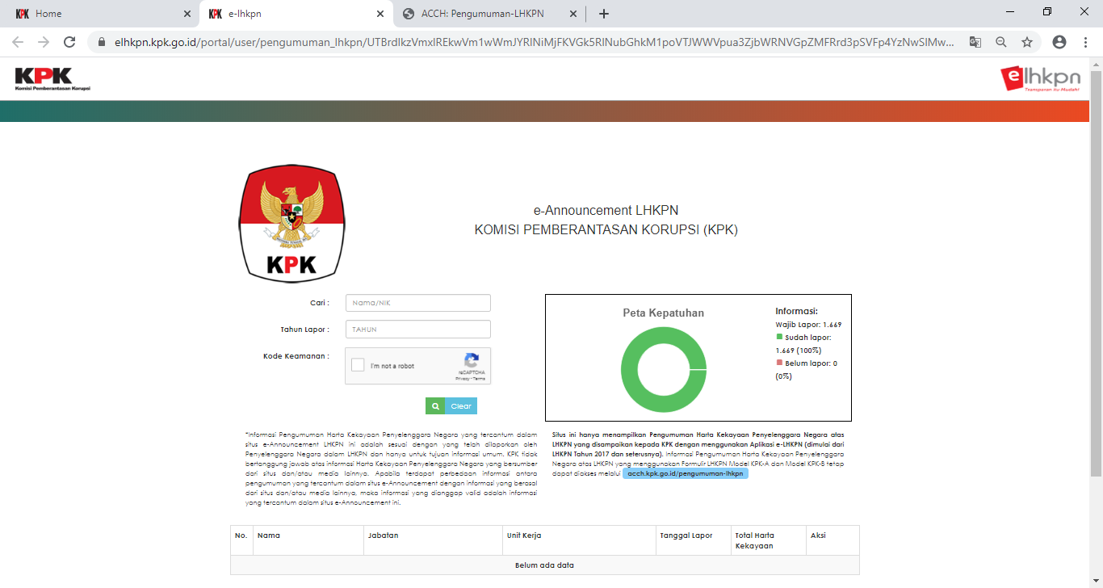
02
Notes:
to discourage attempts to conceal assets
COI
Illicit Enrichment
Integrity = Gain Public Trust

Slide 14
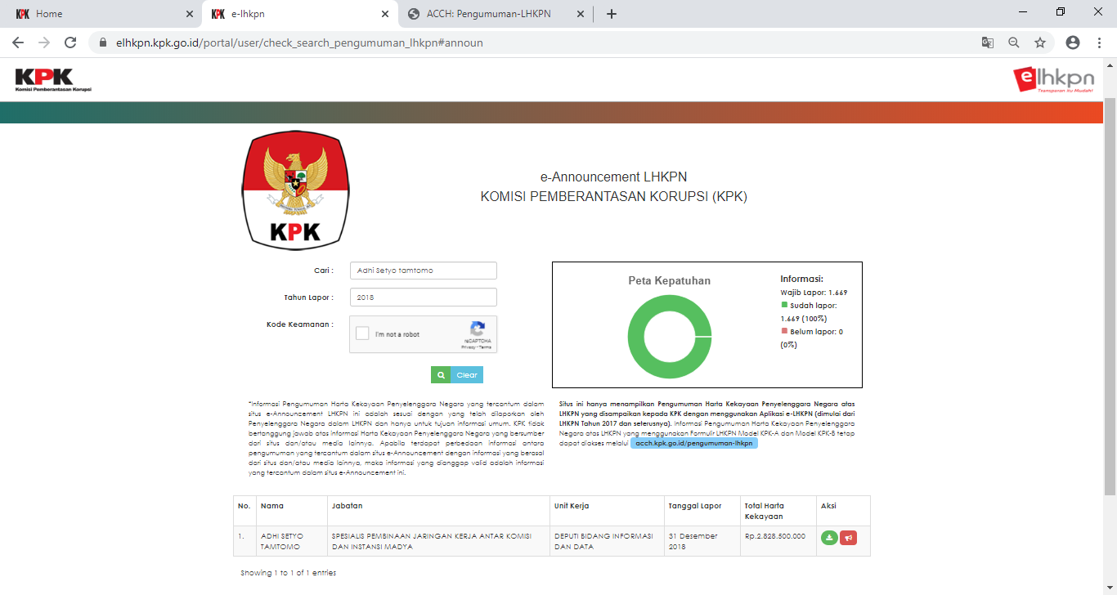
Notes:
to discourage attempts to conceal assets
COI
Illicit Enrichment
Integrity = Gain Public Trust

Slide 15
TOTAL:
364.172
Visitors to the website
43.338
on July, 2019
74.422 on August, 2019
75.996 on Oct, 2019
66.494 on Sept, 2019
52.698 on Nov 2019
51.224
on Des 2019
02
Notes:
to discourage attempts to conceal assets
COI
Illicit Enrichment
Integrity = Gain Public Trust

Slide 16
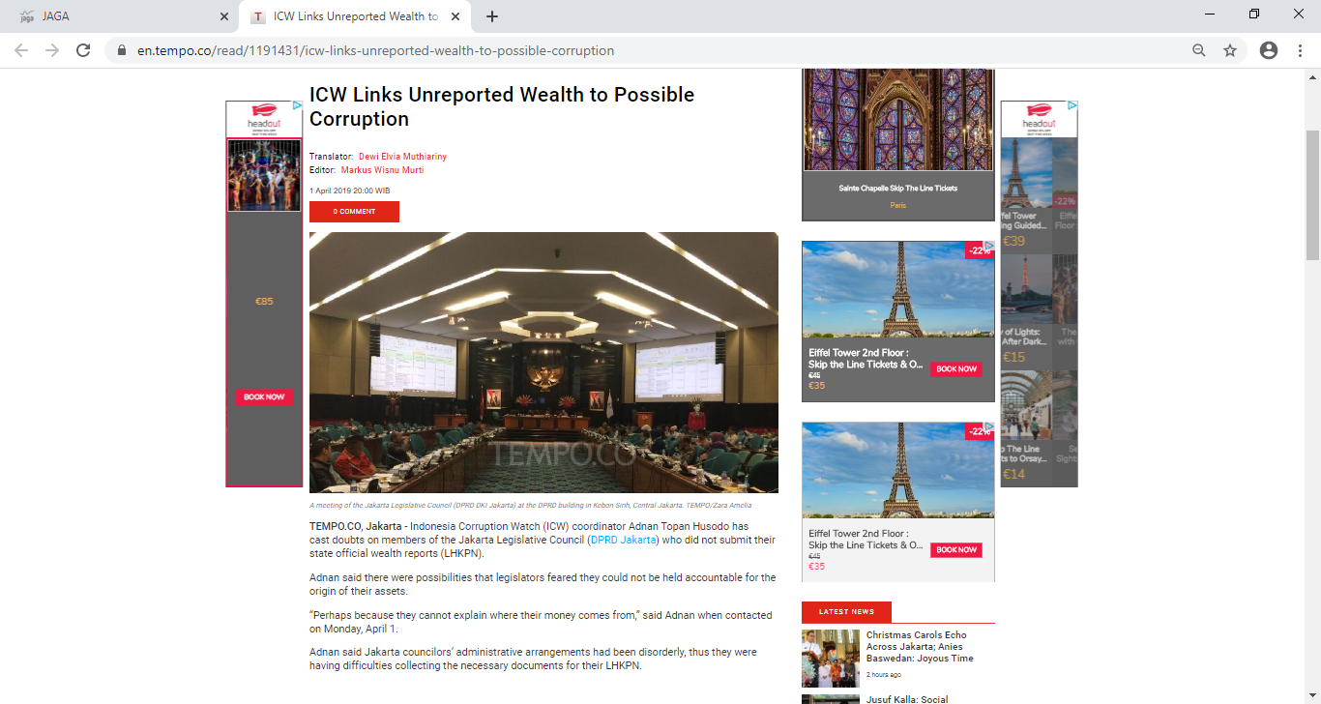
02
Notes:
to discourage attempts to conceal assets
COI
Illicit Enrichment
Integrity = Gain Public Trust

Slide 17

Adhi Setyo Tamtomo
Adhi.Tamtomo@kpk.go.id
+62 815 998 2287

Slide 18
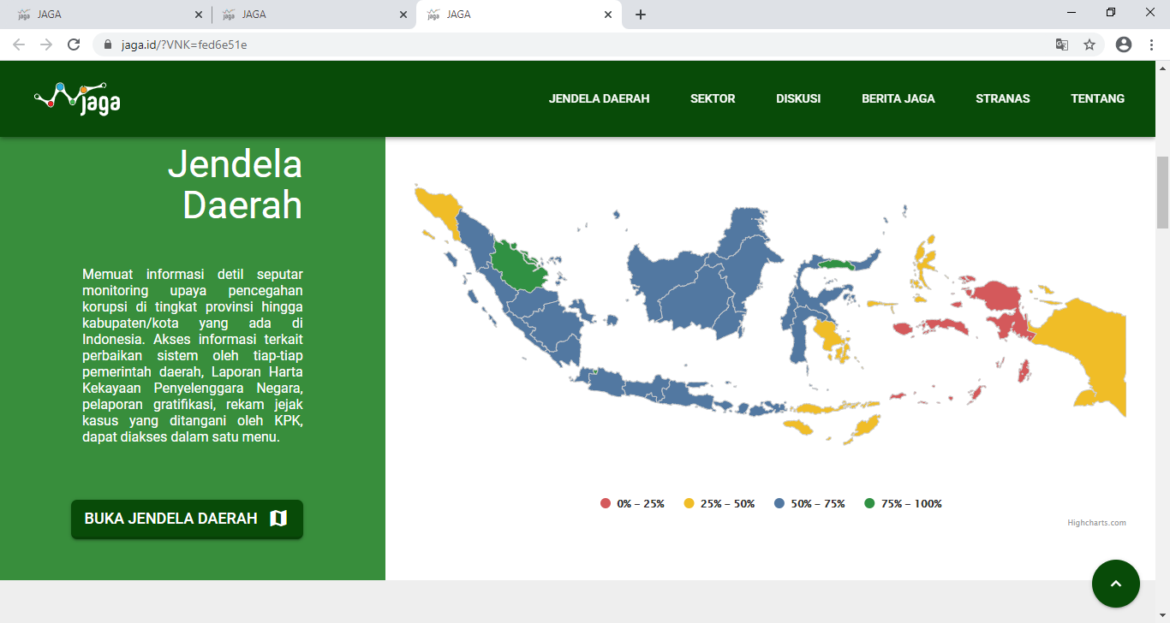
02
Notes:
to discourage attempts to conceal assets
COI
Illicit Enrichment
Integrity = Gain Public Trust

