Slide 1

MAKING TRANSPARENCY WORK: TECHNOLOGY-DRIVEN APPROACHES TO FACILITATE PUBLIC ACCESS TO INFORMATION
PUBLIC INFORMATION | OPEN DATA | CITIZENS PARTICIPATION | SERVICE DELIVERY

Slide 2
Chain of Procurement Monitoring Activities
Budeshi Data Entry
Budeshi Waka
FOI Request
Project Monitoring
Feedback
Using data from Budeshi platform we embark on monitoring exercise and Budeshi Waka afterwards

Slide 3
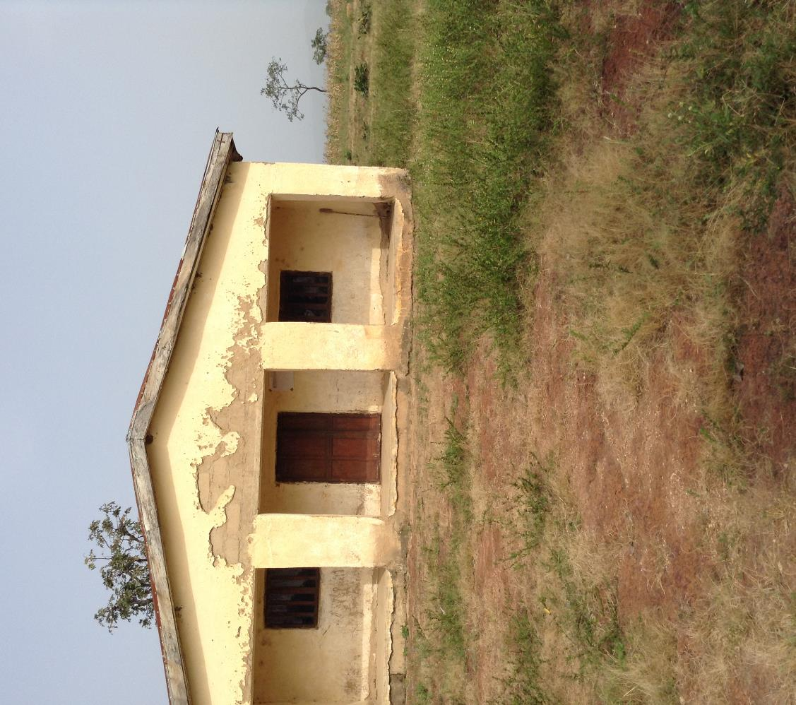



WHAT WE REQUEST FOR?
In the Freedom of Information requests sent to public institutions,
PPDC requests for the following information
Records of payments of capital projects
released for the previous year
Data Gathering
List of contracts awarded by the institution
Procurement plans for the current year

Slide 4

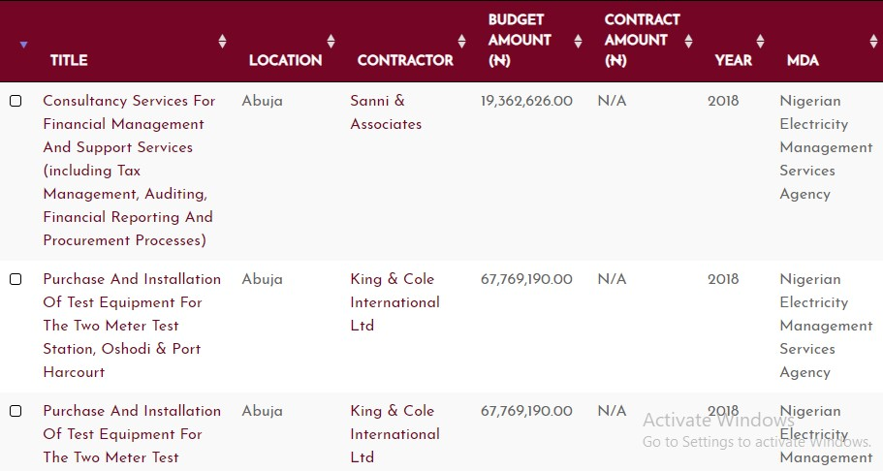
Upload data on Budeshi
Budeshi is an Open Contracting platform that demonstrates the Open Contracting Data Standard (OCDS)
What We Do With The Data
Embark on Monitoring Excercise
Using data from Budeshi, our procurement monitors visit project sites to verify conformance to provided information.

Slide 5
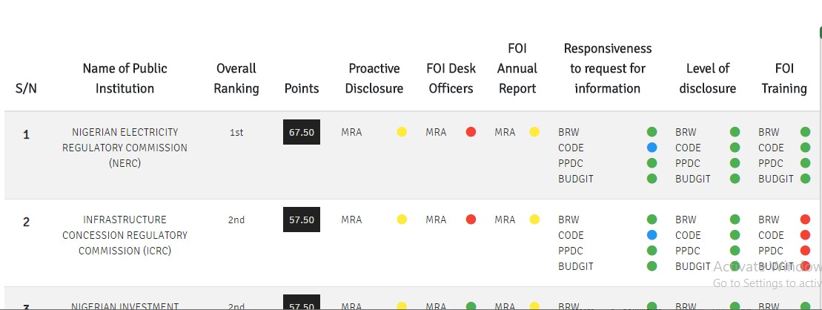
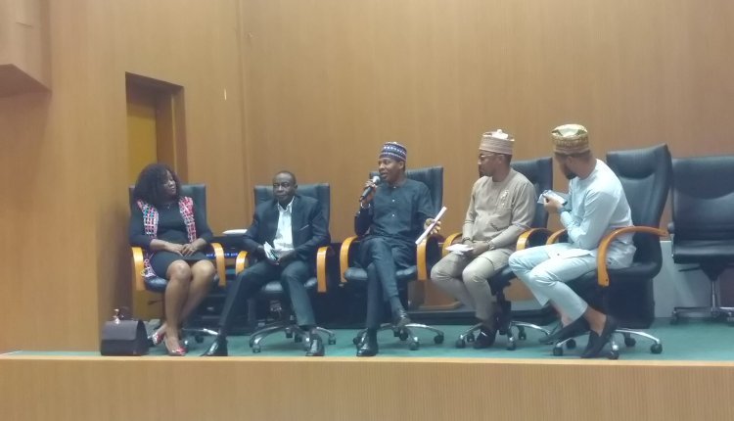
FOI Compliance and Transparency Ranking
PPDC ranks public and security institutions based on their compliance with the FOI Act 2011

Slide 6
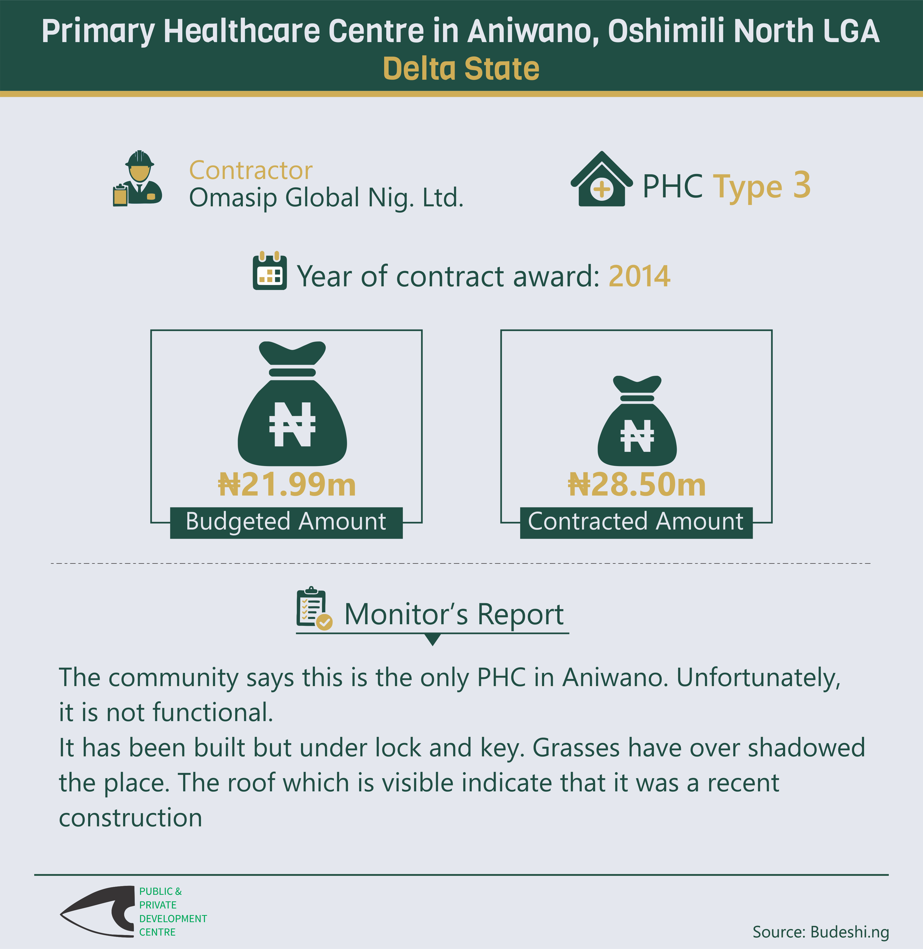
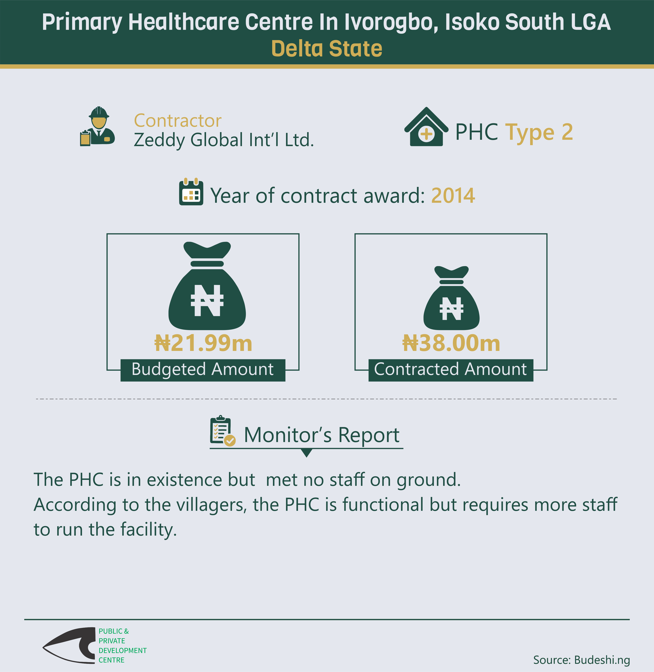
Delta State
Contract Details and Monitor’s Report

Slide 7
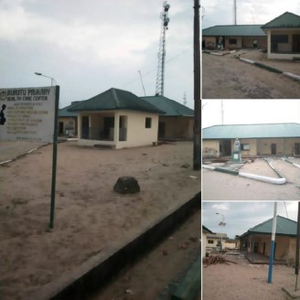
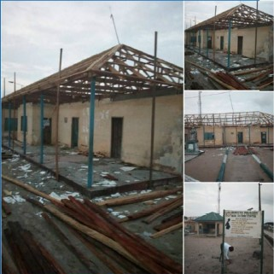
BURUTU CASE STUDY
BEFORE
AFTER

Slide 8

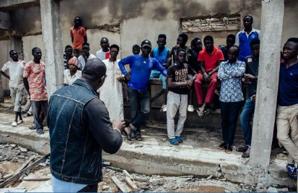
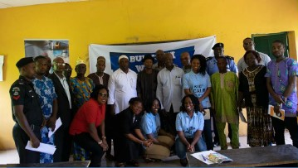
CITIZENS ENGAGEMENT
BAUCHI TOWN HALL MEETING
EDO TOWN HALL MEETING

Slide 9
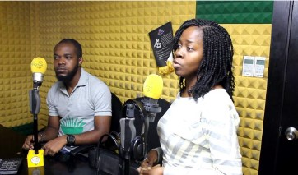
HOW WE ENGAGE
Send reports to relevant agencies
Engage the public through TV, radio programs and social media
Train public institutions about open data
Produce Documentaries

Slide 10

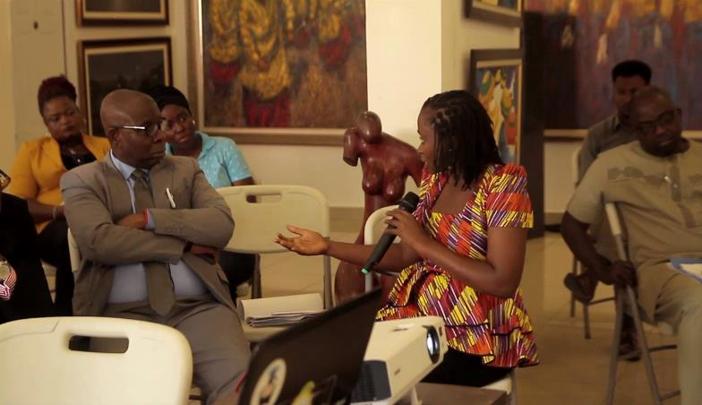

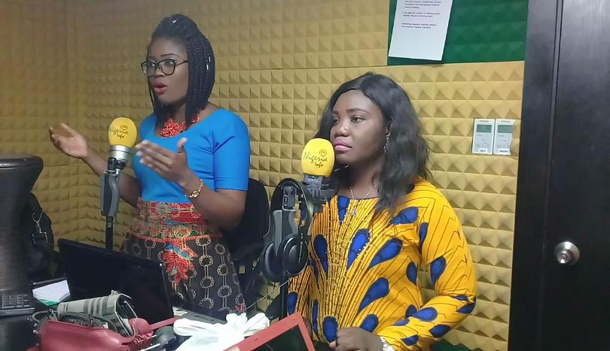
FEEDBACK
M E C H A N I S M S

Slide 11

THANK YOU
www.procurementmonitor.org
www.budeshi.ng

