Slide 1
UNCAC Chapter II Overview
Prevention of Corruption under the United Nations Convention against Corruption
8-10 April 2019
Addis Ababa

Slide 2

United Nations Convention against Corruption
Chapter II
Preventive
measures
Chapter III
Criminalization &
Law Enforcement
Chapter V
Asset Recovery
Chapter IV
International
Cooperation

Slide 3
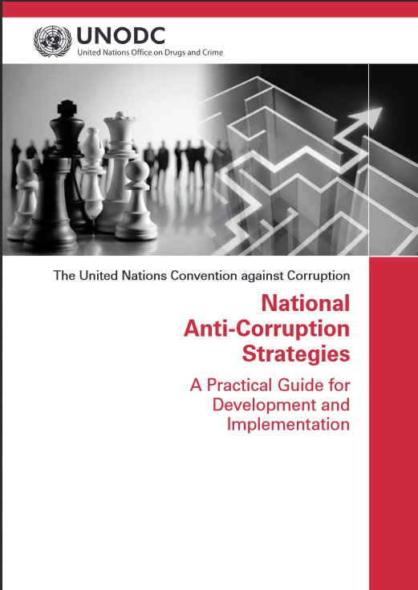
Preventive anti-corruption policies and practices (Article 5)
A general provision requiring States to take an effective and coordinated approach to the prevention of corruption.
Anti-Corruption Policies must promote the participation of society, reflect the rule of law and promote the proper management of public affairs and public property.

Slide 4

Preventive anti-corruption body or bodies (Article 6)
States must ensure the existence of a body or bodies that prevent corruption with sufficient independence, resources and staff to carry out their functions.
Measures they may take include implementing anti-corruption policies and increasing and disseminating knowledge about prevention of corruption.

Slide 5
Recruitment, Management and Training of Public Officials (Article 7)
Adequate procedures for recruitment, selection and
training of officials. Special measures for “high-risk” areas.
Adequate remuneration and equitable pay scales.
Education and training programmes, including specialized anti-corruption training.
Consider measures to enhance transparency in funding of political parties and candidates.

Slide 6
Conflicts of Interest, Codes of Conduct and
Asset Declarations (Articles 7 and 8)
National Implementation
Application of prohibitions and restrictions to public officials.
Specialised codes of conduct for “high risk” areas.
Proactive measures to resolve conflict of interests.
Centralised bodies for the enforcement of conflict of interests and asset declaration standards.

Slide 7
Case Study: Country A’s Asset Declaration System
Introduction of Computerised Financial Declaration System in 2000 with significant benefits:
    Higher level of compliance with declaration requirements
    (from 67% to 96%).
    Improved access to FDS forms: requests via Internet (66 to 823).
    Drastic reduction of operative costs (from 70$ to 8$ per form).
    Increased capacity to analyze and investigate (from 40 to 321).
    Significant reduction of paper work.
    More access for all people.

Slide 8
Public Procurement and Management of Public Finances (UNCAC Article 9)
UNCAC Requirements
Public distribution of information so potential tenderers can prepare and submit applications.
Use objective and predetermined rules and criteria for public procurement systems.
Effective system of domestic review, appeal and remedies where rules not followed.
Specialised training and declaration requirements for staff responsible for public procurement.

Slide 9
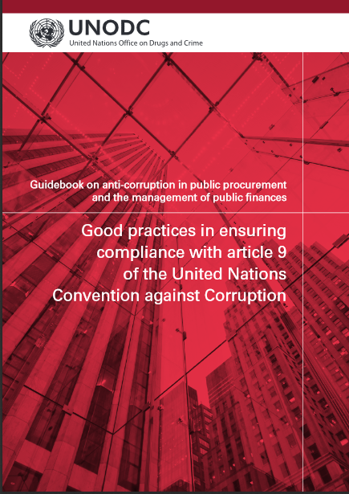
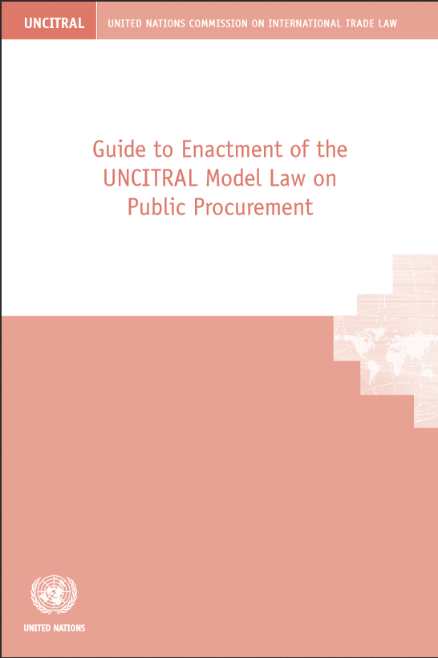
UNODC publication : UNCITRAL model law :

Slide 10
Transparency and Efficiency in Public Administration (Article 10)
UNCAC Requirements
Take measures to enhance transparency in public administration including:
Public access to information on organisation, functioning and decision-making processes.
Simplifying administrative procedures.
Publishing information on the risk of corruption in public administration.

Slide 11
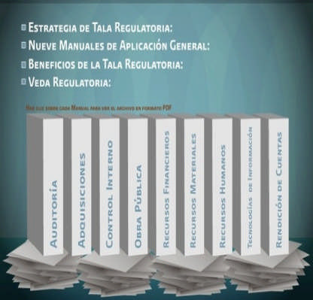
Case Study: Country B’s Administrative Regulatory Guillotine
Inventory of rules: 34,457
Reduction of 47% of obsolete rules
16,261 rules were eliminated
More than 10 thousand administrative rules were standardized
Cost Savings
$5 billion
Equivalent to:
28% of Annual Education Budget
81% of Annual Social Programs Budget
9 Administrative Handbooks

Slide 12
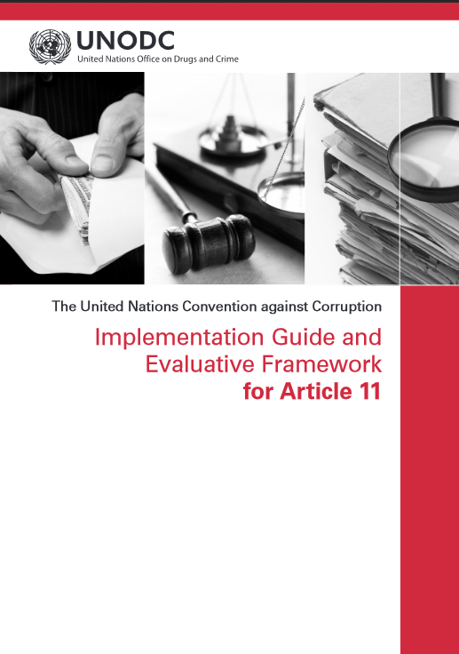
Judicial and Prosecutorial Integrity (Article 11)
Convention’s Requirement: Strengthen integrity and prevent opportunities for corruption among judiciary.
Judiciary with integrity essential but often seen as most corrupt.
Bangalore Principles on Judicial Conduct.
Implementation Guide for Article 11 .

Slide 13
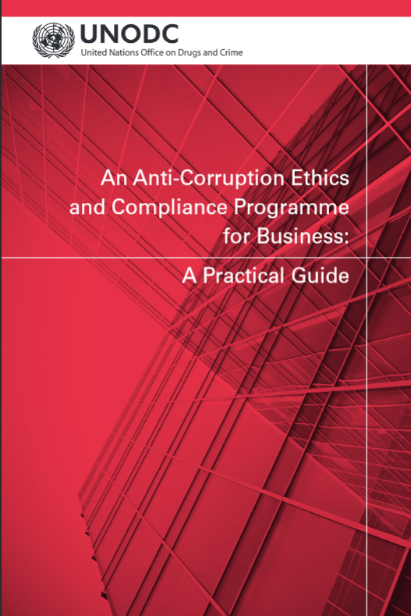
Private Sector (Article 12)
States required to take measures to prevent corruption involving the private sector, enhance accounting standards and apply appropriate penalties when measures are breached.
Examples of the types of measures that can be taken:
  Promote cooperation between law enforcement agencies and the private sector.
  Promote the development of standards designed to safeguard integrity of relevant private entities.
  Promote transparency in the identity of legal and natural persons.

Slide 14

Participation of Society (Article 13)
Art.13 recognizes the important role of civil society in the prevention of corruption.
State Parties required to:
  take measures to promote the active participation of individuals and groups outside the public sector in the prevention of, and fight against, corruption.
  raise awareness as to the causes and effects of corruption.

Slide 15

Participation of Society (Article 13)
4 measures which it is recommended that States include in efforts to engage civil society in corruption prevention:
(a) Enhance transparency of and public contribution to decision-making processes.
(b) Ensure that the public has access to information.
(c) Public Information activities and public education programmes.
(d) Respect, promote and protect freedom to receive, publish and disseminate information on corruption.

Slide 16





Case Study: Country C’s Transparency Portal
Established in 2004 to provide enhanced access to public expenditure information to the public.
Information covered includes:
    Spending of the federal government through tender processes or direct contracts
    All transfers to states, municipalities and the federal district
    All transfers to citizens benefiting from social programs.
    Spending of each body and agency on travel allowances, salaries office supplies, equipments, projects and services contracted.

Slide 17
Anti-Corruption Awareness-Raising Activities
Diversity in awareness-raising activities which should be tailored to the specific needs of the country. Ex.:
Malaysia: Television drama of successful corruption investigation.
Jordan: Radio series regarding integrity in public life, including the impact of corruption on women.
Civil Society Participation
i.e. contributions by civil society to developing and monitoring the implementation of national anti-corruption strategies

Slide 18
Measures to prevent money-laundering (Article 14)
Requirement that States institute a comprehensive regulatory and supervisory regime for banks and non-bank financial institutions
States should consider measures to detect and monitor the movement of cash and financial instruments
States should develop and promote global, regional and subregional cooperation.

Slide 19
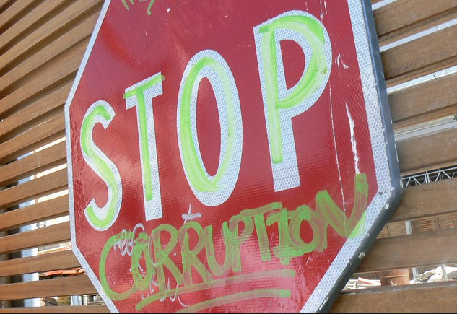
Thank you!
For further information:
Corruption and Economic Crime Branch
P.O.Box 500 Vienna
A-1400 Austria
Tel: +43-1-26060-4913
Fax: +43-1-26060-5841
www.unodc.org/corruption

