Slide 1
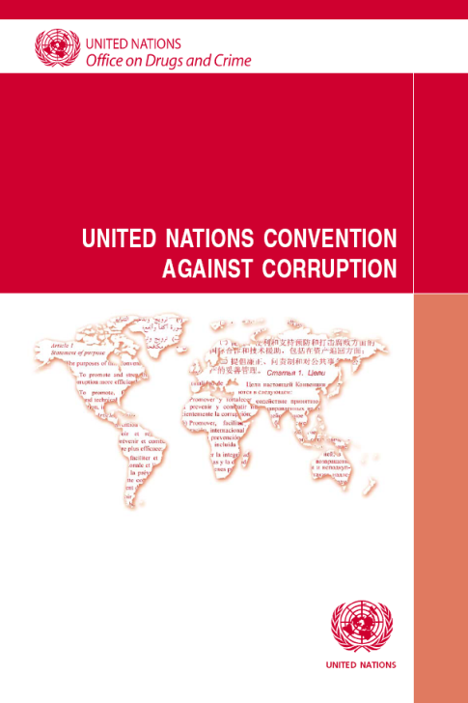
The United Nations Convention against Corruption and its Review Mechanism

Slide 2
General information related to the Convention
Decision-making bodies
Implementation Review Mechanism
Self-assessment checklist
Tools to assist in the reviews

Slide 3
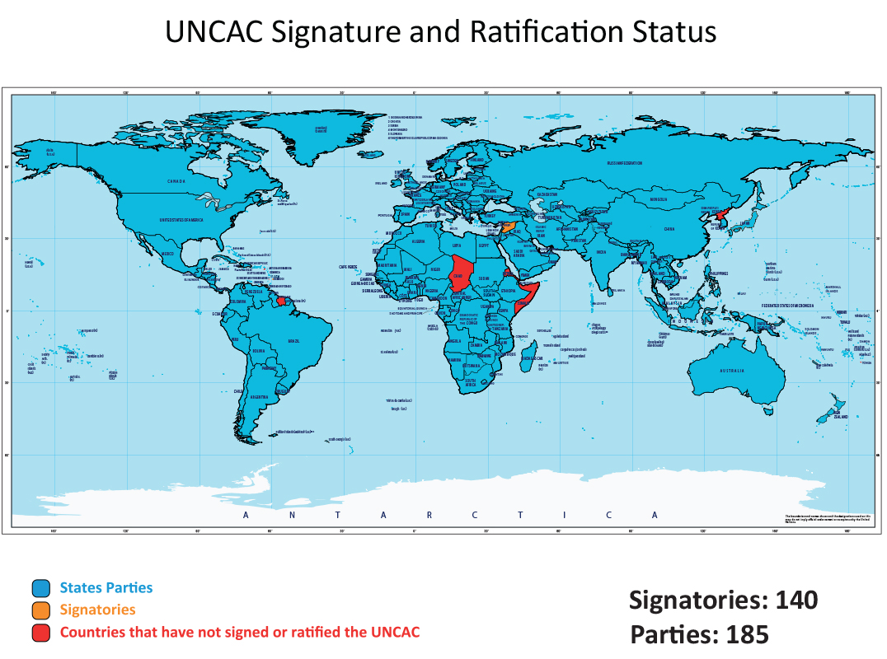
The United Nations Convention against Corruption
Adopted by the General Assembly: Resolution 58/4, 31 October 2003
Entry into Force: 14 December 2005
186
Notes:
3

Slide 4

The United Nations Convention against Corruption
Preventive
measures
Criminalization
and law
enforcement
Asset recovery
International
cooperation

Slide 5
Levels of obligation
1. Mandatory provisions
Each State Party shall disallow the tax deductibility of expenses that constitute bribes […] (art. 12, para. 4)
2. Obligation to consider/endeavour to adopt
Each State Party shall consider taking, in accordance with the fundamental principles of its domestic law, disciplinary or other measures against public officials who violate the codes […] (art. 8, para. 6)
3. Optional provisions
Where appropriate, States Parties may also give special consideration to concluding agreements or mutually acceptable arrangements, on a case-by- case basis, for the final disposal of confiscated property (art. 57, para. 5).

Slide 6
General information related to the Convention
Decision-making bodies
Implementation Review Mechanism
Self-assessment checklist
Tools to assist in the reviews

Slide 7
The Conference of the States Parties (art. 63)
CoSP 7
Nov. 2017
Austria
Promote and review implementation
Make recommendations
Facilitate information exchange
CoSP 6
Nov. 2015
Russian
Federation
CoSP 5
Nov. 2013
Panama
CoSP 4
Oct. 2011
Morocco
CoSP 3
Nov. 2009
Qatar
CoSP 2
Jan 2008
Indonesia
CoSP 1
Dec 2006
Jordan

Slide 8
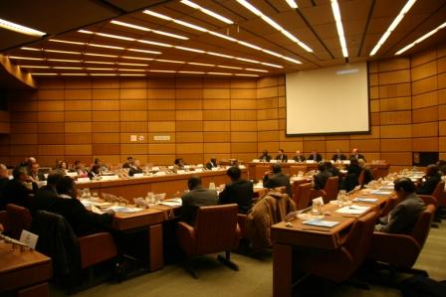
Subsidiary bodies to the
Conference of the States Parties
Implementation Review Group
Open-ended Intergovernmental Working Group on Prevention
Open-ended Intergovernmental Working Group on Asset Recovery
Open-ended intergovernmental expert meetings to enhance international cooperation under the Convention

Slide 9
General information related to the Convention
Decision-making bodies
Implementation Review Mechanism
Self-assessment checklist
Tools to assist in the reviews

Slide 10
The Implementation Review Mechanism
Art. 63, para. 7:
[…] the Conference of the States Parties shall establish, if it deems it necessary, any appropriate mechanism or body to assist in the effective implementation of the Convention.

Slide 11
Working Group for Review of Implementation - Implementation Review Group
Established by the Conference at its first session (Jordan, 2006)
Tasked with preparing terms of reference of a review mechanism at the second session of the Conference (Indonesia, 2008)
Implementation Review Mechanism established at the third session of the Conference (resolution 3/1, Doha, 2009)

Slide 12
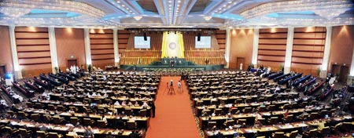
Third session of the Conference of the States Parties
Doha, from 9 to 13 November 2009
Resolution 3/1:
Establishes the Implementation Review Mechanism
Contains the terms of reference for the Mechanism
Based on the outcome of the deliberations in the Implementation Review Group

Slide 13
Overview of the Terms of Reference
Peer review process
Drawing of lots for each year of the review cycle
Each phase = two cycles of five years (2010-2015; 2016-2021)
  First cycle: Chapters III (Criminalization and law enforcement); and IV (International cooperation)
  Second cycle: Chapters II (Preventive measures); and V (Asset recovery)

Slide 14
Goals of the Mechanism: (para. 11, TORs)
Assist States parties in their implementation of the Convention
Help States parties to identify and substantiate specific needs for technical assistance and to promote and facilitate the provision of technical assistance;
Promote and facilitate international cooperation in the prevention of and the fight against corruption, including in the area of asset recovery;
Promote and facilitate the exchange of information, practices and experiences gained in the implementation of the Convention;

Slide 15

Guiding principles
Non adversarial/ non punitive/ no rankings
Opportunity to share good practices and challenges
Assist States in implementing the Convention
Balanced geographical approach
Technical/ Intergovernmental nature
Complement existing review mechanisms
Diversity of legal systems and levels of development
Confidentiality

Slide 16

Stages of the review
1) Self-assessment
2) Desk review
3) Dialogue between State under review and reviewing States
4) Direct dialogue (country visit or joint meeting)
5) Final review report and executive summary
What is the timeframe?
Role of the Secretariat
Civil society

Slide 17
Module schedule for country reviews – Start: 29 June 2019
Within 3 weeks
(20 July)
Within 1 month
(29 July)
Within 2 months
(29 August)
Preferably within 5 months
(29 November)
Within 6 months
(29 December 2019)
State under review nominates focal point
Deadline for reviewing expert nominations: 6 July
Secretariat organizes tele/videoconference:
Submission of SACL
Language of review
Division of labour
Active dialogue
State under review
submits self-assessment
Within 1 month
(29 September)
Secretariat circulates checklist to reviewing experts, after translation
Within 1 month
(29 October)
Reviewing experts submit
outcome of the desk review
Secretariat organizes tele/video conference to introduce
outcome of the desk review
Dialogue: up to
2 months
(until 29 December 2018)
Reviewers prepare draft country report assisted by secretariat, State under review agrees to final report, executive summary is prepared
State under review organizes direct dialogue, facilitated by secretariat
(joint meeting or country visit)
End of review

Slide 18
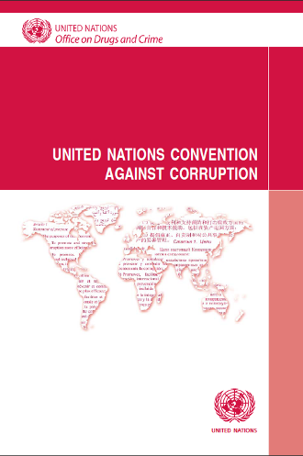
Looking forward
First cycle: moving towards completion
  164 executive summaries now completed and available
  More are nearing finalization
Second cycle: Prevention and Asset Recovery
  Launch of 2nd cycle – start of reviews: 4 July 2016
  Development of expertise and good practices in these areas
  Lessons learned from first cycle

Slide 19
General information related to the Convention
Decision-making bodies
Implementation Review Mechanism
Self-assessment checklist
Tools to assist in the reviews

Slide 20

Documents for the Review Mechanism
Convention
COSP resolutions
Terms of Reference of the Review Mechanism
Guidelines for Governmental experts and the
Secretariat
Blueprint for country review reports and executive summaries
Guidance document for filling in self-assessment checklist
Executive Summaries and other documents available on UNODC Website:
http://www.unodc.org/unodc/en/treaties/CAC/country-profile/index.html

Slide 21
General information related to the Convention
Decision-making bodies
Implementation Review Mechanism
Tools to assist in the reviews

Slide 22

The self-assessment checklist
Used in the first cycle
Adapted for the second cycle and approved by the Implementation Review Group in June 2016
Parts to be answered: General information, chapters II and V
Available for download from our website: http://www.unodc.org/unodc/en/treaties/CAC/self-assessment.html
Also available:
Self-assessment checklist as PDF document
Guidance notes

Slide 23
1. Is your country in compliance with this provision?
Yes/Yes, in part/No
2. Please describe (cite and summarize) the measures/steps your country has taken, if any, (or is planning to take, together with the related appropriate time frame) to ensure full compliance with this provision of the Convention.
3. Please provide examples of the implementation of those measures, including related court or other cases, available statistics etc.
Question flow in the
self-assessment checklist

Slide 24
Additional resources:
Travaux préparatoires
Legislative Guide
Technical Guide
State of implementation report
Additional tools
  (e.g. art. 11, StAR Initiative
  documents)

Slide 25

For further information:
Corruption and Economic Crime Branch
United Nations Office on Drugs and Crime
P.O.Box 500 Vienna
A-1400 Austria
Tel: +43-1-26060-4913
Fax: +43-1-26060-5841
http://www.unodc.org/unodc/en/corruption/implementation-review-mechanism.html

