Slide 1

UNCAC Coalition:
An introduction
Gillian Dell, gdell@transparency.org
UNCACCoalition.org

Slide 2

About the Coalition
A global network of over 100 CSOs and individual members and an additional 200+ groups in its wider network in more than 100 countries founded in 2006.
Coordination Committee of 12 members – two international, eight regional, two individual
Committed to the use of the UN Convention against Corruption (UNCAC) to combat corruption. Ratification, implementation and monitoring.
Facilitate exchange of information among Coalition members and mobilise civil society action at international, regional and national level.
Registered in Austria as an association since 2015
Secretariat provided since mid-2018 by the Vienna Hub – team is here

Slide 3
The Coalition’s Objectives
Increased transparency and participation at national and international levels
Promoting the right of access to information
Gaining recognition of grand corruption as an international crime
Increasing asset recovery and transparency and accountability in the return of assets
Improving beneficial ownership transparency and anti-money laundering
Ensuring full recognition that corruption is not a victimless crime
Establishing a formal follow-up mechanism on UNCAC implementation reviews.

Slide 4
Our methods of work
Capacity building
Research and analysis
Coalition-building & collective action
Advocacy

Slide 5
Civil Society and UNCAC Processes
UNCAC Article 13
International level
  Exclusion from COSP subsidiary bodies
  Tight regulation of materials
  Exclusion of NGOs based on objections
National level
  Optional inclusion in reviews
  “Transparency Pledge”
  Guide to Transparency and Participation in the UNCAC Review Process

Slide 6
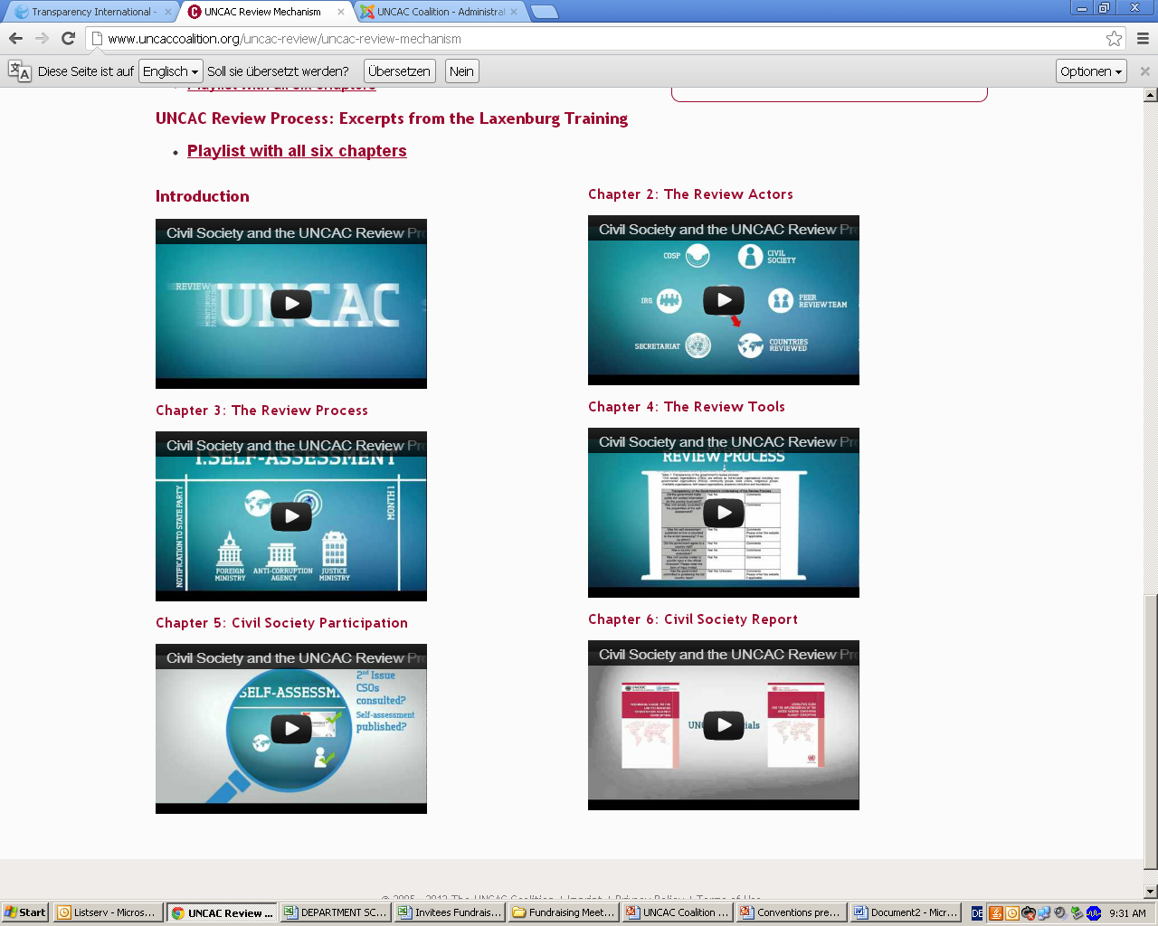
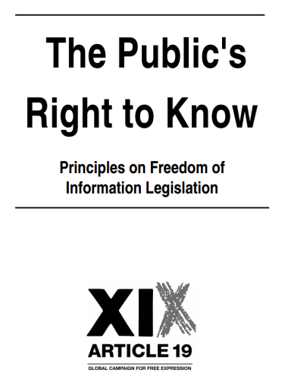
Achieving increased transparency and participation
The challenges:
  Review mechanism flawed, compromises
  Insufficient access to information on
  review process, statistics & cases, official reports
  The approaches:
National level: awareness-raising & advocacy for
transparency & participation
“Transparency Pledge” & Guidance
Global level: advocacy on observer status
Reporting on results

Slide 7
Achieving increased transparency and participation
Transparency Pledge
As UNCAC States Parties, we hereby reaffirm the importance of transparency and public consultation in addressing corruption. We believe civil society can play a crucial role in preventing and combatting corruption in our country. We believe civil society can contribute to successful implementation of UNCAC provisions, therefore we commit ourselves to follow the six Principles of Transparency during the second cycle of the UNCAC review process.
Principles of Transparency
We will publish updated review schedules for our country review
We will share information about the review institution or the coordinator (focal point)
We will announce the completion of the country review indicating where the report can be found
We will promptly post online the self-assessment and the full country report in a UN language, together with the executive summary in local languages
We will organise civil society briefings and public debates about the findings of the report
We will publicly support participation of civil society observers in UNCAC subsidiary bodies
Countries: Belgium, Bulgaria, Cyprus, France, Germany, Italy, Latvia, Lebanon, Mexico, Norway, Peru, Poland, Portugal, Slovenia, Spain, Sweden, United Kingdom, United States

Slide 8
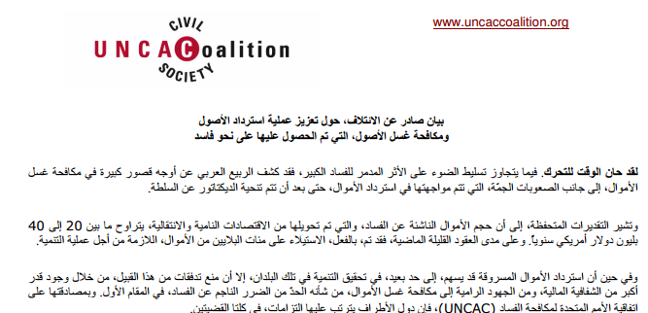
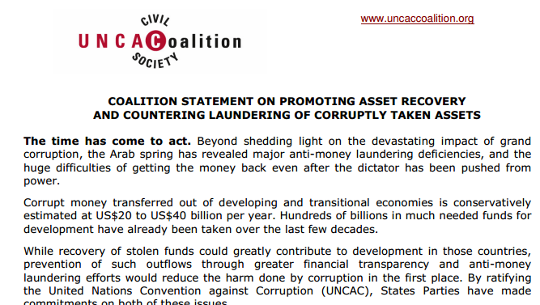
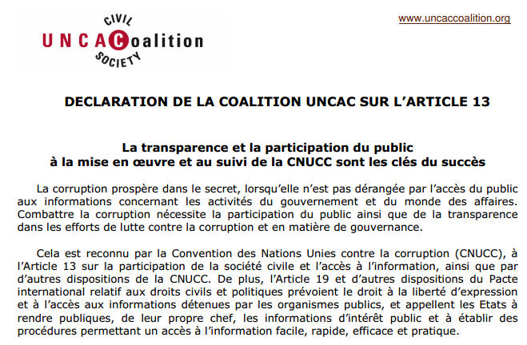
Anti-money laundering and asset recovery
The challenges:
  Weaknesses in legal and institutional framework
  Lack of international cooperation
  Accountable asset return
  The approaches:
Coordinating joint messaging and advocacy towards Conference of States Parties & other meetings
Sharing information among groups in different countries

Slide 9
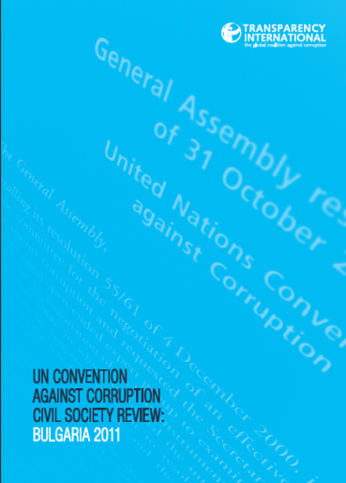
Assistance to CSOs in the 2nd cycle of the UNCAC review process
The challenges:
  National CSOs may not know how and why to contribute
  Lack of access to relevant information about process
  Lack of access to relevant information about performance
  Government difficulties seeing civil society role
  Lack of follow-up to reviews
  The approaches:
Support to national level: research, analysis, dialogue and advocacy
  Training, in-person and via videos
  Templates & guidance materials
  Pro bono assistance
Global level: multi-country analysis & advocacy on key weaknesses

Slide 10
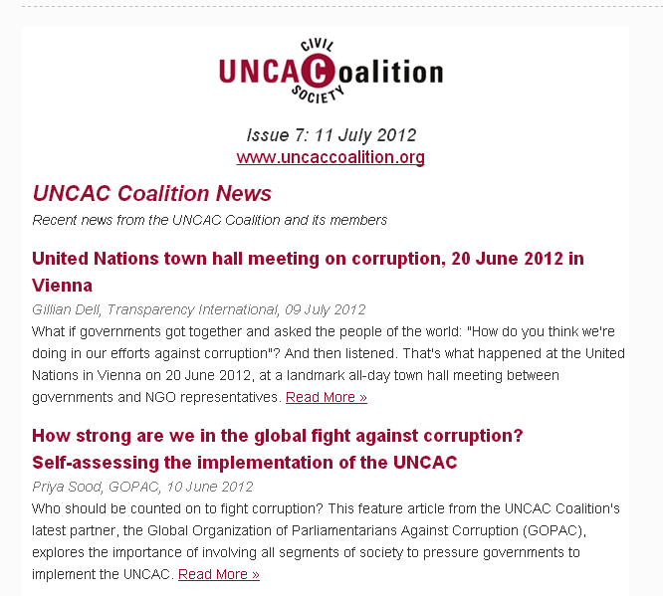
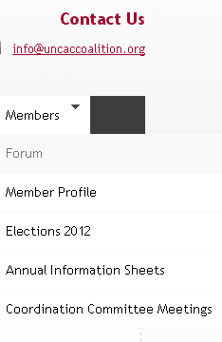
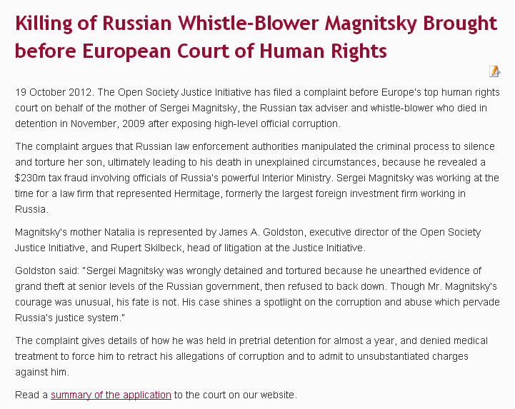
UNCAC Coalition communications
  Website: www.uncaccoaliton.org
  (articles, blog, resources, members’ zone)
  Listserv (closed email group)
  Social media
    Twitter @UNCACCoalition

Slide 11
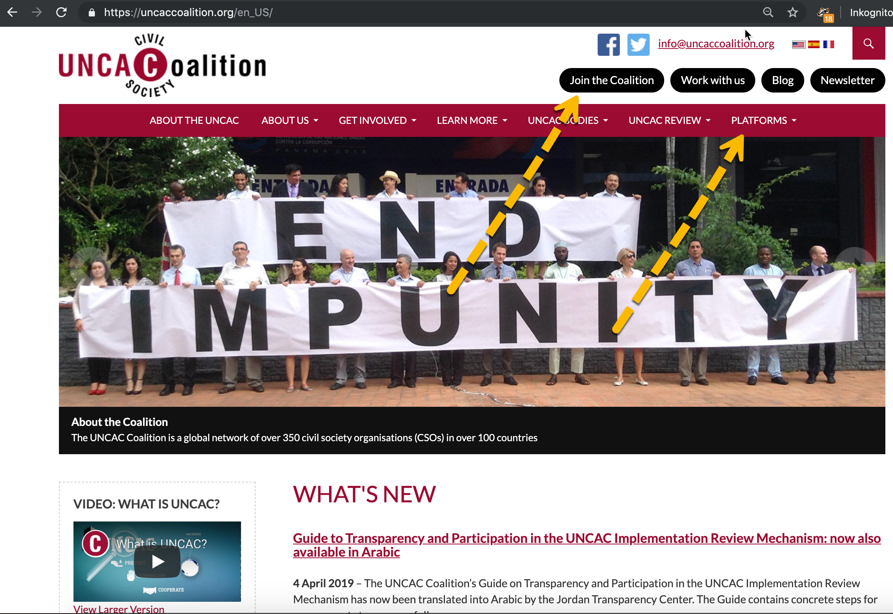

Slide 12
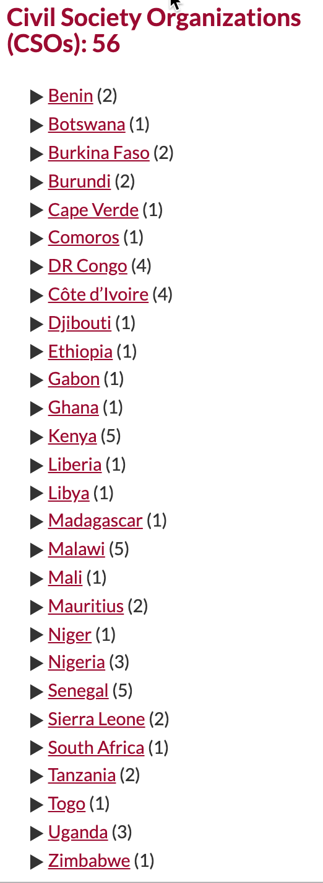
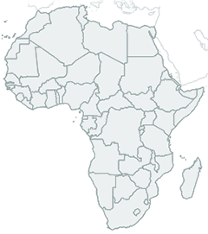
UNCAC Coalition communications
  Website www.uncaccoaliton.org
  Regional
  Anti-Corruption Platforms
    Africa
    Southeast Asia
    Southeast Europe
    To join platform:
    https://uncaccoalition.org/en_US/anti-corruption-platforms/africa/

Slide 13
COSP Objectives
Priority anti-corruption issues and proposals for action are put on the international agenda
The COSP adopts resolutions that clarify and highlight targets for national anti-corruption performance in key priority areas and strengthen the UNCAC review mechanism. Priority areas include: access to information, beneficial ownership transparency, accountable asset return, review process.
Strategic partnerships are forged with policymakers, IGOs and NGOs to promote consensus and action around priority issues
CSOs, policy-makers and the public have increased understanding of UNCAC measures that can prevent corruption and end impunity
States Parties are mobilised to provide CSOs with greater access to and inclusion in official UNCAC meetings and reviews.
CSOs and governments understand better how to use UNCAC fora to advance in priority areas

Slide 14
Coalition Written Submissions 2017
Making UNCAC work: Coalition statement to 7th COSP
Implementing effective measures to prevent corruption
Recovery of damages and compensation for victims of corruption
Making grand corruption a priority (TI)
Towards a comprehensive, effective, transparent and accountable implementation of UNCAC Chapter
A Guide to Transparency and Participation in the UNCAC Implementation Review Mechanism

Slide 15
COSP Activities
Plenaries
  Make statements
  Track statements
Side events
  Make statements
  Track statements
Tables
Communications, social media
Actions

Slide 16


