Slide 1


PREPARING AN
UNCAC CSO REPORT
GILLIAN DELL – TRANSPARENCY INTERNATIONAL
Addis Ababa, Ethiopia, 11 April 2019
Email: gdell@transparency.org

Slide 2
AIM OF CSO PARALLEL REPORT
Reasons to do it
Clarifies what reforms you expect from the government
Provides evidence-based support for advocacy
Contributes to balance and accuracy of UNCAC reviews, higher quality:
  Provides supplementary information
  Takes a more critical perspective

Slide 3
DECISIONS TO MAKE
Scope of report
Comprehensive versus topic-specific (focus on selected Articles)
Mandatory versus optional provisions
Review process and Convention implementation
Recommendations (based on best practice)
Use of report
Broad advocacy approach or focus on review process
Practical considerations
Resources, expertise
Costs versus benefits
Time-frame of the national implementation review

Slide 4
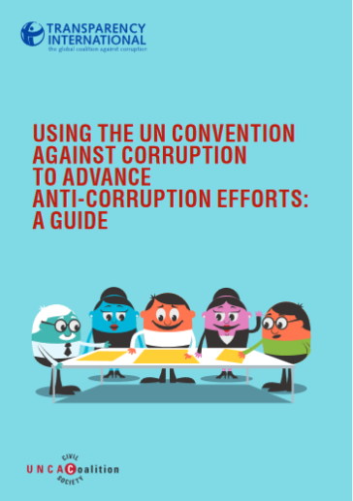
PREPARATION (I)
Before you start…
Read the Monitoring & Advocacy Guide & watch our UNCAC review training videos: www.uncaccoalition.org
Check UNODC guidance material
Research the timetable of the national review process
Get guidance materials from UNCAC Coalition, which is currently is finalizing detailed guides for researchers on
  Transparency provisions (Chapter II)
  Asset Recovery (Chapter V)
  Template for parallel report

Slide 5

PREPARATION (II)
Before you start…
Check for partners and support
  Link up with other CSOs and private sector groups interested in getting involved—UNCAC Coalition may be able to help
  Identify pro bono legal support in you country—TI may be able to help
  Identify funding
    UNCAC Coalition may be able to provide technical support (guidance, editing, peer-review support) & some financial support
Inform your government and share the report
template or information about your plans

Slide 6
PRO BONO LEGAL SUPPORT
Thomson Reuters – Trustlaw
http://www.trust.org/trustlaw/#free-legal-assistance
International Senior Lawyers Project
http://www.islp.org/content/clients-partners
Advocates for International Development
http://www.a4id.org/broker-service
IBA - International Pro Bono Website
www.internationalprobono.com

Slide 7
TRACKING PROCESS ISSUES
Transparency of the Government’s Undertaking of the Review Process
Did the government disclose information about the country focal point? | Yes/ No | Comments
Is the review schedule known? | Yes/ No | Comments Please indicate whether the review is on time
Was civil society consulted in the preparation of the self-assessment? | Yes/ No If yes, who? (please tick) Women’s groups Access to information groups Trade unions Academic networks Anti-corruption groups Other (please list) | Comments Please list the organisations consulted Please indicate date of consultation
Was the self-assessment published on line or provided to civil society? | Yes/ No | Comments Please enter link if applicable and date of publication or information about when/how the self-assessment was provided
Did the government agree to a country visit by the review team? | Yes/ No | Comments Please indicate date of the visit
Was a country visit undertaken? | Yes/ No | Comments
Was civil society invited to provide input to the official reviewers? | Yes/ No | Comments Please list the organisations invited Please enter the form of input invited
Was the private sector invited to provide input to the official reviewers? | Yes/ No | Comments Please list the firms/organisations invited Please enter the form of input invited
Has the government committed to publishing the full country report | Yes/ No/ Unknown | Comments Please indicate if published by UNODC and/ or country and enter a link if applicable.

Slide 8

INFORMATION COLLECTION
Desk research:
  laws, regulation
  other review mechanisms (AU, OECD WGB)
  reports on judicial practice, expert policy papers, court records
  reports of oversight bodies
  newspaper clippings, media monitor services
  online search
    websites of government agencies, available statistics, cases, etc.

Slide 9
INFORMATION COLLECTION
Key informants (interviews or off-record background information):
  public officials
  Experts in oversight bodies (Court of Audit, Anti-Corruption Commission, Information Commissioner, Human Rights Commission, etc.)
  CSO experts, academics, journalists, private sector representatives, other relevant stakeholders with legal and/or practical expertise on specific issues
    e.g. access to information, procurement, budget transparency, conflicts of interest, asset recovery

Slide 10
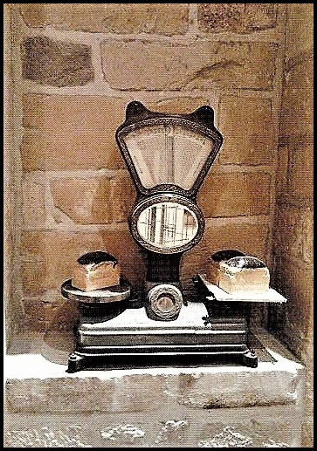
GENERAL GUIDELINES
Provide an assessment of whether implementation of UNCAC in a certain area is satisfactory or not
Explain the reasons for any conclusions and recommendations
Be balanced: highlight strengths as well as weaknesses in the performance
Reference information provided
  Provide credible sources
Use concise & clear language
Notes:
Photo: Flickr, Sylvie Burr

Slide 11
COVERAGE OF REPORT
Selection of articles (Guide p. 83)
Chapter II (prevention)
Art. 6 (preventive anti-corruption bodies)
Art. 7 (public sector integrity)
Art. 8 (codes of conduct for public officials)
Art. 9 (public procurement & management of public finances)
Art. 10 (public reporting)
Art. 11 (measures relating to the judiciary & prosecution services)
Art. 13 (participation of society)
Art. 14 (measures to prevent money laundering)
Chapter V (asset recovery)
Status of implementation
Enforcement in practice

Slide 12

GUIDANCE ON ASSESSING THE
LEGAL FRAMEWORK
Guidance to Filling Rev. Draft Self-assessment, pp 16-17)
Article 7.1(a): Public Sector
Information sought may include...
“The legal framework for recruitment and hiring, retention and promotion of civil servants and, where appropriate, other non-elected public officials, including any public examinations that may be administered as part of the process, and any specific criteria applied that aim at assessing their merit, equity and aptitude as well as their integrity;
Description of the specific procedures for the recruitment and hiring of senior managers, if they are different from other civil servants;

Slide 13
GUIDANCE ON ASSESSING THE
LEGAL FRAMEWORK
Guidance to Filling Rev. Draft Self-assessment, pp 16-17)
Article 7.1(a): Public Sector
Information sought may include...
Description of the methods used to ensure that principles of efficiency, transparency and objectivity of criteria for human resource management are applied;
Description of any safeguards aimed at guaranteeing the transparency and fairness of the recruitment process (e.g. the procedures and practices to publish and disseminate vacancy announcements, documentation or recording of interviews and rating of candidates, administration of written tests, use of interview panels);
Description of the mechanism(s) to file a complaint or appeal against a human resource decision, including in relation to a recruitment process or decision.“

Slide 14
ACCURACY
Steps to prevent libel (Guide pp. 76 -77)
Libel check (and fact check) of the report by qualified lawyers
Cross-check the information: you are not telling stories but analysing facts.
Be careful to reflect the status of cases at the time of writing:
  Allegations only? Investigation or prosecution by authorities? Judgement? Final or subject to appeal?
Tone down language about allegations (use language such as “allegedly”, “reportedly” etc.)
Avoid mentioning names of implicated persons involved, unless you have reliable open source reference
All sources of information should be fully referenced

Slide 15
CONSULTATION
Obtain government feedback
Contact focal point and/or officials in the Justice or Interior Ministry or Anti-Corruption Agency and /or government delegate to the last UNCAC Conference of States Parties.
Send them copy of the near-final report for comment & arrange meeting
To avoid errors and build dialogue around issues

Slide 16
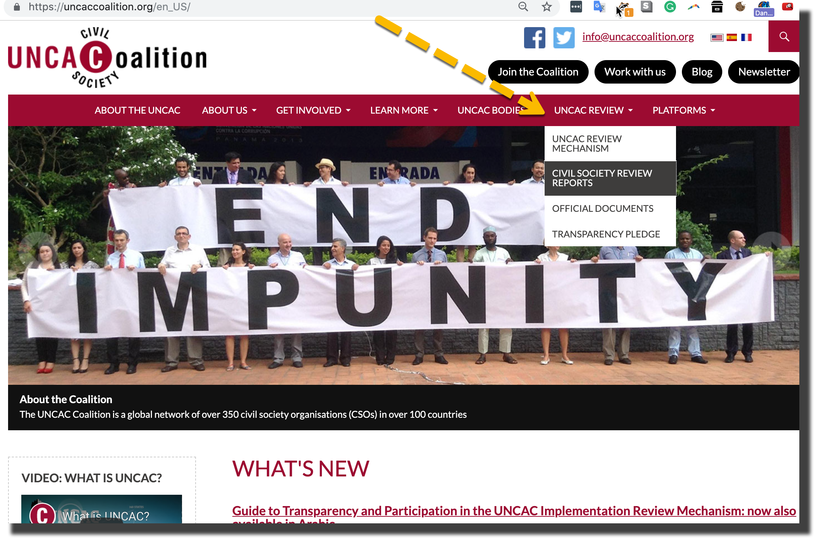
DISSEMINATION

Slide 17
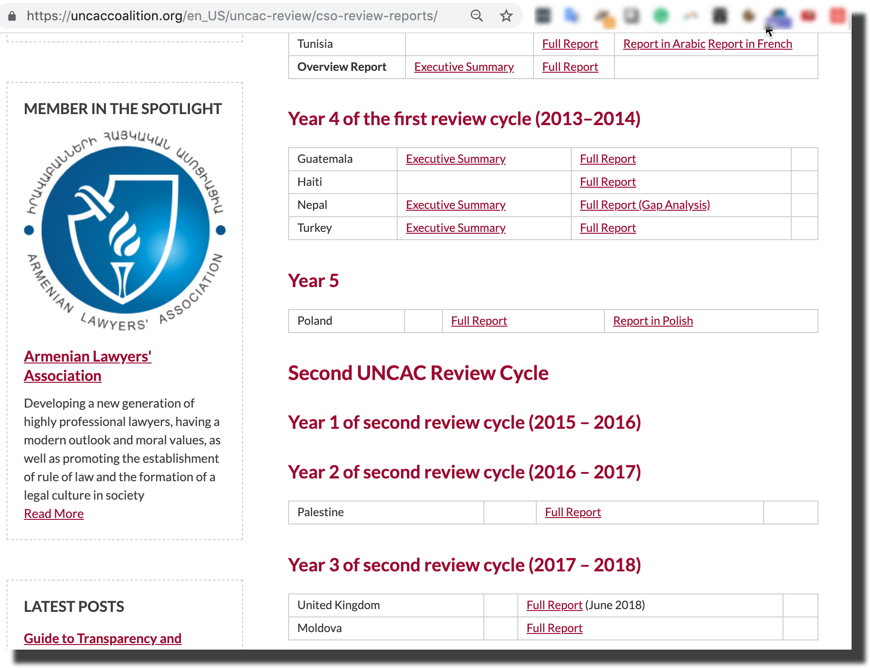
DISSEMINATION

Slide 18
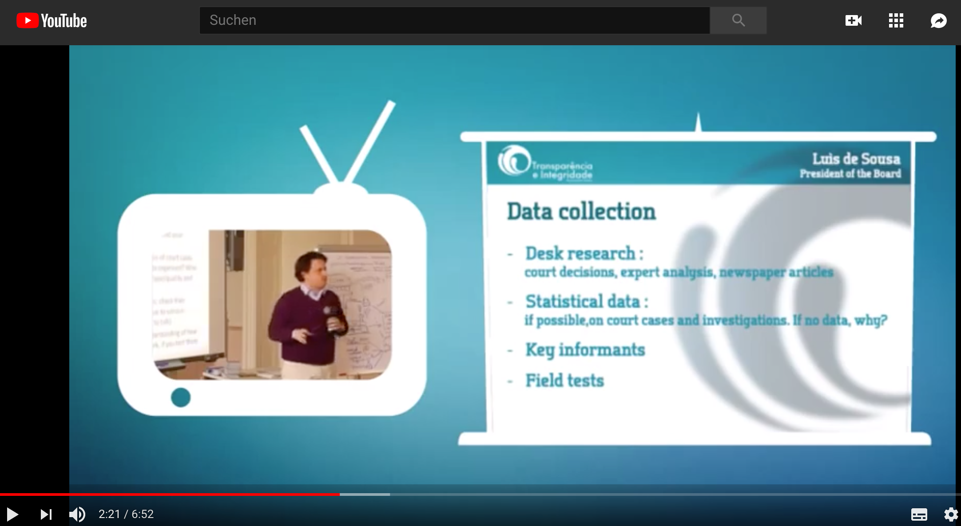
TRAINING VIDEO ON PREPARING REPORT
https://www.youtube.com/playlist?list=PLF50533B4151454B9

Slide 19
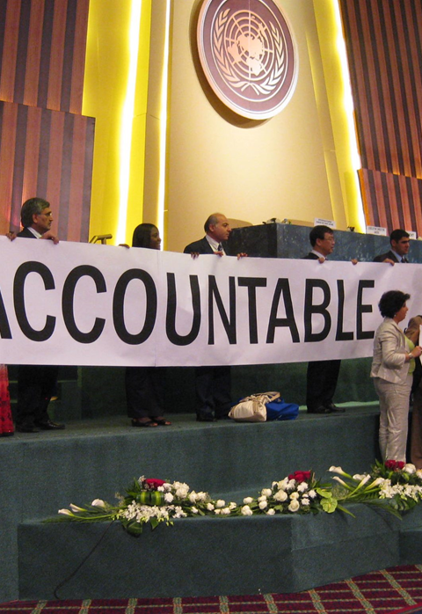
DISSEMINATION
National level
Government
UNCAC reviewers
Development partners
Think tanks, academia
National media
Organisation’s website & social media
International level
UNCAC fora (IRG, Working Groups, COSP)
UNCAC Coalition website
Other global forums
Regional forums

Slide 20
www.transparency.org
facebook.com/transparencyinternational
twitter.com/anticorruption
blog.transparency.org
© 2019 Transparency International. All rights reserved.

