Slide 1


CONDUCTING ADVOCACY AROUND THE
UNCAC REVIEW PROCESS
GILLIAN DELL – TRANSPARENCY INTERNATIONAL
Addis Ababa, Ethiopia, 11 April 2019
Email: gdell@transparency.org

Slide 2
WHY IS THE UNCAC REVIEW USEFUL FOR ME?
Notes:
- cross-cutting issues: right to information, protection of whistleblowers, codes of conduct, integrity of the judiciary, fair business sector

Slide 3
OK, BUT HOW TO PUT IT INTO PRACTICE?
Notes:
- cross-cutting issues: right to information, protection of whistleblowers, codes of conduct, integrity of the judiciary, fair business sector

Slide 4
ADVOCACY PLANNING
Identify overall aim (or goal)
Identify key change objectives (or issues/targets)
Identify key actors in decision-making processes and other stakeholders (or target audiences)
Develop key messages (by audience)
Identify key advocacy opportunities
Design advocacy activities
Risks & assumptions
Human and financial resources
Monitoring & evaluation

Slide 5
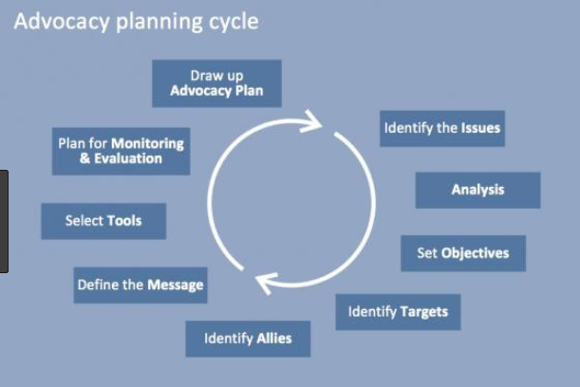
ADVOCACY PLANNING CYCLE

Slide 6
ADVOCACY PLANNING TOOLS
Picking a winning issue
Problem tree
Solution tree
Stakeholder analysis
Risk analysis
Developing an anti-corruption advocacy plan - a step-by-step guide:
http://uncaccoalition.org/resources/advocacy/developing-an-advocacy-plan-a-step-by-step-guide-transparency-international.pdf

Slide 7
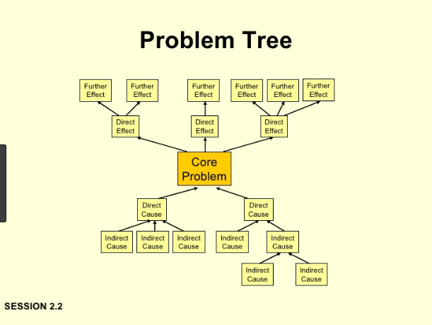

Slide 8
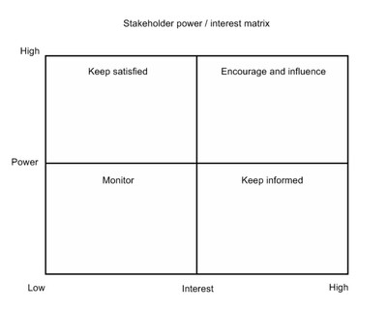
STAKEHOLDER ANALYSIS
WHO HAS INTEREST AND POWER?

Slide 9
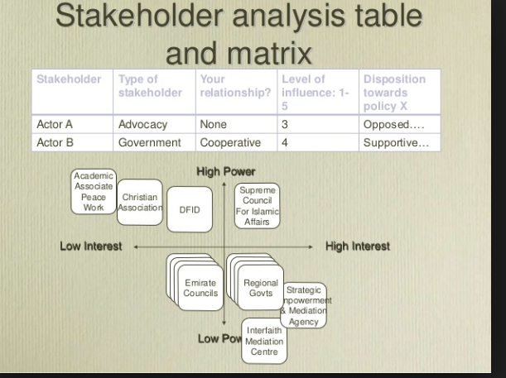
STAKEHOLDER ANALYSIS
WHO HAS INTEREST AND POWER?

Slide 10
RISK ANALYSIS
Risk | Likely impact | Likelihood of occurring | Mitigating actions

Slide 11
OBJECTIVES OF CSOs IN THE REVIEW
WHY GET INVOLVED?
Build public awareness of UNCAC obligations
Communicate expectations about performance
Enhance accuracy of assessment
Demonstrate role of civil society in anti-corruption
Use official platform for outreach to
  Government
  National public
  International community

Slide 12

STAGES & ENTRY POINTS
WHEN CAN CSOs GET INVOLVED?
Notes:
Photo: Flickr, USDA by Lance Cheung.

Slide 13
STAGES & ENTRY POINTS
WHEN CAN CSOs GET INVOLVED?
  Self-assessment (input and publish)
  Country visit or otherwise review team assessment and CSO input
  Publication of the review report
  Follow-up to review
  Transparency & participation: All optional—but needed

Slide 14
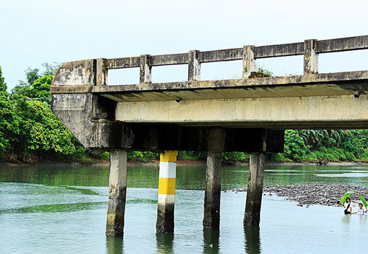
AREAS FOR NGO INVOLVEMENT
WHAT SUBJECT MATTER?
Process issues: Advocate & monitor
  Transparency
  CSO participation
Content issues: Monitor & advocate
  Access to information
  Implementation through laws and regulations
  Application and enforcement of laws and regulations, including data

Slide 15

CSO MONITORING & ADVOCACY
WHAT TYPE OF INVOLVEMENT?
  Advocate transparent & inclusive process – and monitor process
    Public information—need to know focal point & timetable
    Consultation
    Prompt publication of reports
  Prepare inputs to the self-assessment and review team
  Comment on process and results
  Contribute to & comment on follow-up

Slide 16
PUBLICATION OF DOCUMENTS – 1ST CYCLE
https://www.unodc.org/unodc/en/treaties/CAC/country-profile/index.html
Self-assessments published by
Botswana, Nigeria, Rwanda,
Tanzania
Full 1st cycle reports published by
Botswana, Burundi, Cameroon, CAR, Côte d’Ivoire, Ethiopia, Kenya, Lesotho, Madagascar, Malawi, Namibia, Niger, Nigeria, Rwanda, South Africa
Not published yet by
Angola, Benin, Côte d’Ivoire, Djibouti, Gabon, Ghana, Liberia, Mali, Mauritania, Mauritius, Mozambique, Senegal, Seychelles, Togo
Not ready with executive summary
Chad, Comoros, Congo Brazzaville, Democratic Republic of Congo, Equ. Guinea, South Sudan, Sudan
Not published by
Benin, Comoros, Congo Brazzaville, Côte d’Ivoire, Democratic Republic of Congo. Gabon, Ghana, Liberia, Malawi, Mali, Niger, Senegal, South Sudan, Togo

Slide 17
PUBLICATION OF DOCUMENTS – 2ND CYCLE
https://www.unodc.org/unodc/en/treaties/CAC/country-profile/index.html
Self-assessments published by
Nigeria
Full 2nd cycle reports published by
Mozambique
Not published yet by
Mauritius, Senegal (executive summaries published)
Not ready with executive summary
All other African countries
Not published by
All other

Slide 18
DISCUSSION
What’s your experience?

Slide 19
www.transparency.org
facebook.com/transparencyinternational
twitter.com/anticorruption
blog.transparency.org
© 2019 Transparency International. All rights reserved.

