Slide 1


Civil society guide on working with the UNCAC
Mirella Dummar Frahi
Civil Society Team Leader, UNODC

Slide 2
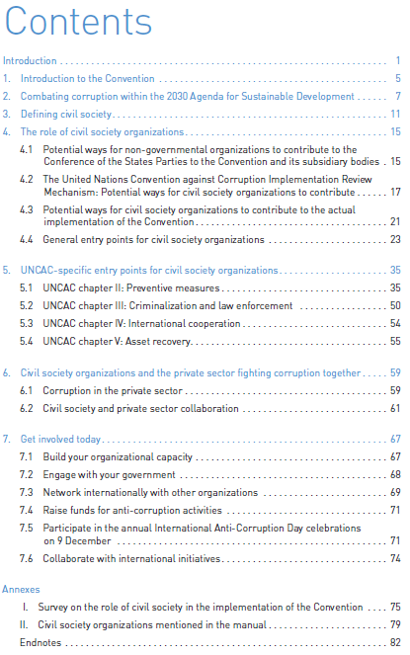
The guide shows entry points for CSOs in UNCAC and its Review Mechanism
Introduction to the Convention and its nexus with the Sustainable Development Goals
Specific entry points for the four chapters of the UNCAC: Preventive measures, Criminalization and law enforcement, International cooperation, and Asset recovery
Ways to work with the private sector
Plus, general opportunities for capacity building, networking, on International Anti-Corruption Day, and fundraising

Slide 3
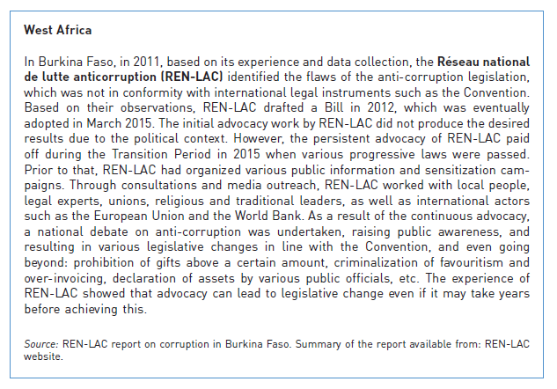
Highlighting civil society stories
Contains over 70 examples of CSO success stories and examples from around the world
Each example listed under the specific entry points in text
Copied right is the success story under the advocacy chapter. REN-LAC’s advocacy work helped influence the drafting of new anti-corruption bill in 2015 in Burkina Faso

Slide 4

CSO Entry Points: Preventive measures (UNCAC Chapter II)
Art 13 encourages civil society participation
National Action Plans and Strategies (Art. 5)- the formulation and implementation.
Public reporting (Art. 10) and transparency, access to information laws.
Codes of conduct (Art. 8) and Public procurement (Art. 9)
Integrity in the judicial system (Art. 11)

Slide 5

CSO Entry Points: Criminalization and Law Enforcement (Chapter III)
Advocate for means to deter and punish corruption
Whistleblowing and Whistleblower Protection (Art. 33) and witness protection (Art. 32)
Example of TI’s Advocacy and Legal Advice Centres (ALACs) providing free and confidential legal advice to witnesses and victims of corruption. Currently operating in 11 African states
Notes:
Criminalization and law enforcement
Chapter III recognizes the importance of having means to deter and punish corruption. CSOs are able to advocate for the implementation of this Chapter. With regard to the adoption of relevant legislation criminalizing corrupt conduct or amendments to legislation, CSOS can help to ensure that both decision-makers and citizens are aware of the need to criminalize corrupt activities and take into consideration IRM recommendations and good practices. By monitoring the law enforcement regime in practice, they can pinpoint gaps and report on cases that were insufficiently followed up. This includes, follow-up to corruption cases, but can also be looked at more broadly. As pointed out above under the section of judicial and prosecutorial integrity, case monitoring and advocacy for the reduction of backlogs could be useful to ensure that the court systems function efficiently and fairly and that the risk of corruption is reduced.
In addition, CSOs may assist in corruption cases by appearing as parties to corruption proceedings where their legal systems allow as the below case indicates. CSOs may also conduct trainings for new employees in the public and private sector, publish guidelines for reporting persons, or launch broader media campaigns to raise awareness levels regarding existing reporting mechanisms.

Slide 6


CSO Entry Points: International cooperation (Chapter IV) and asset recovery (Chapter V)
CSOs may assist States in:
Advocacy and awareness raising on specific cases/legislation
Investigation and legal action e.g. representation of victims
Monitoring the use of confiscated assets
Notes:
International Cooperation and Asset Recovery
Chapter IV of the UNCAC deals with matters relating to international cooperation in the fight against corruption. The Convention requires States to cooperate with each other on mutual legal assistance, extradition, the transfer of sentenced persons and law enforcement cooperation. While CSOs are generally not involved in these types of international cooperation, they can contribute to efforts to strengthen international cooperation between civil society organizations in different countries on anti-corruption.
Chapter V of the Convention provides a framework for the process of tracing, freezing, confiscating and returning stolen assets to their country of origin. This is a complex and lengthy process, potentially involving multiple jurisdictions and often complicated by technical, legal or political barriers. The civil society in both the requesting and requested countries can support this process through advocacy and awareness raising, prevention, investigation and legal action, and ensuring that the confiscated assets are used for their intended purpose.

Slide 7
CIVIL SOCIETY INPUT
The Civil Society Team sent a survey to over 2,500 CSOs working on anti-corruption matters to learn about their role in the implementation of the Convention.
Full responses to the survey were received from 124 civil society organizations in 113 countries globally.
Other inputs were collected through direct outreach, including workshops
Results from a question are illustrated on the graph
*Graph created from survey responses

Slide 8


Thank you for your attention!
Civil Society TEAM
unodc-ngounit@un.org
+43 1 26060 5582

