Slide 1

Advocating for access to information across the European Union
Rachel Hanna, Legal Researcher and Campaigner

Slide 2

What is the right of access to information?
The right of the individual to gain access to all information held by the public authorities (in theory)

Slide 3
Jurisprudence on the Right to Information
Inter-American Court of Human Rights (2006)
European Court of Human Rights (2009)
UN Human Rights Committee (2011)
  Proactive: Governments should proactively publish information of public interest into the public domain, and that access to this information should be easy, prompt, effective and practical
  Reactive: Governments should also enact the necessary procedures where the public can gain access to information, such as access to information laws.

Slide 4
Council of Europe Convention on Access to Official Documents (2020)
First International Treaty on Access to Official Documents
Signed and ratified by
  Armenia
  Bosnia and Herzegovina
  Estonia
  Finland
  Hungary
  Iceland
  Lithuania
  Montenegro
  Norway
  Republic of Moldova
  Sweden
  Ukraine

Slide 5
Remember your right can be limited!
Internationally accepted exceptions:
Council of Europe Convention on Access to Official Documents
national security, defence and international relations;
public safety;
the prevention, investigation and prosecution of criminal activities;
disciplinary investigations;
inspection, control and supervision by public authorities;
privacy and other legitimate private interests;
commercial and other economic interests;
the economic, monetary and exchange rate policies of the State;
the equality of parties in court proceedings and the effective administration of justice;
environment; or
the deliberations within or between public authorities concerning the examination of a matter.

Slide 6
Harm and Public Interest Test
Harm test: the public authority must show that releasing this information would cause real and non-hypothetical harm to a protected interest.
Public interest test: the public authority must balance the harm that disclosure would cause against the public interest served by disclosure of the information.

Slide 7
Essential elements of the right according to international standards
Right of everyone
All information
All public bodies
Limited exceptions
Free (copying costs only)
Rapid provision of information
Independent oversight bodies

Slide 8
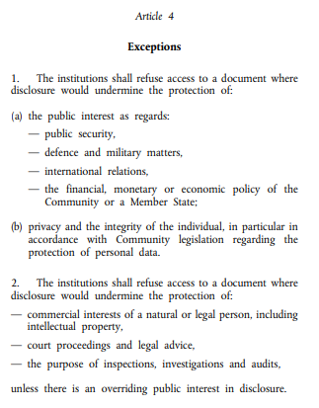
Exceptions at the EU level - Regulation 1049/2001
Harm test
Harm test
Public interest test

Slide 9
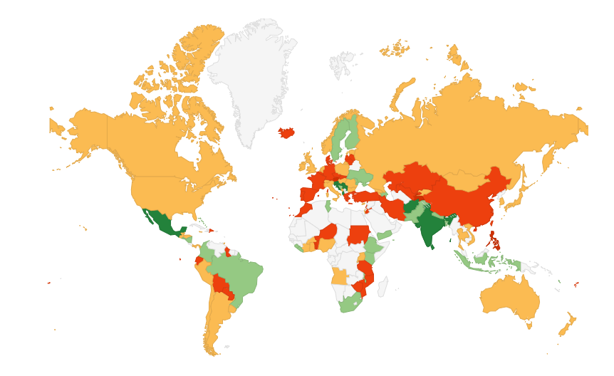

RTI Rating: Global access to information laws

Slide 10
How to use the RTI rating
You can use it to find out information on the access to information regime in each country:
Can I make a request in that country? Indicator 4
Everyone (including non-citizens and legal entities) has the right to file requests for information.
Does every public body have to comply with the law? Indicator 12
The right of access applies to a) private bodies that perform a public function and b) private bodies that receive significant public funding.
Do I have to pay? Indicator 24
It is free to file requests.

Slide 11
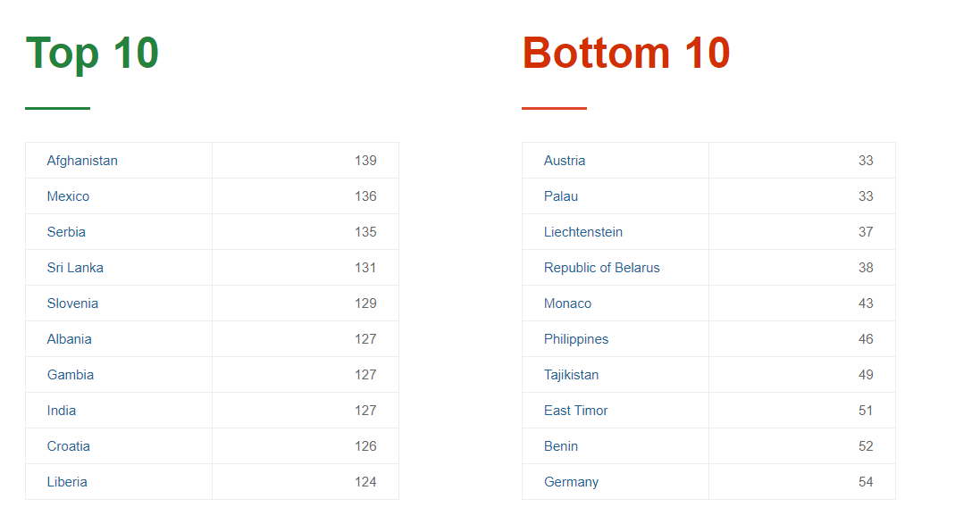
Varying quality of laws

Slide 12
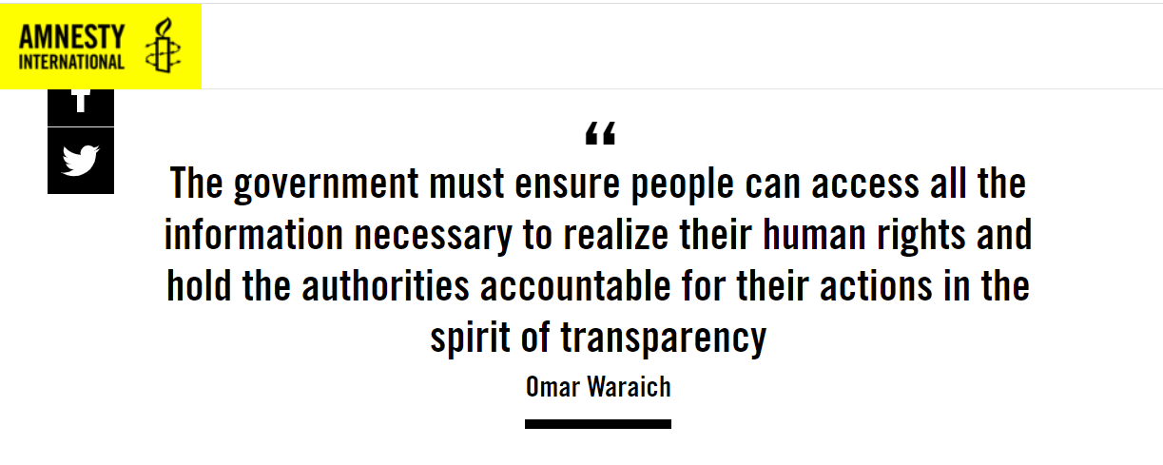
On paper vs in practice

Slide 13
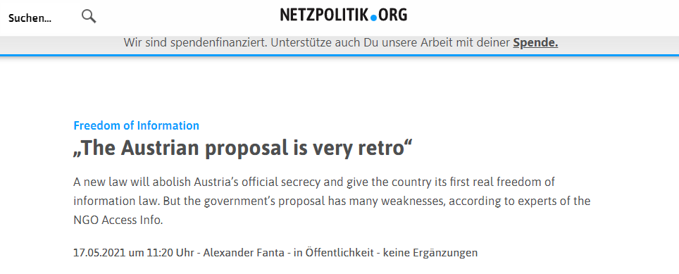
New isn’t always better

Slide 14
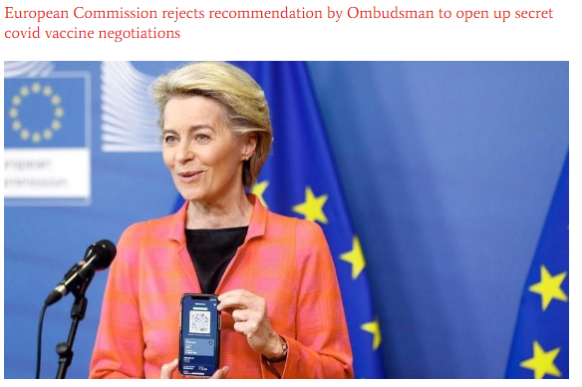
Fit for purpose in the digital age?

Slide 15
Top tips for submitting requests
Plan ahead to save time
Start out with a simple request
Check the rules about fees and ask for electronic documents
Show that you know your rights!
Never say why you want info, but you could consider saying your role
Keep a record and check the timelines

Slide 16
Top tips for appealing
What exception has been used? Is it subject to a harm and public interest test? Have they been properly applied?
  Harm test: If the body hasn’t applied this, you can argue that they have not sufficiently demonstrated that harm would be caused upon release of the requested information.
  Public interest: If the public body states that there is no public interest in the release of the information, you can argue why there is a public interest.
Ask for partial access
RTI rating – is there an internal or external appeal process?
Reference the law and your rights – and keep the draft
Reach out for help!

Slide 17
Thank you!
For more information, get in touch:
Rachel Hanna: rachel@access-info.org

