Slide 1
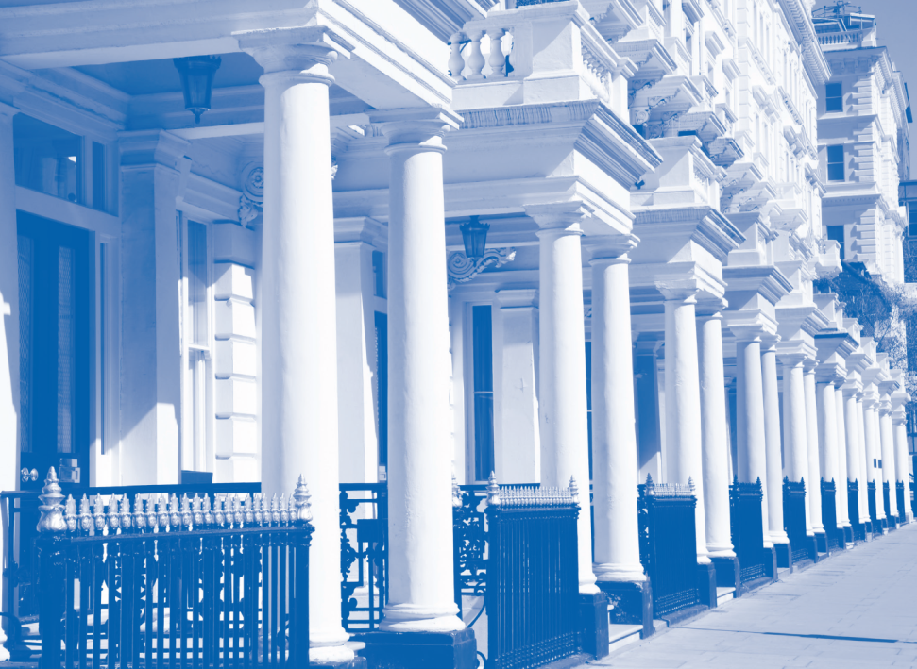
Corrupt Capital
HOW THE SECRET OWNERSHIP OF PROPERTY IN
LONDON AND THE REST OF THE UK FACILITATES
GLOBAL CORRUPTION
Nick Maxwell (Head of Research TI-UK)

Slide 2
Corrupt capital
Notes:
3 – Although the margin of error is very large, even the most conservative estimates indicate the massive scale of the problem.
4 - These are jurisdictions where the legal system creates a deliberate veil of secrecy that obscure the identity of those arranging corporate structures and establishing companies, usually for the benefit and use of people or companies that are not resident in that country. The use of these secret and anonymous companies disguises the identity and source of funds of the owners of those companies, and constitutes a serious obstacle to investigating money laundering.

Slide 3
Project research context
In depth research into proceeds of corruption risks in UK property
Analysing data from the Land Registry and Metropolitan Police Proceeds of Corruption Unit released for the first time
First sector report out of a larger ‘The UK’s role as a corruption services centre’ report due in Autumn 2015 (including other regulated sectors)
Notes:
3 – Although the margin of error is very large, even the most conservative estimates indicate the massive scale of the problem.
4 - These are jurisdictions where the legal system creates a deliberate veil of secrecy that obscure the identity of those arranging corporate structures and establishing companies, usually for the benefit and use of people or companies that are not resident in that country. The use of these secret and anonymous companies disguises the identity and source of funds of the owners of those companies, and constitutes a serious obstacle to investigating money laundering.

Slide 4
Key findings
UK is attractive to those seeking to launder the proceeds of grand corruption from around the world
Companies incorporated in British Overseas Territories and Crown Dependencies are the preferred method of concealment for those under criminal investigation for grand corruption
Notes:
3 – Although the margin of error is very large, even the most conservative estimates indicate the massive scale of the problem.
4 - These are jurisdictions where the legal system creates a deliberate veil of secrecy that obscure the identity of those arranging corporate structures and establishing companies, usually for the benefit and use of people or companies that are not resident in that country. The use of these secret and anonymous companies disguises the identity and source of funds of the owners of those companies, and constitutes a serious obstacle to investigating money laundering.

Slide 5
Key findings
Companies incorporated in British Overseas Territories and Crown Dependencies present significant barriers to private sector due diligence and law enforcement investigations
The scale of UK property holdings by companies incorporated in British Overseas Territories and Crown Dependencies is very large
Notes:
3 – Although the margin of error is very large, even the most conservative estimates indicate the massive scale of the problem.
4 - These are jurisdictions where the legal system creates a deliberate veil of secrecy that obscure the identity of those arranging corporate structures and establishing companies, usually for the benefit and use of people or companies that are not resident in that country. The use of these secret and anonymous companies disguises the identity and source of funds of the owners of those companies, and constitutes a serious obstacle to investigating money laundering.

Slide 6
Key findings
Due diligence is undermined by offshore secrecy
Estate agents only conduct due diligence checks on the vendor, not the purchaser
Typically awareness of AML responsibilities and suspicious reporting levels within the sector are very low
Pooled accounts within the sector also an issue
Notes:
3 – Although the margin of error is very large, even the most conservative estimates indicate the massive scale of the problem.
4 - These are jurisdictions where the legal system creates a deliberate veil of secrecy that obscure the identity of those arranging corporate structures and establishing companies, usually for the benefit and use of people or companies that are not resident in that country. The use of these secret and anonymous companies disguises the identity and source of funds of the owners of those companies, and constitutes a serious obstacle to investigating money laundering.

Slide 7
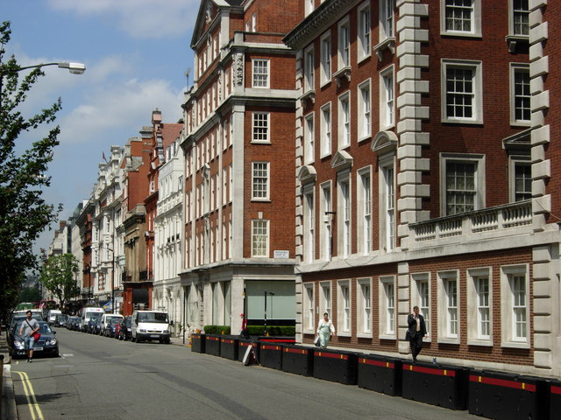
Why the UK?
Notes:
The UK’s combination of political stability, light-touch regulations and privileged connections with well-known secrecy jurisdictions in the British Overseas Territories and Crown Dependencies
There are over 1,400 financial services firms in the UK – the majority of which are foreign-owned – and over 250 foreign banks, which is more than any other country in the world.
The FSA estimated that every year between £23bn and £57bn was being laundered within and through the UK, which corresponds respectively to 1.4% and 3.6% of the national real GDP for that year.
1 - The UK is one of a small number of global financial centres that play a key role in processing substantial levels of corrupt capital. The UK represents an alluring location for individuals to hide the proceeds of their corrupt activities for many of the same reasons that the UK is attractive for legitimate business

Slide 8
Why is the UK property sector attractive for the corrupt?
Luxurious properties in the UK provide a much-sought badge of wealth and respectability, and represent a very safe bet for criminals.
The UK attracts the greatest foreign investment volumes among all European real estate markets,
According to a 2013 Savills report, 90% of new-build luxury properties were purchased by overseas buyers. (Eastern Europe, MENA, China)
Notes:
1 - Buying such properties allows the corrupt to launder considerable amounts of stolen money with a single purchase. Large amounts of money can be ‘parked’ in a high-end property and then re-invested somewhere else with very little risk of capital loss. A property can also produce further income by letting it or even used to conveniently launder even more money by signing bogus lease contracts with fake tenants.
2 - Ahead of Germany’s £16.2bn as the second largest.

Slide 9
How big is the problem?
£180m+ worth of property in UK have been brought under criminal investigation as the suspected proceeds of corruption since 2004. This is believed to be only the tip of the iceberg of the scale of proceeds of corruption invested in UK property. Over 75% of the properties under criminal investigation use offshore corporate secrecy
The average price of a property under criminal investigation in the UK is £1.5m. The minimum is £130,000, the maximum is £9m and the median is £910,000. 48% of properties investigated were valued at over £1m
Notes:
2 - A Guardian investigation revealed an estimated £350m worth of vacant properties on a single prestigious London street in Hampstead. The empty buildings include a row of 10 mansions worth £73m, which have stood largely unused since they were bought between 1989 and 1993. Most of the properties are registered to companies in the British Virgin Islands, Curaçao, the Bahamas, Panama and the Channel Islands, allowing international owners to remain anonymous.

Slide 10
UK property in criminal cases of grand corruption
Notes:
2 - The average price of a property under the POCU investigation is £1.5m. The minimum is £130,000, the maximum is £9m and the median is £910,000. Whilst 48% of properties investigated were valued at over £1m.
This data confirms for the first time that companies incorporated in the Crown Dependencies and British Overseas Territories, which are independent legal jurisdictions and are the international responsibility of the UK, are the preferred option for concealment for those under criminal investigation for grand corruption in the UK
Our findings complement the 2011 analysis from the UN Office on Drugs and Crime and the World Bank Stolen Asset Recovery (StAR) initiative, which examined over 150 grand corruption cases and found that out of the corporate vehicles involved in money laundering associated with the cases, the following territories had hosted the secret corporate vehicles: British Virgin Islands (91); United Kingdom (24); Cayman Islands (15); Bermuda (12); Jersey (12); Isle of Man (7)

Slide 11
The scale of offshore holdings of UK property
36,342 London properties totalling 2.25 sq miles are held by offshore haven companies. Of these, 38% in the British Virgin Islands, 16% in Jersey, 9.5% in Isle of Man, and 9% in Guernsey
Almost one in ten properties in the City of Westminster (9.3 per cent), 7.3 per cent of properties in Kensington & Chelsea and 4.5 per cent in the City of London are owned by a company registered in an offshore secrecy jurisdiction.
Notes:
2 - A Guardian investigation revealed an estimated £350m worth of vacant properties on a single prestigious London street in Hampstead. The empty buildings include a row of 10 mansions worth £73m, which have stood largely unused since they were bought between 1989 and 1993. Most of the properties are registered to companies in the British Virgin Islands, Curaçao, the Bahamas, Panama and the Channel Islands, allowing international owners to remain anonymous.

Slide 12
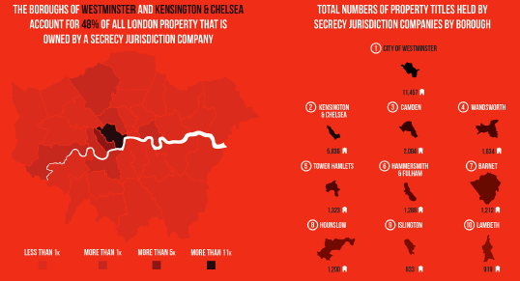
Offshore corporate holdings of property in the UK
Notes:
10% of the properties in the city of Westminster, 7.2% in Kensington & Chelsea and 4.5% in City of London are owned by a company registered in an offshore secrecy jurisdiction

Slide 13
How big is the problem?
Estimates that £122bn of property is held by companies incorporated in British Offshore Territories and Crown Dependencies
£100 million was raised in the enveloped property levy in its first year, almost five times more than forecast by the government. Homeowners paying the tax of as much as 143,750 pounds a year can keep their identities hidden through trusts and overseas shell companies.
According to the latest figures, which cover October 2013 to September 2014, estate agents contributed to only 0.05% of all Suspicious Activity Reports (SARs) submitted. This figure does not match the risks posed by money launderers to the UK property market
Notes:
2 - A Guardian investigation revealed an estimated £350m worth of vacant properties on a single prestigious London street in Hampstead. The empty buildings include a row of 10 mansions worth £73m, which have stood largely unused since they were bought between 1989 and 1993. Most of the properties are registered to companies in the British Virgin Islands, Curaçao, the Bahamas, Panama and the Channel Islands, allowing international owners to remain anonymous.

Slide 14
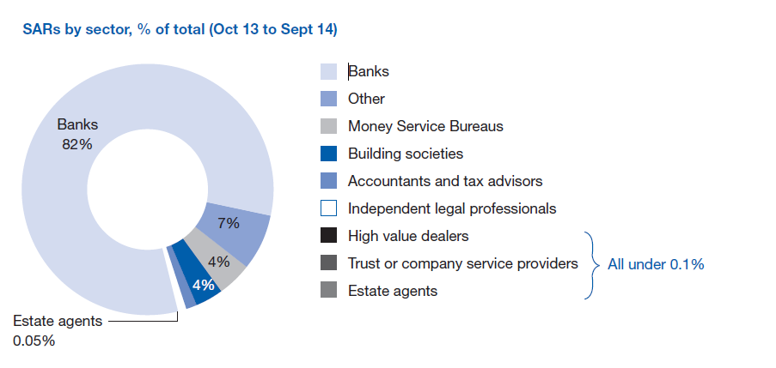
SAR 2013/14
Notes:
2 - A Guardian investigation revealed an estimated £350m worth of vacant properties on a single prestigious London street in Hampstead. The empty buildings include a row of 10 mansions worth £73m, which have stood largely unused since they were bought between 1989 and 1993. Most of the properties are registered to companies in the British Virgin Islands, Curaçao, the Bahamas, Panama and the Channel Islands, allowing international owners to remain anonymous.

Slide 15
Due diligence requirements
assess the risk of the business being used by criminals to launder money
check the identity of customers and check the identity of relevant ‘beneficial owners’ of corporate bodies and partnerships
monitor customers’ business activities and report anything suspicious to the National Crime Agency
make sure the necessary management control systems are in place
keep all documents that relate to financial transactions, the identity of customers, risk assessment and management procedures and processes
make sure that employees are aware of the regulations and have had the necessary training
Notes:
3 – Although the margin of error is very large, even the most conservative estimates indicate the massive scale of the problem.
4 - These are jurisdictions where the legal system creates a deliberate veil of secrecy that obscure the identity of those arranging corporate structures and establishing companies, usually for the benefit and use of people or companies that are not resident in that country. The use of these secret and anonymous companies disguises the identity and source of funds of the owners of those companies, and constitutes a serious obstacle to investigating money laundering.

Slide 16
But offshore secrecy prevents this
Peter Bolton King, global residential director at the Royal Institute of Chartered Surveyors:
“When you have a company hidden offshore, it is … almost impossible for your average estate agent to find out what on earth is going on.
Mark Hayward, Managing Director of the National Association of Estate Agents:
“Proof of funds is often the main focus for estate agency checks, beyond that there is typically limited interest in or awareness of the need to carry out due diligence. If checks are carried out and they identify a company holding the property, the due diligence will very likely stop there.
Notes:
3 – Although the margin of error is very large, even the most conservative estimates indicate the massive scale of the problem.
4 - These are jurisdictions where the legal system creates a deliberate veil of secrecy that obscure the identity of those arranging corporate structures and establishing companies, usually for the benefit and use of people or companies that are not resident in that country. The use of these secret and anonymous companies disguises the identity and source of funds of the owners of those companies, and constitutes a serious obstacle to investigating money laundering.

Slide 17
Other vulnerabilities and regulatory gaps in UK property AML
Weaknesses also include that anti-money laundering regulations for estate agents only require due diligence on the seller, not the purchaser
the regime relies on lawyers to cover any estate agency risks, which ignores the risk of complicit lawyers
the lack of recorded sale price by the Land Registry
the historic lack of regulatory sanctions for AML breaches in the sector
low levels of awareness of AML responsibilities within the sector
Pooled accounts

Slide 18
Recommendations
We make 10 recommendations in this report. The key recommendation is:
Transparency should be established over who owns the companies that own so much property in the UK. TI-UK believes that any foreign company intending to hold a property title in the UK should be held to the same standards of transparency required of UK-registered companies.
Notes:
- In addition, we have 3 further recommendations for the UK government, 4 recommendations for HMRC and 2 recommendations for the Land Registry.

Slide 19
Nick Maxwell
Nick.Maxwell@transparency.org.uk
www.transparency.org.uk - www.transparency.org
TI-UK launched an interactive map of London which reveals the statistics for each borough – ukunmaskthecorrupt.org

