Slide 1
CSO Training on the UNCAC
Engaging the private sector in UNCAC implementation & monitoring
Kuala Lumpur, 27 February 2014
Notes:
This presentation shall be used within the Transparency International Movement for self-study training.
Version: March 8, 2012

Slide 2
Corruption, private sector and civil society
A part of your advocacy strategy
Potentially influential allies for effecting change
Potential challenges and risks
They are part of the problem, they are victims and they are part of the solution.

Slide 3
In order to systematically develop a private sector engagement plan, CSOs should follow 4 intuitive steps:
Step 1: Identify and prioritize target groups within the local private sector (e.g. multinational enterprises) to utilize its limited resources efficiently.
Step 2: Seek to understand the needs of the selected target groups (e.g. training, advise, tools) and their corruption-related challenges (e.g. extortion, facilitation payments).
Step 3: Select activities that match the needs of the target groups.
Step 4: Develop a clear private sector engagement strategy, which documents the major objectives, activities, effort, timeline etc.
1
2
3
4
Identify your target group
Understand their needs
Select your activities
Plan your engagement
Notes:
If you are a National Chapter that has worked with the private sector before, knows with whom you want to engage and what the needs and challenges of these companies are, you may proceed directly to step 3 ‘Select your activities’.
If you are a National Chapter with little experience in the private sector, it is recommended that you browse through the first two steps of this process to familiarize yourself with identifying the target group(s) and their needs and challenges.
Please note that section 3 of this presentation lists tools for conducting each of these 4 steps.

Slide 4
Step 1: Identify your target group
Ask the following two questions for each of the identified target groups:
?
What is the potential influence of the target group for UNCAC implementation and monitoring?
?
What chances of activating the target group? What chances of resistance from target group?
Factors to consider:
Size of company
Access to decision makers
Strategic industry (e.g. information technology, environment)
Driver in public perception, standing in community
Factors to consider:
Size and complexity of business operations
Industry
Country of origin
Business model (e.g. sales through intermediaries)
Formal/ informal sector
Notes:
Tools for addressing these two questions are listed in chapter ‚WHAT support is available for National Chapters to engage with the private sector?‘ of this presentation.

Slide 5
Step 1: Identify your target group
The outcomes of this process should be visualized in a Prioritization Map.
Target groups with a high degree of influence and a high likelihood of interest should be prioritized for engagement.
CSOs facing limited resources and multiple target groups (in the “red zone”) can further prioritize according to:
Contacts to target groups
Knowledge about target groups and sectors
Past experiences with target groups (also from other National Chapters), etc.
high
Other MNEs
Some MNEs and some successful local ?
Accounting & auditing companies?
Other local companies
medium
DEGREE OF INFLUENCEr
???
???
???
low
SMEs-Agriculture
low
medium
high
LIKELIHOOD OF INTEREST
→ Exemplarily visualization of a Prioritization Map.
MNEs: Multinational enterprises; SMEs: Small and medium enterprises; SOEs: State-owned enterprises

Slide 6
Step 2: Understand their needs
Each target group may have different needs relating to anti-corruption challenges that need to be understood by the CSO:
The target group may need…
…regarding the benefits of UNCAC
Information
Raising awareness
Training
Advice
Tools
Support for ‘leveling the playing field’
Public sector integrity
Procurement etc.
Whistleblowing
Leveling the playing field
Technical assistance to government
International counterparts with whom to discuss issues

Slide 7
Step 3: Select your activities
There are a variety of activities for CSOs to engage with the private sector; selecting and prioritizing the most appropriate activities should be based on a clear understanding of the needs and challenges of the target group (refer to Step 2).
TI’s Private Sector Activity Framework provides a generic overview of engagement activities.
The Framework aligns the most common engagement activities according to
Engagement partners: CSOs can not only engage with a single business or a group of companies (BUSINESSES), but also jointly with businesses and public sector representatives in multi-stakeholder groups (MULTI-STAKEHOLDERS) or with key influencer of the private sector, such as regulators, investors, academia etc. (INFLUENCERS).
Degree of engagement: The effort and knowledge for the CSO to engage with businesses can be classified in LOW, MEDIUM, or HIGH, offering an indication for CSOs about the scope of engagement.
Notes:
Influencers:
Legislator,
National and International Public Procurement Agencies
Value Chain Stakeholders (e.g. customers, suppliers)
Investors and Creditors
Export Credit Agencies
Media

Slide 8
Step 3: Select your activities (2/2)
Private Sector Activity Framework (partial, adapted for UNCAC work)
 |  | Degree of engagement
 |  | Low | Medium | High
Engangement partners | Businesses
 | Multi-stakeholders
 | Influencers
Awareness & Commitment
Training & Support
Business Coalitions
Advocacy
The activities listed should not be seen as a sequential processes; typically, activities are conducted in parallel.
Notes:
In the following, each activity is described, providing general information as well as engagement advantages and disadvantages/constraints for a National Chapter.

Slide 9
Key challenges and risks
Different organizational cultures and structures
Different approaches to operations and expectations
Their policy agenda may be incompatible with yours in important ways
Unknown to you they may be implicated in improper practices

Slide 10
FAQ: How can the private sector contribute to implementation and monitoring of international conventions (e.g. UNCAC) ?
Examples
!
Lobbying for ratification & implementation: CSOs can collaborate with major national and international businesses to seek ratification and implementation of international conventions (e.g. United Nations Convention Against Corruption). Interest from businesses may come for various reasons:
Aligning local business conditions to international standards (e.g. to decrease investment risks for foreign institutions)
‘Level the playing field’ by introducing comparable standards for all business participants.
Monitoring the convention (Peer reviews): The private sector may have important expertise and information about the challenges to anti-corruption law enforcement in the country under review. They may appreciate the opportunity to share their experiences during the self-assessment and with the review team.
Providing support to CSO activities, financially or in kind
!
!

Slide 11
German CEOs urge lawmakers to step up action against corruption
16 August 2012
CEOs from 35 top German companies urge German lawmakers to ratify UNCAC in a joint letter recently published by major German and international newspapers.
Warning that failure to ratify the Convention would harm the reputation of German firms abroad, they concurred: "In the international context, a democratic country such as Germany must be entirely credible and should not unnecessarily make itself vulnerable."
"German industry is very much interested in corruption-free and fair competition in all partner countries",
The business leaders, recognized that the Conventions the most significant international treaty in the global fight against corruption. "The ratification of the Convention would support the multiple efforts of companies in the prevention of corruption“.

Slide 12
CSR as a starting point for CSO-Private Sector Engagement
CSR can be a useful tool that allows CSOs to:
Frame the issue in a language businesses understand and accept
Leverage on existing private-sector led initiatives and commitments
Identify specific areas for engagement and cooperation
But first, what is CSR?

Slide 13
Other terms that are interchanged with CSR
Philanthropy
Community Giving (Community Development)
Corporate Citizenship
Corporate Integrity
Sustainability
Triple Bottomline Approach
Social Entrepeneurship
Creating Shared Value
Responsible Business Conduct

Slide 14
Corporate Social Responsibility
Many definitions, but growing acceptance that:
“CSR is not about how you spend your money, it should be about how you make your money””

Slide 15
Corporate Social Responsibility
An evolving framework to address a company’s societal (and environmental) impacts and varying stakeholder expectations
A voluntary set of principles and actions that a company initiates in an effort to become more sustainable
It is an ongoing process, not a one-off project, event or report
At its core is stakeholder engagement

Slide 16
Why does a company practice CSR?
Compliance
Reputational returns
Risk management
Employee engagement
Competitive advantage
“enlightened self-interest”

Slide 17
Leading International Principles & Standards

Slide 18
The UN Global Compact works toward the vision of a sustainable and inclusive global economy which delivers lasting benefits to people, communities, and markets.
To help realize this vision, the initiative seeks to:
Mainstream the Global Compact’s Ten Principles in business strategy and operations around the world; and
Catalyze business action in support of UN goals and issues, with emphasis on collaboration and collective action.

Slide 19
Human Rights
Principle 1: Businesses should support and respect the protection of internationally proclaimed human rights; and
Principle 2: make sure that they are not complicit in human rights abuses.
Labour
Principle 3: Businesses should uphold the freedom of association and the effective recognition of the right to collective bargaining;
Principle 4: the elimination of all forms of forced and compulsory labour;
Principle 5: the effective abolition of child labour; and
Principle 6: the elimination of discrimination in respect of employment and occupation.
Environment
Principle 7: Businesses should support a precautionary approach to environmental challenges;
Principle 8: undertake initiatives to promote greater environmental responsibility; and
Principle 9: encourage the development and diffusion of environmentally friendly technologies.
Anti-Corruption
Principle 10: Businesses should work against corruption in all its forms, including extortion and bribery.

Slide 20
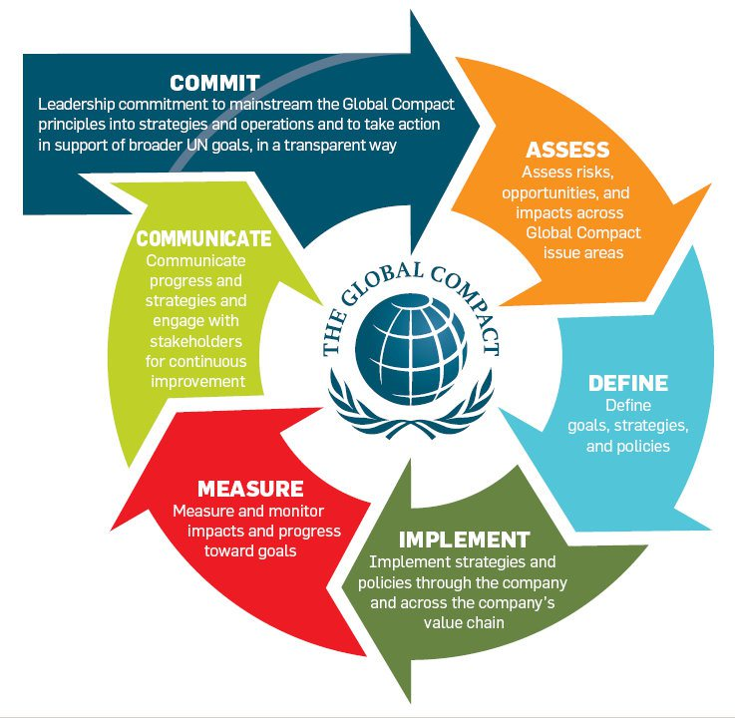

Slide 21
ISO 26000 provides guidance on how businesses and organizations can operate in a socially responsible way. This means acting in an ethical and transparent way that contributes to the health and welfare of society.
Key point: ISO26000 is NOT a certifiable standard

Slide 22
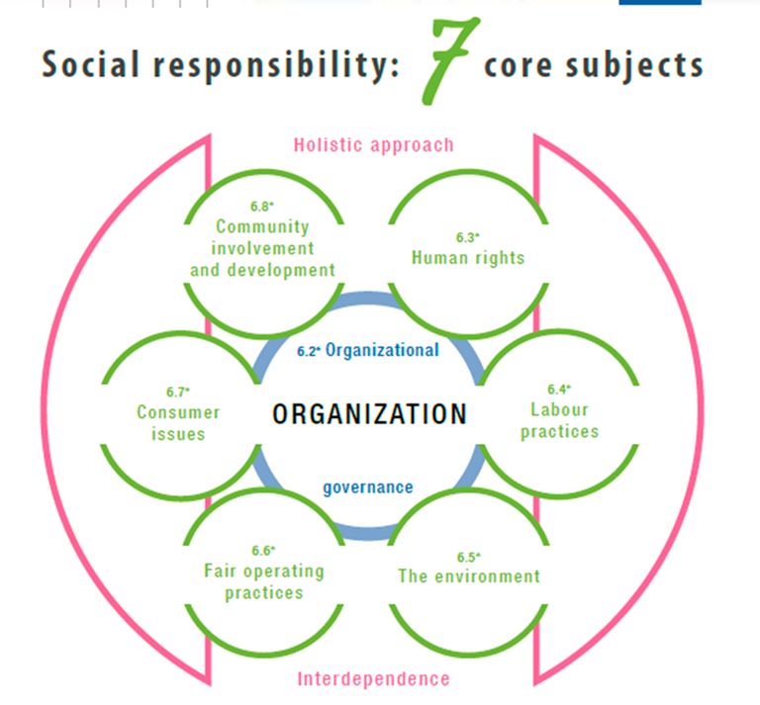

Slide 23
The GRI Sustainability Reporting Guidelines offer Reporting Principles, Standard Disclosures and implementation guidance for the preparation of sustainability reports by organizations, regardless of their size, sector or location.
The Guidelines also offer an international reference for all those interested in the disclosure of governance approach and of the environmental, social and economic performance and impacts^{I} of organizations.
Key shift in G4 version: greater focus on materiality
A key shift in focus in the G4 version: greater emphasis on ‘materiality’

Slide 24
Where does anti-corruption work fit in?
UN Global Compact’s 10th Principle
"Businesses should work against corruption in all its forms, including extortion and bribery.“

Slide 25
Where does anti-corruption work fit in?
ISO26000 Core Subject
Fair Operating Practices
Issue 1: Anti-corruption
Issue 2: Responsible political involvement
Issue 3: Fair competition
Issue 4: Promoting social responsibility in the value chain
Issue 5: Respect for property rights

Slide 26
Where does anti-corruption work fit in?
GRI G4 Guidelines on Standard Disclosures
Strategy and Analysis
Organizational Profile
Identified Material Aspects and Boundaries
Stakeholder Engagement
Report Profile
Governance
Ethics and Integrity

Slide 27
Summary
Challenge companies on their own commitments (if none, on peer- or industry-accepted codes or competitor’s actions)
Find synergies and alignment of interests that lead to mutually beneficial outcomes (and also shared risks) – COLLECTIVE ACTION
Finally, be patient, be open, be flexible (without sacrificing your principles)

Slide 28
STAY INFORMED www.transparency.org
www.asean-csr-network.org
Transparency International - Secretariat
Private Sector and Conventions
Email: privatesector@transparency.org and conventions@transparency.org
ASEAN CSR Network
Email: info@asean-csr-network.org and jerry@asean-csr-network.org

