Slide 1
UNCAC Implementation Review Group Opening up procurement Alice GarTland #opencontracting
Open Contracting Partnership

Slide 2
U
US$9,500,000,000,000,000

Slide 3
…it was only a small change in the technical specifications…

Slide 4
A focus on results
Four key areas:
Value for money
Integrity
Fairness & a level playing field
Effective service delivery

Slide 5
Better ways of working
Multi-stakeholder collaboration
^{Constructive engagement}
Working across entire contracting chain
User friendly data (machine readable)
Capacity building of stakeholders
^{Tool development & adaptation}
Institutional mechanisms for feedback
^{Innovation}

Slide 7
Impact on deals:
Savings of 13%
Competition up 33%

Slide 8
Open Contracting Data Schema
^{Planning}
^{Tender}
^{Award}
^{Contract}
^{Implementation}
^{Contract Record}
An open data schema describing how to release documents & data at each stage of a contracting process as machine readable, extensible, user friendly data

Slide 9
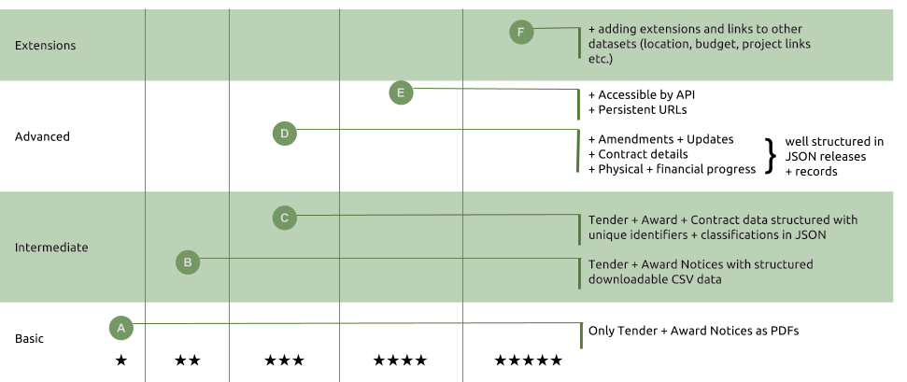
Progressive implementation. It’s not pass or fail.

Slide 10
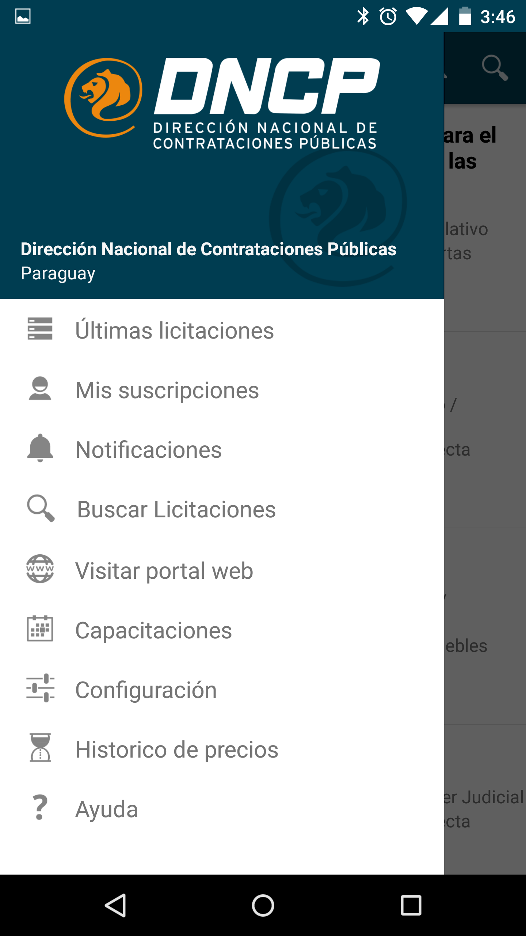
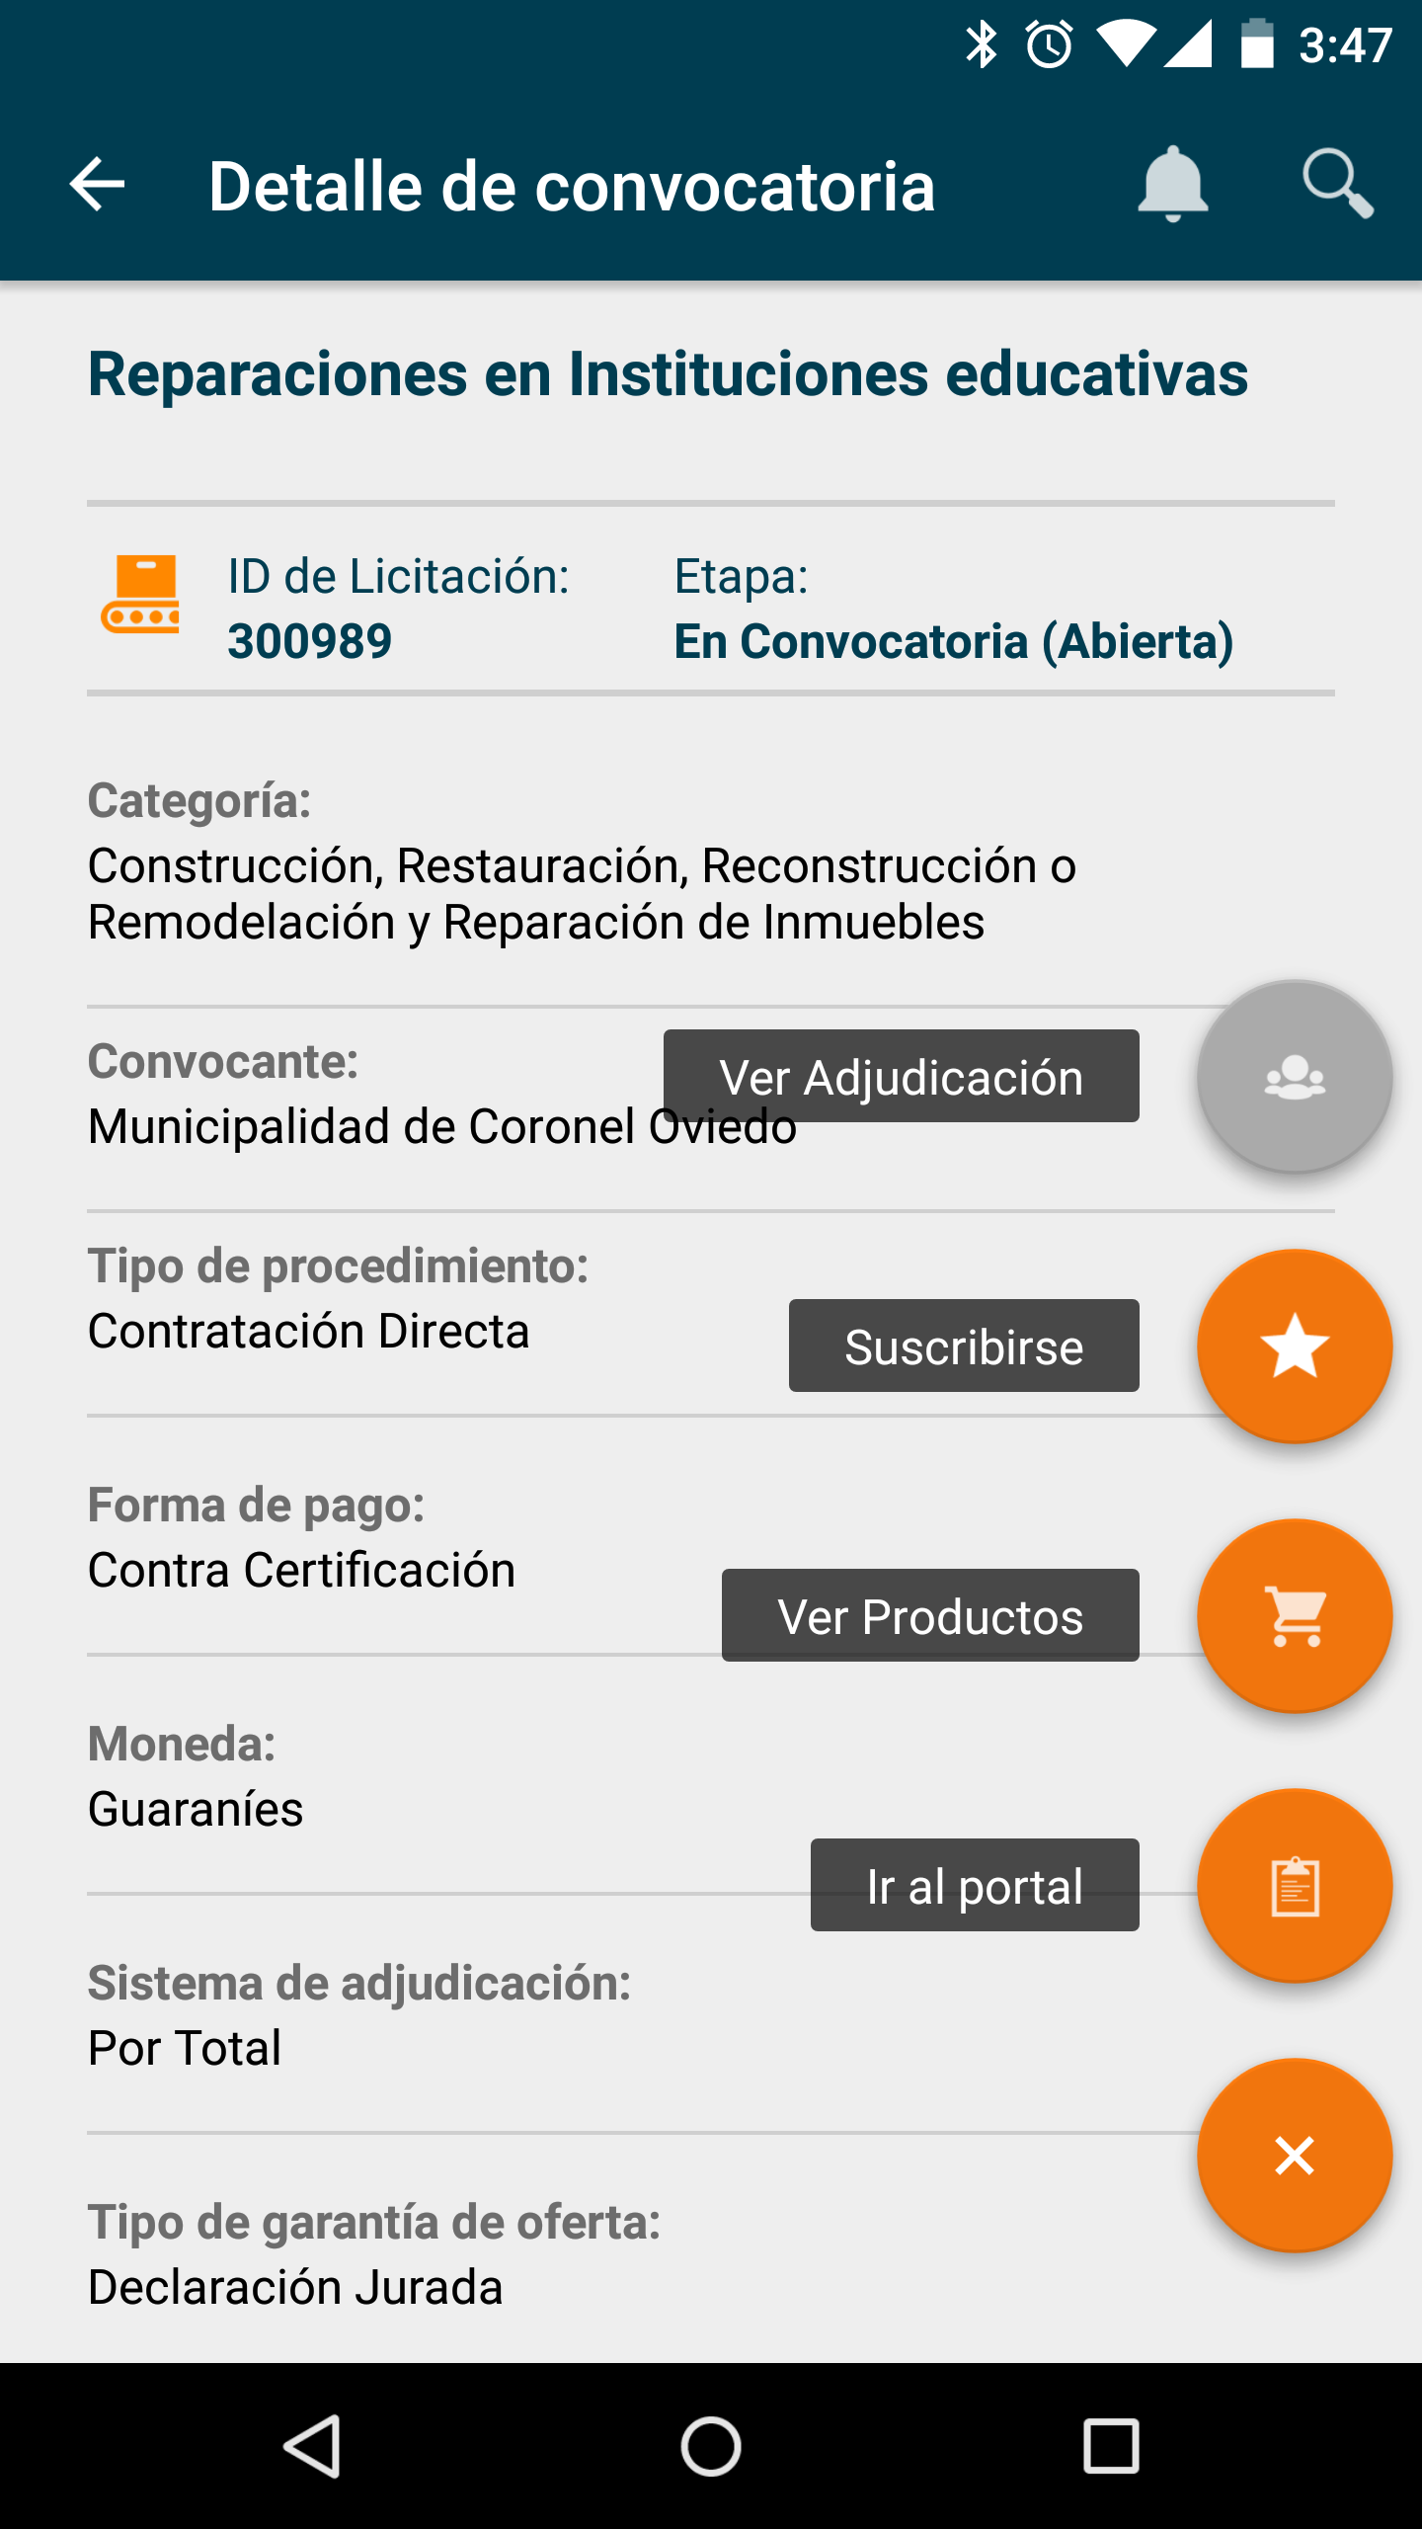
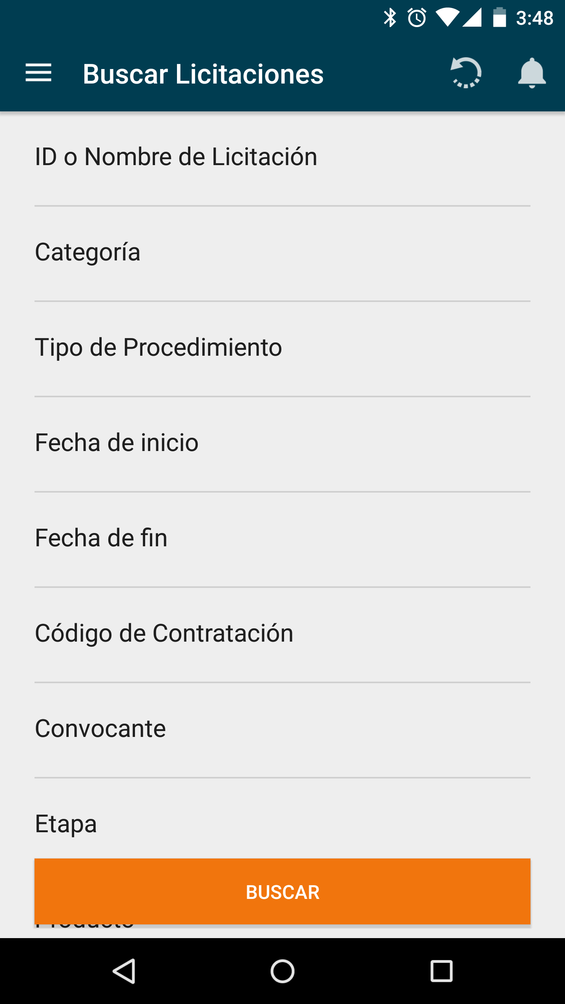
Apps for business in Paraguay

Slide 11
Czech Republic
Comparison of procurement entities

Slide 12
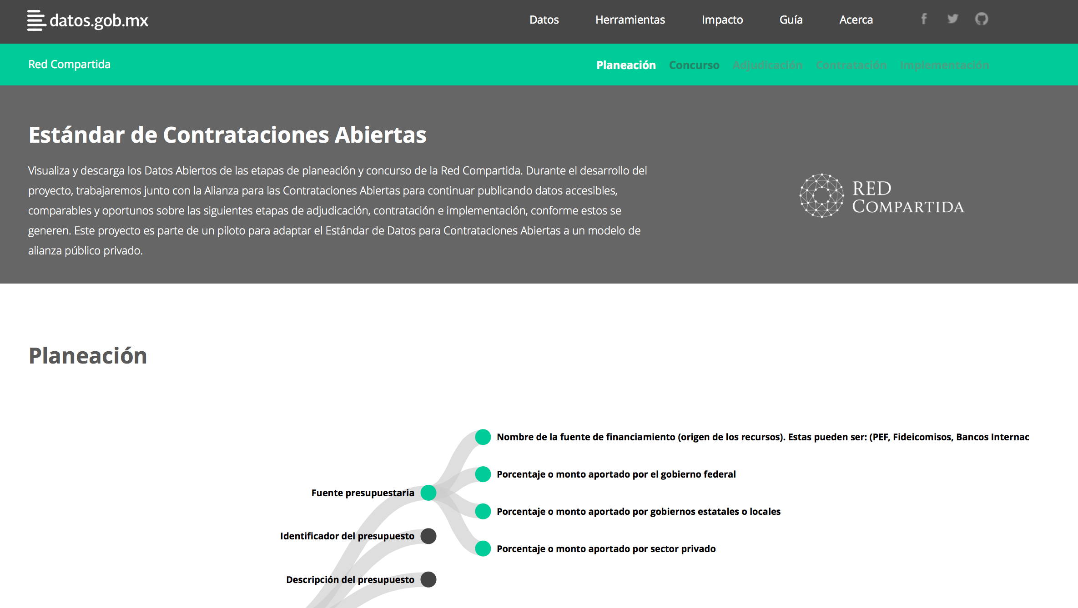
Tracking the Telecom PPP in Mexico

Slide 13
Identify “red flags” or “key risk indicators” such as patterns of overpricing, collusive bidding
Needs structured information on key dates, identifiers for entities (incl bidders), cost estimates, award data

Slide 14
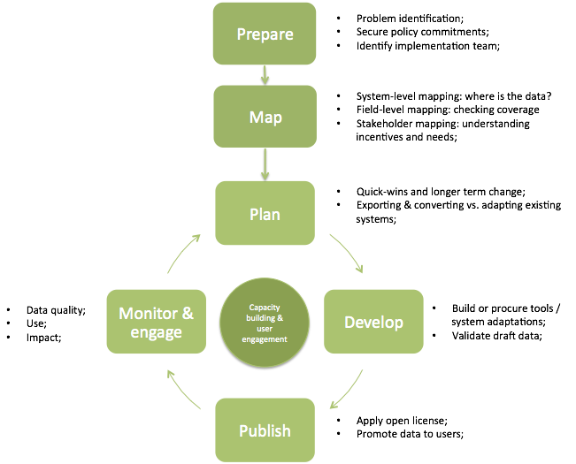
National implementation

Slide 15
Leadership & next steps
Default is changing:
Anti Corruption Summit 2016: 40 Countries proposed
‘open-by-default’ approach to share information
proactively, unless good reason not to; Time for UNCAC to make the shift to ‘open by default’ too?
UNCAC Review is an opportunity to consider approach in Article 9
Peer review process also opportunity to ask more searching & diagnostic questions?

Slide 16
The future is open !
alicemgartland@gmail.com
www.open-contracting.org
@opencontracting

